Slide 1
Securing Framework with Formal Verification
Roei Mesilaty – Dolev Levy

Slide 2
Reminder
BLOCKCHAIN
A decentralized, distributed ledger where transactions are recorded in ordered “blocks”.
The blocks are cryptographically linked, ensuring immutability and transparency.
Each block has: ID ,data (set of transactions) ,Pointer to previous block and Hash of previous block.
Notes:
So before we start we want to give some quick reminders. Lets start with blockchain

Slide 3
Reminder
Smart Contract
On-Chain Code: A smart contract is a program written in a Turing complete language that lives on a blockchain.
Automatic Execution: It runs itself whenever someone sends a transaction.
Transparent Rules: Its code and data are public and unchangeable, so everyone knows exactly how it behaves.
Trustless Enforcement: Once triggered, it enforces agreements itself—no middleman needed, and results are final.

Slide 4
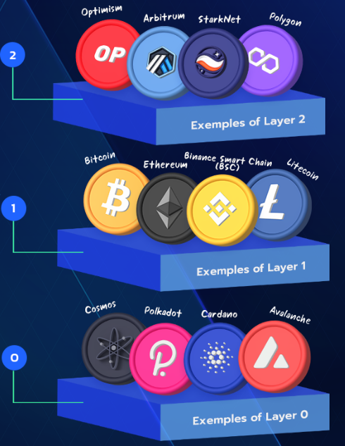
Introduction
Blockchain Layers
Layer 0 – a peer- to–peer network for inter-communication that connects and synchronizes all nodes within that single network.
Layer 1 – The base blockchain protocol responsible for accounts, balances, transaction execution, data availability, and security.
The Aptos network is a Layer 1 blockchain.
Layer 2 – Faster and cheaper layer that sits on layer-1 that does optimization and some of the heavy lifting off-chain.
a
a
a

Slide 5
The main characters
The Aptos Network & Framework
The Move Language
The Move Prover
Notes:
We start with the aptos network which is a safe, scalable layer 1 blockchain – with built in support for the move language , which is used for writing smart contracts .
Formal verification tool for smart contracts
Platform that allows to offers various on chain actions that was thoroughly tested.

Slide 6
Introduction
The Move Language
There are many other languages for writing smart contracts, so why do we need the Move language? Some of the benefits of the Move language:
Static Type Checking: The Move compiler enforces a strong, static type system at compile time, catching type errors before bytecode is produced.
Bytecode Verification: A Move bytecode verifier checks resource- and memory-safety invariants both when you publish your module and just before execution, preventing invalid or malicious code from running.
Formal Verification Support: Move is designed for use with formal verification tools (e.g., Move Prover), letting you prove critical properties about your smart contracts before deployment.
Notes:
S – now lets dive in and explain more on each .

Slide 7
Introduction
The Move Language – how it works ?
A Move program is essentially a sequence of updates that try to evolve a global persistent memory state ,which just called the (global) memory.
updates are a series of atomic transactions.
The global memory is a collection of resources organized in Move structures.
A resource in memory is indexed by a <type, address> pair. An address is a unique identifier in the Aptos Network that typically represents the address of a user account.

Slide 8
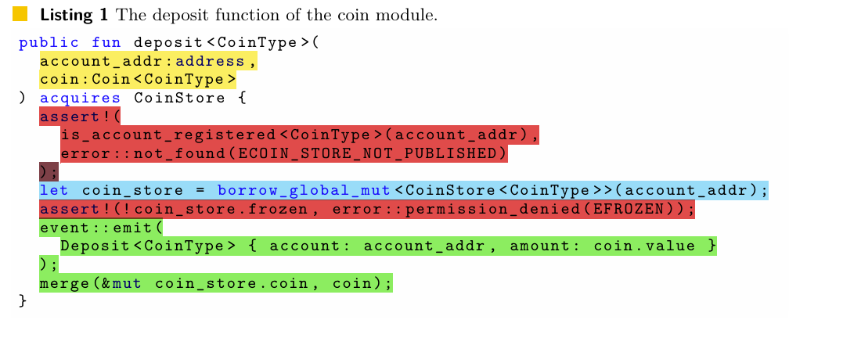
Introduction
The Move Language - Example 1
Notes:
The function is generic –meaning it can accept all types of coins.
It accepts the address of the account which the coins need to be deposited into.
It accepts the coin that needs to be deposited.
Then it first checks if the user actually has this coin listed under his account – if not it will abort – meaning the user doesn’t support this coin.
Then it gets a mutable reference to the coin store of the user – which give access to his coins .
Then in red you can see that the function checks whether the users coin store is not frozen – meaning the transaction cant happen .
If all passes – then it preforms the action and deposits the coins by calling the merge function and emit a deposit event.

Slide 9
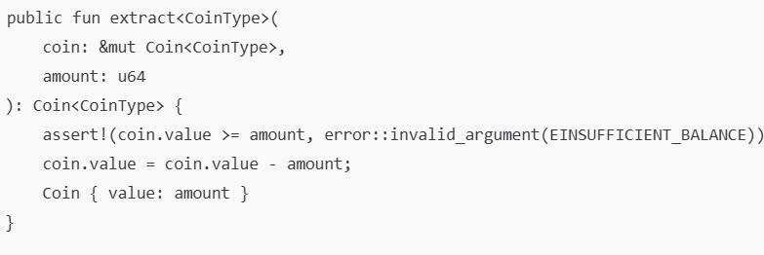
Introduction
The Move Language - Example 2
Notes:
extract function - coin module.
accepts a mutable reference
uses assert to verify
The reduces
returns reference to new coin

Slide 10
The Move Prover (MVP)
The Move Prover (MVP for short) is a formal verification tool for smart contracts that are written in the Move language.
The Move language is tightly coupled and integrated with MVP because they have been developed and are evolving together.
Move features an expressive specification language designed to define the intended behaviors of a Move smart contract.
The Move Prover
Notes:
Uses mathematical methods to prove that a contract always behaves according to its specification.
Mvp and move Tightly coupled – developed and evolved together
Move features an expressive specification language designed to define the intended behaviors of a Move smart contract

Slide 11
The Move Prover (MVP)
Move Specification Language
The Move specification language allows developers to specify the properties of their smart contracts, leveraging MVP to guarantee they behave as specified.
Before and after conditions: You can write simple “before-and-after” checks and global rules right next to your Move code.
Talk about “everyone” or “someone”: Whether you need a rule to apply to all items (e.g. every account) or just prove that at least one item meets a condition, you can say it directly in your specs.
Automatic, in-code checking: Those rules go straight into the Move Prover—no extra files or tools—so you catch mistakes early without leaving your code editor.
Notes:
Example for first like deposit example – a pre condition - we can check that the user supports the coin we want to deposit and to check afterwards the the new balance is equal to the last + amount of coint = new balance
For second bullet you can set a maximum number of transaction for a user for instance – or to limit a specific user .
For third meaning its right in your code

Slide 12
The Move Prover (MVP)
Move Specification Language- Example 1
Notes:
first 2 yellow lines which are the pre-condition : the first one will abort if the user doesn’t support this type of coin ,
And the second one verifies that the CoinStore resource is not frozen .

Slide 13
The Move Prover (MVP)
Move Specification Language- Example 2
Notes:
Another specification that is part of the coin module.
It accepts a mutable reference for the resource
And the amount to reduce.
Pre Cond – verifying that the account has enough coins Post Cond – result. Value mean that the function needs to return the amount that was extracted and second post : checks that the reduction indeed happened

Slide 14
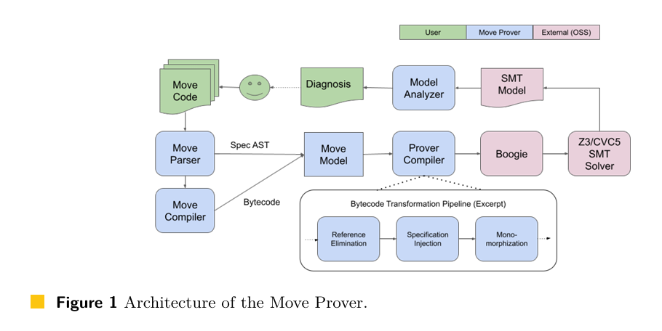
The Move Prover (MVP)
How it works ?
The Mover prover accepts the move code and specifications.
It creates AST out of the specs and compiles the move code to Bytecode, then merging them together and preforms series of Byte code transformation.
Eventually MVP checks whether the Move satisfies the specifications and if not, it will generate a counterexample - an assignment to program variables such that the specification does not hold.

Slide 15
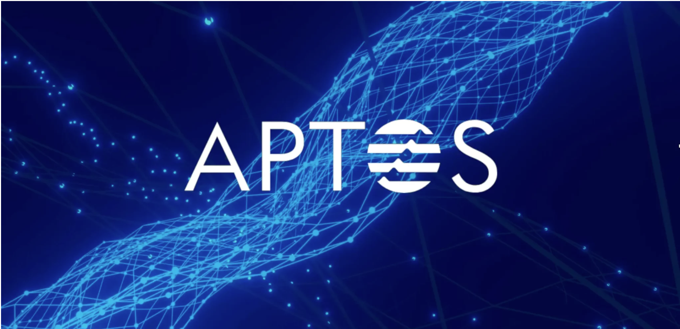
Introduction
The Aptos Network
The Aptos Network is a safe, scalable layer-1 blockchain with built-in support for the Move programming language designed for fast and secure transaction execution.
High Throughput & Low Latency -Thanks to its parallel execution engine (Block-STM) and optimistic pipelining, Aptos can process thousands of transactions per second with sub-second finality.
Notes:
S – So previously we explained about the layer-1 blockchain, so: * It offers a platform for using smart contracts with move language in a safe and effective way.

Slide 16
Introduction
The Aptos Framework
The Aptos framework is a package of move modules that define standard and common on-chain actions for the Aptos Network.
Aptos Framework, similar to an operating system for a computer, serves as the foundational platform for the Aptos Network, defining its core functionalities, managing on-chain resources, and offering a standardized environment for the development of user smart contracts.
Some of the actions it offers : prologue and epilogue of transactions, the staking mechanism, and Aptos Digital Asset Standard.
Also, Beyond system-related actions, the framework establishes standards for coins and staking, math libraries, efficient data structures.
Notes:
3* Prologue and epilogue are basically the pre-transaction that checks signatures, balances and gas, and the epilogue is the post-transaction cleanup that deducts fees, and does the final stage changes.
4* Examples: Smart vectors which adapt depending on their size , and cryptographic algorithms.

Slide 17
Motivation
Securing Aptos Framework with Formal Verification
Do layer-1 frameworks still fail?
In January 2022, attackers exploited a logical bug in Qubit Finance’s bridge between Ethereum and Binance Smart Chain, faked Ethereum deposits, and managed to mint (create) unauthorized ETH tokens, and ultimately drained about $80 million from its lending pools.
For those who want to further read on that incident: https://blockworks.co/news/defi-protocol-qubit-finance-loses-80m-in-hack
Notes:
Small example

Slide 18
Motivation
Why formal verification for the aptos framework?
First, The Aptos network defines some of the most common and crucial actions on the blockchain, and it has undergone rigorous verification and testing, which reduces bugs and enhances the safety of the network.
Given its essential role in the Aptos Network, security and safety of the framework are of utmost importance: bugs can cause network disruptions or lead to significant financial losses.
Although thorough testing and auditing of the Aptos Framework was done, it’s not enough.
Formal verification, in contrast, can provide rigorous proofs of critical properties.
Notes:
Does not guarantee the absence of bugs because we can miss …
Formal - mathematically prove that the function actually does what it is expected to do under all possible conditions – can give better coverage and enhance safety.

Slide 19
Formal Verification of the Aptos Framework-HARDSHIPS
Reminder: Formal verification is the process of mathematically proving that a system behaves as intended under all possible conditions. Instead of just testing some cases, it uses logic and proofs to cover all cases.
Applying formal verification to a smart contract framework is challenging: it includes
tens of thousands of lines of code and undergoes constant evolution.
A formally verified smart contract is only as correct as its specifications.
The goal: devise a comprehensive set of specifications for large and evolving codebase.
Notes:
2 - Big code base that is constantly changing and evolving.
3 if the specifications are not correct – the whole verification may not be correct.

Slide 20
The aptos framework devising specification approaches
Top-down approach
Bottom-up approach
Notes:
Explain what are aborts in functions in Move.

Slide 21
The Aptos framework
Top-down approach
starting from high-level requirements to detailed specifications.
They developed a traceability framework that enables the tracking of how high-level requirements are tested, audited, and verified.
This ensures that all critical safety properties are covered .
Notes:
Meaning starting from high level and going down to modules and functions.

Slide 22
The aptos framework
Top-down approach
We are going to show how they used the top-down approach to verify that the frame work upholds to security requirements.
So First , they identified critical security requirements for each module within the Aptos Framework.
Then the have documented the requirements with details covering their definition, criticality, implementation approach, and enforcement methods.
The enforcement methods include: audit, test, and, where appropriate, formal verification.
For each requirement that can be enforced by formal verification, they created the corresponding formal specifications and verified them with MVP.
Notes:
Definition – describing the requirement,
Criticality- how important it is
implementation approach – how the requirement is going to be work
enforcement methods – how to enforce the requirement.

Slide 23
The aptos framework
Top-down approach-Example the coin module
That’s the part of the documentation of the high-level security requirements of the coin module.
It states that the supply of a coin can be changed only by certain operations, such as burn and mint – ensuring coins cannot be created arbitrarily.
And it's enforced through TotalSupplyNoChange function.
Notes:
This is an example for one of the high level requirements
Burn function – responsible for destroying coins
Mint – responsible for creating new coins.

Slide 24
The Aptos framework
Top-down approach-Example the coin module
supply : a helper function that returns the current number of coins exist from a specific coin.
TotalSupplyNoChange: a schema specification that defines a post-condition ,it verifies that number of coins before the last execution and the current number of coins is equal.

Slide 25
The Aptos framework
Top-down approach-Example the coin module
That specification applying the TotalSupplyNoChange after any execution of a function from the coin module except mint, burn and burn from.
That way verifying that the number of coins stays the same (except when using functions that are allowed to change the quantity of coins)
Notes:
The specify that the re

Slide 26
The aptos framework
Bottom-up approach
Systematically deriving specifications from individual functions to modules.
This approach allowed us to uncover, verify, and document functional properties of the Aptos Framework.
Notes:
so the way it works is starting from individual functions and climbing up to the high-level requirements - making sure each part is verified separately.

Slide 27
Securing The aptos framework with formal verification BOTTOM-UP APPROACH
Systematic Functional specification
Systematic Functional specification is the action of turning high-level security requirements into proven code checks, but how is it done?
Read every Move function’s code & comments.
Pull out its $requires$, $aborts_if$, and $ensures$ clauses
Inspect each struct to identify its data invariants.
Create global module invariants from them.
Notes:
Extract the rules associated with the functions, we check the pre/post conditions and abort conditions

Slide 28
Securing The aptos framework with formal verification BOTTOM-UP APPROACH
Abort conditions
Abort conditions capture three classes of checks:
Who is allowed to call the code
What valid inputs look like
When the system’s state must meet certain criteria.
Notes:
1) Account without permission tries to perform an action he’s not allowed to
2) Input argument outside of expected range
3) Any unexpected global state that the function sees.
Explain about the move specification -
Behind the scenes – Two conditions that the move prover proves

Slide 29
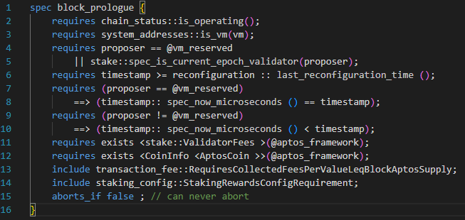
Securing The aptos framework with formal verification BOTTOM-UP APPROACH
Abort conditions
Why is it so important to be able to prove these two conditions that we talked about?
Notes:
Example of how important it is, is this function. - 96 move functions in 22 different move modules. Proven impossible once its pre-conditions are met.

Slide 30
Securing The aptos framework with formal verification BOTTOM-UP APPROACH
Struct Invariants
Struct Invariants are rules that every instance of a data type must always satisfy.
Why do we need them? Prevent malformed data that could break later logic.
How we get them? Read comments and runtime checks in the code, then turn them into formal invariants.
What MVP does? Automatically proves that every time you build or update a struct, its invariants hold.
Notes:
Examples * Ensuring that gas limit is not negative and that it is not higher than what the system can represent * If we work with percentage field – ensures we don’t get out of the 0-100 range.

Slide 31
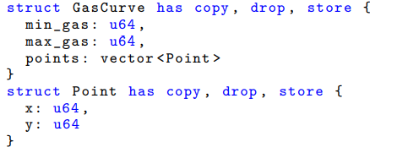
Securing The aptos framework with formal verification BOTTOM-UP APPROACH
Struct Invariants
Notes:
Used to adjust storage gas fees dynamically works if the data inside it makes sense, e.g. you can’t have a gas minimum that’s higher than the maximum, or curve points that go backwards.

Slide 32
Securing The aptos framework with formal verification BOTTOM-UP APPROACH
Struct Invariants
Notes:
Thanks to these invariants, any gas_curve or Point you see in the code is guaranteed to follow these rules, no need to recheck everywhere you use them ...

Slide 33
Securing The aptos framework with formal verification BOTTOM-UP APPROACH
Global Invariants
Rules that the global state must consistently satisfy
They relate multiple resources stored at different addresses.
Expressed as conditions over the global state that consist of Move resources in the global memory state.
Part of the module specification and are automatically verified by the Move Prover.
Notes:
S - They describe rules that must always hold across the entire blockchain state.
Unlike struct invariants, … Prevent system-wide mismatches that could lead to unexpected aborts.

Slide 34
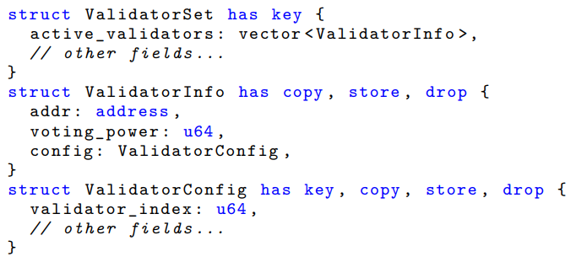
Securing The aptos framework with formal verification BOTTOM-UP APPROACH
Global Invariants
Notes:
checks that transactions follow the defined rules
takes valid transactions
helps reach consensus.
does its job well - earns rewards in tokens.
punished if it behaves badly (tries to cheat), it can lose part of its stake.

Slide 35
Securing The aptos framework with formal verification BOTTOM-UP APPROACH
Global Invariants
Notes:
update_stake_pool - function that updates a validator’s performance score.
grabs the validator’s settings (validatorConfig) using their address, uses their validator_index to access the right spot in a list of performance metrics. If that index is wrong it aborts.

Slide 36
Securing The aptos framework with formal verification BOTTOM-UP APPROACH
Global Invariants
Notes:
This invariant guarantees that for every validator in the ValidatorSet, their validator_index is always valid, it must be less than the length of the performance list in ValidatorPerformance. If this rule is always true, then the function we saw earlier (update_stake_pool) can safely use that index without fear of aborting. Without - system can crash. The global invariant – ensures that it will never happen MVP – verifies it

Slide 37
Securing The aptos framework with formal verification
Discussion & Conclusions
Benefits –
Formal Guarantees - Establishes proofs for key properties of the Aptos Framework
Early bug detection - Helps in identifying bugs and issues
Clear Documentation – The specifications in each function/module generate convenient documentation.
Maintainability – Invariants and module-level contracts make future changes faster and easier for developers.
Notes:
E – Next talk about how formal verification helped discover actual bugs

Slide 38
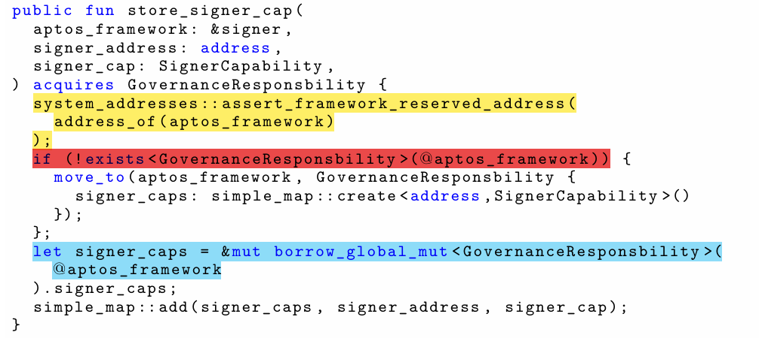
Securing The aptos framework with formal verification
Example – Before fix
Notes:
Example of malfunctioned function
yellow - ensures that only reserved framework accounts with specific range of addresses can call this.
red highlight we can see that the code would create the GovernanceResponsibility resource under whichever reserved account actually signed, but then always read it back from the one @aptos_framework account.
Problem - blue highlighted text two addresses don’t match, the highlighted call cannot find the resource and so the function will abort unexpectedly.
Now show …

Slide 39
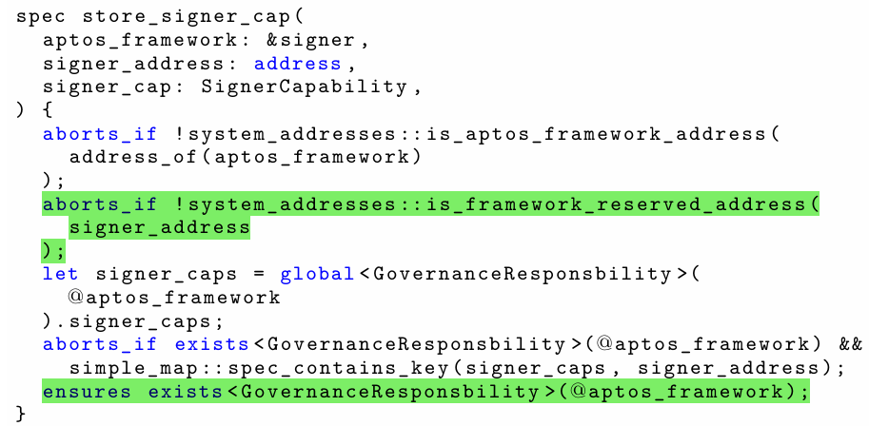
Securing The aptos framework with formal verification
Example – After fix
Notes:
First highlight - pre-condition on the signer’s address - store signer capabilities for truly reserved addresses.
Second highlight - shows the function now formally ensures that the registry does exist by the end of it.
Many other functions fixed ..

Slide 40
Securing The aptos framework with formal verification
Discussion
The specification for the Aptos Framework that are developed in this work are also an important component for the Aptos Network documentation because it offers a precise description of the expected behavior of each function and module. This documentation is vital to ongoing maintenance and quality assurance efforts and makes it easier for developers understand the different functions and modules in details.
Notes:
Expected behavior

Slide 41
Securing The aptos framework with formal verification
Discussion
So some key lessons we learnt: adopting a top-down approach proved to be beneficial, as it allowed us to establish high-level security requirements, ensuring no critical security aspect was overlooked. These high level requirements serve as a communication bridge between security experts and developers, which is very useful for future code maintenance.
Notes:
However, verifying high-level requirements alone can be challenging with big code bases … - reduces cost on chain and need for manual audits

Slide 42
Securing The aptos framework with formal verification
Related Work
Many approaches have been applied to the verification of smart contracts. Two surveys that are available in the paper refer to at least two dozen systems for smart contract verification. It distinguishes between contract and program level approaches. Our approach has aspects of both: we address program level properties via pre/post conditions, and contract level properties via global invariants.
Notes:
the Move ecosystem is the first one where contract programming and specification language are fully integrated within the framework

Slide 43
Securing The aptos framework with formal verification
Conclusion
To ensure highest standards of quality and security within the Aptos Network, formal verification techniques were applied to the Aptos Framework. We got high-level security requirements documented. We specified each aspect of the Aptos Framework, function by function until most high level security requirements were formally verified. During this process, bugs and issues were found and fixed, and generally enhanced the level of quality assurance within the Aptos Framework.
To the best of our knowledge, this represents one of the first instances of formal verification being applied to a smart contract framework.

Slide 44
Securing The aptos framework with formal verification
THANK YOU!

