Slide 1
Demystifying Loops in Smart Contracts
Notes:
demystifying
לופים זה בסיסי אבל בחוזים הם tricky
הם overlooked
מטרת המאמר ..
I didn’t even know what demystifying
Loops are basic, but in smart contracts, they’re tricky
Despite being basic They’re being overlooked in many smart contract tools and analyses
This paper is tries to change that
Goal: to explore how loops behave, why they’re hard to analyze, and how to summarize them effectively.
By the end — you’ll (hopefully) have a clearer picture of loops and why they matter.
“hello everyone Today, were gonna talk about “…” at first when I saw demystifing i..
we're going to explore loops.
basic part of programming, but challenging in smart contracts.
overlooked or avoided in many smart contract tools and analyses. paper that aims to change that — to shed light on how loops are actually used in smart contracts, what makes them tricky to analyze, and how we might better understand, classify, and even summarize them.
By the end of this talk, ill hope you will have a much clearer picture of what loops in smart contracts really look like — and why they matter.“
"So to summarize, this talk is about understanding how loops really behave in Ethereum smart contracts — a topic that’s surprisingly underexplored — and how we can better analyze and express them to support safe and efficient development.“

Slide 2
Agenda
Background and motivation
Analysis of loops (syntactic and semantic)
DSL overview and design
Synthesis with Solis
Evaluation
Results and conclusions
Notes:
basic terms, bigger picture – why matter, why haven’t received attention
study real smart contracts
we’ll introduce Consul (main contribution)
Solis automatically generate dsl summaries
how well this synthesis works in practice
how this can impact smart contract analysis in the future
basic terms, bigger picture - why loops in smart contracts even matter, and why they haven’t received enough attention until now.
Next, we’ll see how the authors study real smart contracts, and how they group loop behaviors both by syntax and by meaning.
Then, we’ll introduce Consul — a small domain-specific language that can summarize common loop patterns in smart contracts. (main contribution of the paper).
Afterward, we’ll see how the authors use Solis — a synthesis tool — to automatically generate DSL summaries from real code.
We’ll look at how well this synthesis works in practice, and what kinds of loops can actually be summarized this way.
And finally, we’ll wrap up with what we’ve learned and how this can impact smart contract analysis in the future.

Slide 3
On Our Previous Episodes…
Notes:
תודה לאור ושירה-
-public record system
-each new block includes a list of transactions and a link
-It shared across many computers
-immutable -

Slide 4
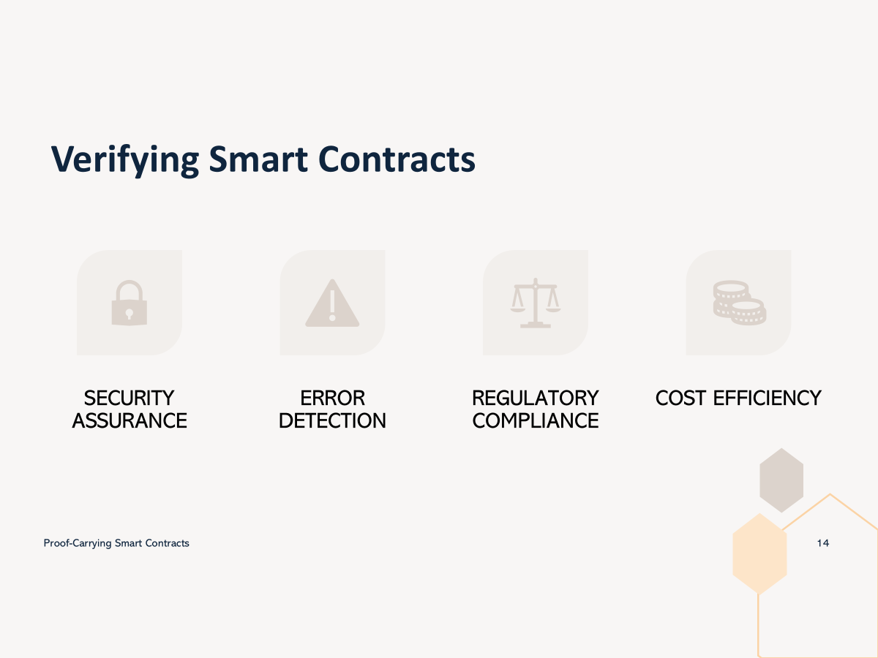
On Our Previous Episodes…
Notes:
-לוודא שהחוזה לא פגיע להתקפות (דאו)
-לתפוס טעויות כמו לולאה שלא נגמרת או תנאים לא נכונים
-must follow legal rules כמו מגבלות גיל או הסכמה לפני העברת כספים
-פעולות יקרות ולנתח אותם לפני עוזר למצוא inefficient logic

Slide 5
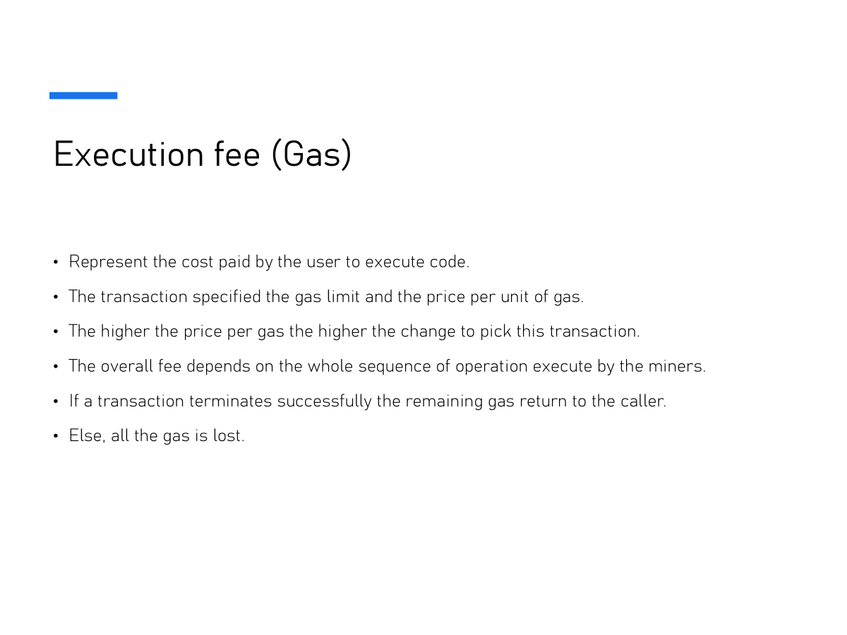
On Our Previous Episodes…
Notes:
מייצג המחיר שמשלמים בשביל להריץ פעולות
Users set a gas limit ואם לעסקה נגמר הגז היא נכשלת וכל הגז מתבזבז
לכן צריך להיות יעילים ומפתחים נזהרים

Slide 6
Motivation
Why Loops in Smart Contracts Have Been Overlooked
Ensuring the correctness and safety of smart contracts is critical, and thus they are subject to intense checking by formal
verification tools.
However, a common assumption in prior research is that loops are rare in smart contracts.
running loops in Ethereum can be expensive.
smart contracts are expected to be easy to analyze .
As a result, many analysis techniques have ignored loops or treated them as corner cases.
This assumption created a blind spot in contract analysis.
Notes:
-expensive — especially if the loop length depends on user input.
- loops add complexity: they involve conditions, boundaries, dependencies.
assumed loops are rare, and focused on simpler things like re-entrancy instead.

Slide 7
A STUDY OF LOOPS IN SMART CONTRACTS
📊Frequency of Loops - How common are loops in real-world smart contracts?
🔁 Nature of Loops, Syntactically - What do loops look like in code?
🧠 Nature of Loops, Semantically - What do loops actually do?
🗂️ Clustering Loops by Semantic Properties -How can we group similar loops?
Notes:
המטרה היא להבין איך לופים משמשים בחוזים אמיתיים אז ניתחנו 20,000 חוזים deployed על איתריום שזה מלא
לסתור את זה שהם נדירים
אורך ומבנה שלהם
מה הם עושים באמת, מה המשמעות שלהם ומה האפקטס
קלאסטר into categories based on their behaviors

Slide 8
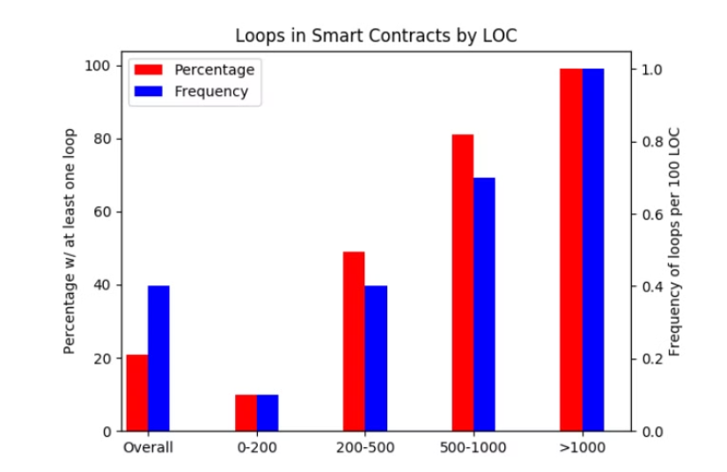
Frequency of Loops
Key finding #1
Roughly one in five contracts contain at least one loop, and only half of the contracts with over 200 lines of code are loop-free.
Across all contracts, we find an average of one loop per every 250 lines of source code.
Loops are not as rare as we asummed — they appear frequently, especially in real-world, complex contracts.
Notes:
ככל שיש יותר שורות קוד יש יותר לופים
מדגישים שלולאות אינן עניין זניח בחוזים חכמים. הן נפוצות, ולכן יש צורך בהבנה עמוקה ובכלים לניתוח
. פתיחה:
"בפרק זה, החוקרים בדקו את התדירות שבה לולאות מופיעות בחוזים חכמים הכתובים ב-Solidity."
"ההנחה המקובלת היתה שלולאות הן נדירות בחוזים חכמים – המחקר מראה תמונה קצת שונה."
מסקנה ראשית: "בערך אחד מכל חמישה חוזים חכמים (20%) כולל לפחות לולאה אחת."
"רק כמחצית מהחוזים שאורכם מעל 200 שורות הם ללא לולאות – כלומר, לולאות הן לא נדירות כפי שאולי חושבים."
"ככל שהחוזה ארוך יותר (יותר שורות קוד), הסיכוי שהוא יכלול לולאה עולה משמעותית."
4. הדגשת החשיבות והמשמעות של הנתונים:
"הנתון החשוב ביותר כאן הוא שבממוצע, מופיעה לולאה אחת בכל 250 שורות קוד. כלומר, חוזים בינוניים וגדולים מכילים לולאות לעיתים קרובות."
5. מסר הכללי:
"הנתונים האלו מדגישים שלולאות אינן עניין זניח בחוזים חכמים. הן נפוצות, ולכן יש צורך בהבנה עמוקה ובכלים לניתוח נכון שלהן." In this part of the study, the authors examine how often loops actually appear in Solidity smart contracts. The common belief was that loops are rare — but the data tells a different story.
In The graph - we have overall and every range of number of lines of code
The red bars indicate the percentage of contracts that contain at least one loop.
The blue bars show the average number of loops per 100 lines of code.
You can see that as contracts get longer — from just 200 lines to over 1000 — both metrics increase dramatically. In fact, nearly all contracts over 1000 lines include at least one loop. Even overall, aboutSo what does this mean 1 in 5 contracts contains a loop, and on average, there's one loop for every 250 lines of code.
? Loops are not just tedge cases — they show up often, especially in more serious, real-world contracts. That’s important, because these are exactly he kinds of contracts where bugs are costly and verification really matters.
This highlights why we need tools that don’t just ignore loops — but actually know how to handle them.

Slide 9
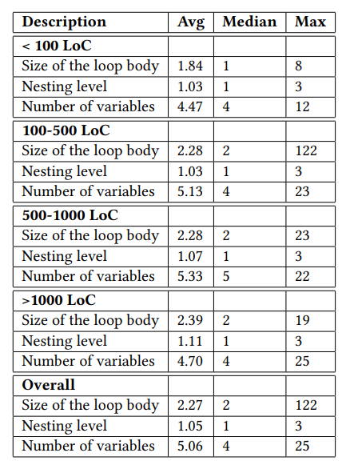
Nature of Loops, Syntactically
Key finding #2
Smart contract loops are typically very short: Median loop size is about 2 lines of code.
Nested loops are very uncommon in smart contracts.
A typical loop touches roughly 5 different variables.
Syntactic properties of loops across different contract sizes
Notes:
-הפשטות יכולה להקל על כלים אוטומטיים לבצע ניתוח סטטי
-וגם להקל עלינו את פיתוח הDSL כי לא נצטרך לפתח ביטויים של לופים מסובכים
אחרי שראינו כמה לולאות נפוצות בחוזים חכמים, בואו נראה איך הן נראות בפועל – מבחינת מבנה וגודל הקוד.
הטבלה מציגה מידע על שלושה מאפיינים סינטקטיים של הלולאות:
גודל גוף הלולאה (כמה שורות קוד יש בלולאה).
רמת הקינון (האם יש לולאות בתוך לולאות).
מספר המשתנים שמשמשים בלולאה."
- רוב מוחלט של הלולאות הן קצרות מאוד – רק 2 שורות קוד בממוצע. - כמעט ואין שימוש בנסטד לופס אפילו בחוזים ארוכים מאוד -לולאות לרוב משתמשות בכ-5 משתנים, נתון שמעיד שהלולאה לא רק קצרה, אלא גם פשוטה באופן יחסי.
הפשטות של הלולאות עוזרת לכלים אוטומטייים לבצע ניתוח סטטיStatic Analysis להיות יעיל יותר – קל יותר לבדוק קוד קצר ופשוט.
"Now that we’ve seen how common loops are, the next step is to understand what these loops actually look like — syntactically.
This chart summarizes three key structural properties of loops:
Loop body size – how many lines of code the loop contains.
Nesting level – whether the loop is inside another loop.
Number of variables – how many distinct variables the loop uses.
The table is organized by contract size — from small to very large contracts.
And here are the three main takeaways:
Most loops are very short – the median is just 2 lines of code.
Nested loops are rare, even in large contracts — which is important, because deeply nested loops are harder to analyze.
A typical loop touches about 5 different variables, meaning it's not overly complex.
Overall, what this tells us is that loops in smart contracts are usually simple in structure — which is great for static analysis and tools that try to automatically reason about their behavior.“
Analyzing structure of loops (not just how often they appear)
3 properties: size, nesting, variables
Median size = 2 lines
Nested loops are rare
Touch ~5 variables
🔍 Bottom line: Loops are structurally simple → good for automation

Slide 10
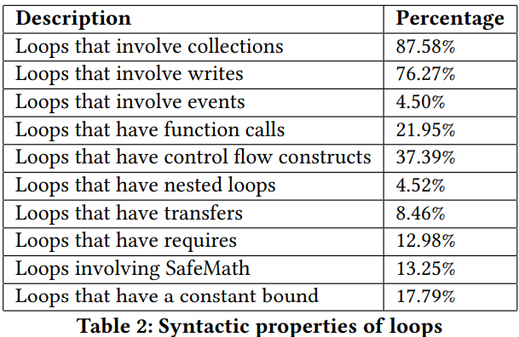
Nature of Loops, Syntactically
Key finding #3
Collections & Writes: The majority of loops iterate over collections and modify contract state.
Few Function Calls: function calls within loops are not very common.
Symbolic Bounds: 80% of Solidity loops have symbolic bounds.
Notes:
collections — like arrays or mappings, modify contract state — they write to storage.
function calls inside loops require more complex interprocedural analysis. So this makes analysis a bit easier.
3. הלולאות פשוטות יותר לניתוח, כי אין "קפיצות" לוגיות לתוך פונקציות אחרות. ואולי מפתחים נמנעים מפונקציות משיקולי גז או סיבוכיות
- not a fixed limit 4. מקשה על ניתוח סטטי כי אנחנו לא יודעים כמה איטרציות יהיו

Slide 11
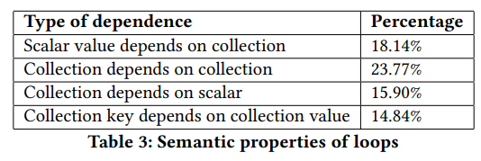
Nature of Loops, Semantically
Notes:
פוקוס על מה לופים עושים?
this table summarizes the semantic dependencies found
הרעיון פה הוא לראות איזה relations
סיווגו ל4 תבניות חזרות של סוגי תלויות

Slide 12
Nature of Loops, Semantically
1. Scalar Value Depends on Collection
Percentage: 18.14%

Slide 13
Nature of Loops, Semantically
2. Collection Depends on Collection
Percentage: 23.77%

Slide 14
Nature of Loops, Semantically
3. Collection Depends on Scalar
Percentage: 15.90%

Slide 15
Nature of Loops, Semantically
4. Collection Key Depends on Collection Value
Percentage: 14.84%
Notes:
התבניות שראינו עד כה היו גסות וכלליות – הן חילקו את הלולאות לקטגוריות בולטות לפי סוג התלות וההתנהגות. אבל אנחנו רוצים לזהות דמיון עדין יותר בין לולאות, גם אם הוא לא נופל בדיוק לאותה תבנית — קלאסטרינג.

Slide 16
Clustering Loops by Semantic Properties
K-means – the process
High-level stats weren’t enough – similar loops (same dependency type) can still behave very differently.
analyzed 1,279 loops and Defined 37 semantic features - will help us capture subtle loop behavior.
Encoded each loop as a binary feature vector representing presence/absence of features.
applied K-means clustering to group loops that exhibit similar semantic behavior — without needing to predefine what those behaviors are
https://www.naftaliharris.com/blog/visualizing-k-means-clustering/
Notes:
- התלויות מטבלה הקודמת לבן לא מספיקות
- האלגו לא צריך שתגדיר מראש מהן הקטגוריות אלא היופי שלו שאתה רק נותן סט של תכונות והוא יודע לקבץ לפי המאפיינים הסמנטיים האלה

Slide 17
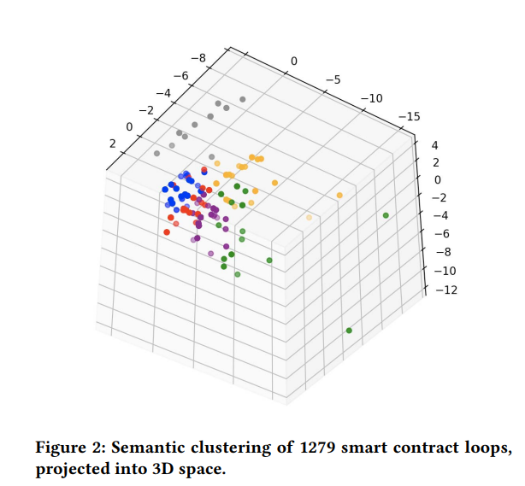
Clustering Loops by Semantic Properties
Red & Green - Loops that perform accumulating computations, similar to a fold operation.
Blue & Orange & Purple - Loops that map or assign values into a global array or mapping. typically involve updating contract state based on some input data.
Gray - Loops with complex arithmetic expressions, often involving multiple operations inside the loop body
Notes:
כדי להציג את התוצאות בצורה מובנת, הם הקטינו את מימד הנתונים והציגו את התוצאות כ־3D plot
רואים התאגדויות של צבעים – סימן שיש דמיון פנימי בין הלולאות באותו קלאסטר.
דגמו 10 לופים מכל קלאסטר לאשר את המשמעות הסמנטית שלהם

Slide 18
A DSL FOR LOOP SUMMARIZATION
What is DSL (Domain-Specific Language) ?
🔹 Focused – Tailored for a narrow domain
🔹 Declarative – Says what to do, not how
🔹 Abstract – Hides low-level details
🔹 Machine-readable: Enables automated analysis
Consul – a DSL designed to summarize the behavior of smart contract loops
Notes:
זה מעודד לפתח שפה שתסכם באופן פורמלי את התבניות האלה
DSL מקשרות בין הקוד עצמו לכוונה של מה שהוא יעשה
-Focused בשונה משפות כלליות כמו פייתון וגאווה
Declarative – כמו SQL או HTML אנחנו מתארים את האפקט ולא את הצעדים המדויקים.
So consul is a small-but-expressive DSL

Slide 19
Why is CONSUL Useful?
Software Verification – Make it easier for a automatic verification tool to check correctness and safety
Static Analysis - Allows automated tools to describe what the loop does.
Optimization - Identifies patterns that can be simplified or made more efficient
bottom line - CONSUL bridges the gap between loop code and high-level intent.
Notes:
Proof-Carrying Smart Contract – דורש הוכחות פורמליות שהתכנית נכונה, כדי לבנות הוכחה צריך להבין מה הלופ עושה וקונסול עוזר לתאר מה נעשה בקצרה ולכן מקל על בניית ההוכחות
CONSUL גם עוזר מאוד לכלים שמנסים להבין מה הקוד עושה בלי להריץ אותו.
יש סיכום ברור של מה הלולאה עושה אז קל לכלים לבדוק שהקוד מתנהג כמו שצריך

Slide 20
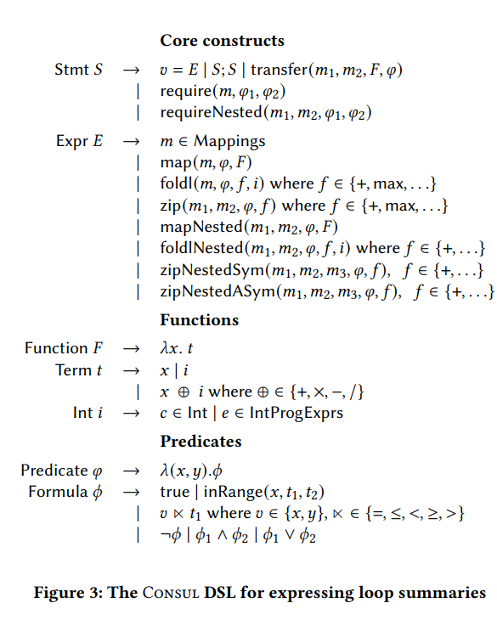
A DSL FOR LOOP SUMMARIZATION
Examples:
Notes:
קצת מזכיר שפות תכנות
אל תיבהלו מהנסטד אמרנו כבר שאין כמעט בכלל nested loops פה הכוונה לטיפול במאפינגס שהם נסטד
Statement can b 3 things:
A batch transfer which means to send money to a set of recipients: the transfer operator sends the ether amounts in the collec m2, to each recipient in collec m1 whose key satisfies the predicate fi.
A require which enforces a pre condition fi2 over all elements in collec m whose keys satisfies fi1
An assignment of expression E to a program var
An exp can be
a map: which applies a function to every elemnt in m that satisfies fi (change all elements that answear fi to 0)
A fold: which aggregates the elements of m that satisfies fi using a binary function f like sum or max, starting from an initial value I (models loop patterns that accumulate values, like summing an array)
A zip: describes loops that iterate over two mappings in parallel, and apply a function to each valid pair of values
All of the nested here: its not about nested loops (for inside a for) which we talked before that are rare but its Nested Structures / Mappings like scores[user][round]
"Here you can see the full syntax of Consul — this is the formal specification of the DSL. It might look dense at first, but don't worry — we're going to break it down with examples in the next slides. For now, notice that Consul is built around a small set of core constructs that capture loop behavior: things like map, fold, and zip, which we’ll explore in more detail shortly. Each construct operates on mappings and uses simple building blocks like lambda expressions and range predicates to describe what the loop does.
On the right, you can already see some examples of actual summaries written in the DSL. We’ll look at these constructs one by one, starting with map, to see how they capture real Solidity loop logic."
"Toward the bottom of the syntax, you’ll see some definitions for functions and predicates. These are here to support constructs like map and fold — they define how conditions and computations are written inside summaries. For example, the λx.t you see is just a way to write a simple function, like x ↦ x + 1.

Slide 21
map - LOOP SUMMARIZATION
Applies a function to each element in a collection (like an array or mapping)
Modifies state based on the output of that function.
Used for loops that perform the same update across multiple elements
Notes:
זה נגיד פונקציה שלא קיימת בsolidity
להסביר על balances שזה מאפינג שמכניסים adress ומקבלים ערך

Slide 22
require - LOOP SUMMARIZATION
Summarizes safety checks over elements in a loop
Helps ensure all conditions are verified before modifying state.
Reverts the entire transaction if any element fails the condition
Notes:
פעולה שהיא בילט אין סולידיטי
אם התנאי נכשל כל מה שקורה אחרי reverted וכל השינויים רולד בק

Slide 23
transfer – LOOP SUMMARIZATION
Summarizes batch ether transfers in loops.
Clearly separates recipient, amount, and condition.
Focuses only on the receiving side.

Slide 24
foldl – LOOP SUMMARIZATION
Accumulates a result by applying a function (+, max) across elements in a collection.
Replaces explicit updates (+=) with a declarative summary.

Slide 25
zip – LOOP SUMMARIZATION
Summarizes updates to one collection using information from another.
Useful in reward distribution, batch processing, or paired logic.
The zip operator expresses how pairs are processed, what’s the range, and the operation
Notes:
אז ראינו שקונסול נותן דרך קצרה וברורה לכתוב לולאות בצורהפורמלית אבל לכתוב ידנית זה לא קל במיוחד כשהלולאות יהיו מסבוכות יותר ולכן נעברו לחלק 4 שבו נכיר את הכלי הסינתזה סוליס שיכול לגנרט מקוד בסולידיטי לסיכומים בקוסנול

Slide 26
SYNTHESIS OF LOOP SUMMARIES
As a first step towards reasoning about loops in smart contracts, they have implemented a tool called Solis for automatically synthesizing loop summaries.

Slide 27
SOLIS:
Solis is a tool that helps us in synthesizing loop summaries
Based on syntax guided synthesis paradigm that take advantage from:
Search engine
Equivalence checker

Slide 28
Solis enumerates DSL programs in increasing order of complexity and leverages properties of the input loop to avoid enumerating useless summaries.

Slide 29
Search Engine
The search engine enumerates candidate Consul summaries for the given loop and uses the verifier to test equivalence between the loop and candidate summary.
The search engine continues this enumeration process until it’s either exhaust all candidate Consul programs for the given loop or until it generates an equivalent summary

Slide 30
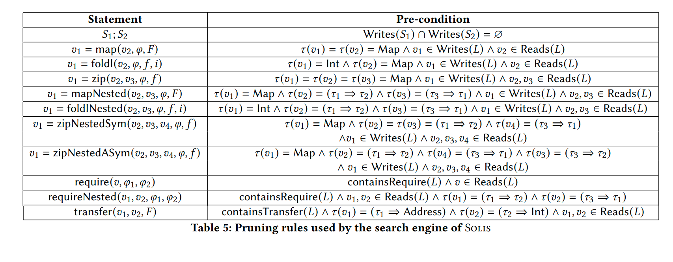

Slide 31
Table 5 presents necessary conditions for the search engine to enumerate a given Consul statement. Those preconditions make use of two main types of information:
Variable types: Given a variable 𝑣, we write 𝜏 (𝑣) = 𝜏1 to indicate that the type of variable 𝑣 is 𝜏1. If 𝜏1 = Map, the notation 𝜏2 ⇒ 𝜏3 indicates that the key type of the map is 𝜏2 and value type is 𝜏3.
Read-write sets: For each loop 𝐿 in the original contract, we need to compute the set of variables it reads from and the set of variables it writes to. Then, we use the notation 𝑣 ∈ Reads(𝐿) (resp. 𝑣 ∈ Writes(𝐿)) to indicate that 𝑣 is read from (resp. written to) in loop 𝐿.

Slide 32
Example constructs
map:
According to the second row of Table 5, SOLIS only enumerates the statement:
𝑣1 = map(𝑣2, 𝜑, 𝐹 )
if both 𝑣1 and 𝑣2 have type mapping and 𝑣1 is written to by the input loop whereas 𝑣2 is read from.

Slide 33
Example constructs
foldlNested:
For an input loop 𝐿, the summary should only contain the statement
𝑣1 = foldlNested(𝑣2, 𝑣3, 𝑓 ,𝑖)
if 𝑣1 has type Int and the value type of 𝑣3 is the same as the key type of 𝑣2.
In addition, 𝑣1 must be written to, and 𝑣2, 𝑣3 must be read from.

Slide 34
Example constructs
Composition:
According to the first row of Table 5, different statements in the summary should not write to the same variable.

Slide 35
Equivalence Checker
Once Solis generates a candidate summary, it needs to check whether the summary is equivalent to the original loop 𝐿.
Towards this goal, we first convert the Consul summary 𝑆 into equivalent Solidity code 𝑆 ′ using syntax-directed translation.
However, there is no checker that check Equivalence between two solidity code, so they had implemented the verifier as illustrated
in the code below:

Slide 36
Compositional Synthesis
🎯 What’s the problem?
When trying to summarize a smart contract loop using the CONSUL DSL, sometimes the loop is too complex to generate a full summary in one go.
That's because the number of possible summaries grows exponentially as the loop becomes more complex.

Slide 37
Compositional Synthesis
🧩 The solution:
Compositional Synthesis.
Compositional Synthesis means breaking the loop into smaller parts, summarizing each part separately, and then composing (combining) the summaries together.
Instead of generating one big summary, they generate multiple small summaries and chain them using sequencing (like S1; S2 in the CONSUL language).

Slide 39
🔍 Example:
This loop writes to two variables: acc and arr.
So, by synthesizing:
foldl for acc followed by map for arr combined as S1 ; S2

Slide 40
EVALUATION
🎯 The Goal:
To evaluate …
So, Given this synthesis pipeline, what specific questions do we want to answer about loops in smart contracts?

Slide 41
EVALUATION
🎯 The Goal:
To evaluate …
What % of loops expressible in CONSUL?
Which CONSUL constructs are most/least common?
What loops cannot be synthesized by SOLIS?

Slide 42
Benchmark and Setup
1200 contracts 1220 loops
excluded loops that cannot be analyzed by SOLIS
e.g., user-defined constructs, multi dimensional arrays.
40% of all loops.
Time-limit: 2 hours per loop.

Slide 43
Results RQ1
At least 56% of the loops in Solidity contracts have a summary that is expressible in the Consul loop summarization DSL, and 81% of these summaries are equivalent to the original loop.

Slide 44
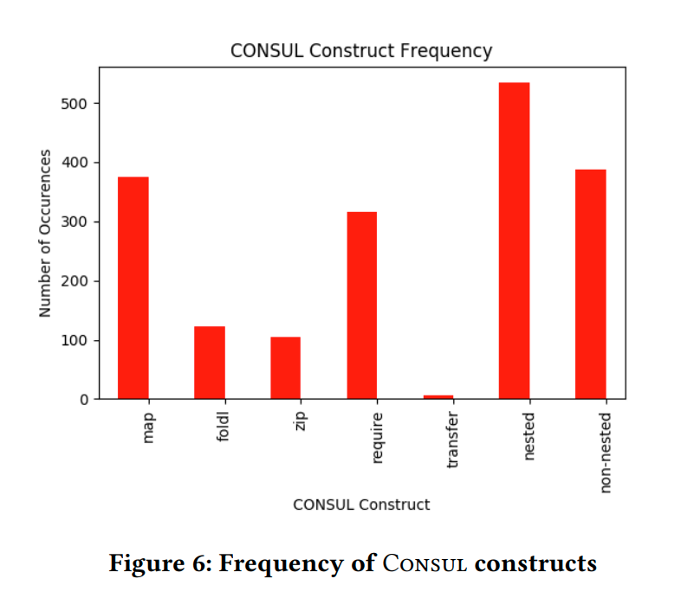
Results RQ2
The most commonly occurring Consul construct in the synthesized summaries is map. Furthermore, the nested variants of Consul operators occur more commonly than their non-nested variants.

Slide 45
Results RQ3
There are two reasons why Solis may fail to generate a useful loop summary.
One reason is due to the incomplete decomposition heuristic described in Compositional Synthesis Section we discussed earlier.
Another reason is the presence of complex arithmetic or nested loops that result in behavior that is not easily expressible in the Consul DSL.

Slide 46
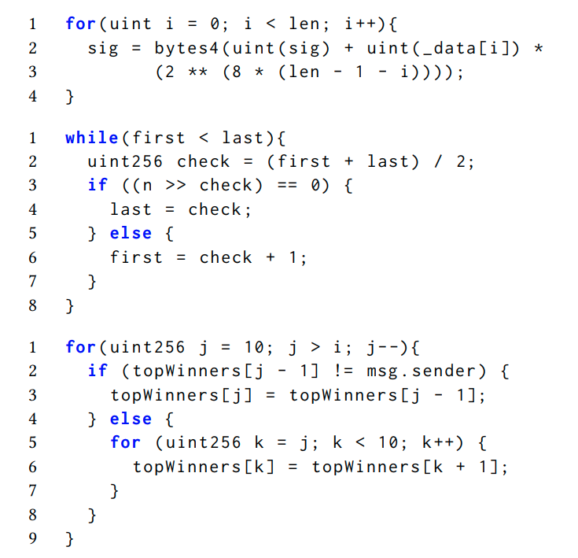
Example Solidity loops which cannot be expressed in CONSUL (Figure 7)

Slide 47
Threats to validity
Benchmark selection
Validity of summaries
Recall: Equivalence checker is bounded
DSL biased by manual crafting

Slide 48
Conclusion
Goal: better understand how loops are used in smart contracts.
The paper presented a large-scale study of loops in Solidity smart contracts.
Static analysis: 20% of contracts contain loops, but most are not complex.
Clustering: there are few common functional-style.
DSL: introduced CONSUL to capture common functional loop behaviors.
Program Synthesis: a majority of loops can be either partially or completely summarized with CONSUL.

Slide 49
Future Work
Improve Completeness:
SOLIS currently sacrifices completeness for scalability.
As a result, it may fail on large loops even when a valid CONSUL summary exists.
Future work will explore better synthesis strategies to handle such loops.
Integrate with Verification Tools:
Plan to combine loop summarization with formal verification tools.
Goal: Fully automate correctness checking of smart contracts.

Slide 50
Questions?

Slide 51
Thank You!

