Slide 1


Search
MOVE
A Language With Programmable Resources
Presented by Michael Ifraimov and Omri Cohen
Paper by: Sam Blackshear, Evan Cheng, David L. Dill, Victor Gao, Ben Maurer, Todd Nowacki, Alistair Pott, Shaz Qadeer, Rain, Dario Russi, Stephane Sezer, Tim Zakian, Runtian Zhou*

Slide 2
Lecture Highlights
• The challenges of representing assets on a blockchain.
• Move's design and how it attempts to solve these challenges.
• An example-oriented overview of Move’s key features.
• The Libra Blockchain
• Some of Move’s technical details and it’s virtual machine design.
• Conclusions and plans for the future.

Slide 3
Managing Assets on the
blockchain 🔗
In order to talk about the blockchain,
we must first understand what is the blockchain?

Slide 4
What is the
blockchain?
  A replicated state machine.
  Validators receive transactions from users and change their state to document these transactions.
    the validators start from the same initial state.
    the validators agree on what the next transaction should be.
    The global state is changed via validators following the concensus protcol.
  We get a consistant state amongst all validators.
Notes:
The Blockchain can also be defined as a distributed ledger, As previously mentioned in Roei and Dolevs talk about Aptos

Slide 5
Challenges of representing assets on a blockchain.
There are two properties of physical assets that are difficult to encode in digital assets:
• Scarcity
• Access control
But what does this mean?

Slide 6
Side note - An explanation of basic economics
Let’s build some intuition...
Ideally, the money supply should be carefully managed to maintain stability.
Unchecked creation or destruction of currency disrupts economic stability.
When too much money enters circulation without a corresponding increase in goods and services, the value of money drops.
This leads to Inflation — a general rise in prices across the economy.
Notes:
Inflation has destroyed economies of many countries like Argentina, Turkey and many African countries.

Slide 7
Scarcity - The supply of assets in the system should be controlled (no inflation).
Access control - A participant in the system should be able to protect his assets (no cheating).
Move’s goal was to be expressive enough to transfer funds, yet constrained enough to prevent violation of scarcity and access control.

Slide 8

How do we enforce scarcity in the digital world?
Let’s build some intuition first...
First proposal:
  G: ID ⟶ N (Naturals)
What’s wrong here?

Slide 9
How do we enforce scarcity in the digital world?
Let’s build some intuition...
First proposal:
  G: ID ⟶ N (Naturals)
What’s wrong here?
  Infinite money? (no scarcity) ⟨Me, 100⟩ x infinity
  Who’s paying K? Can he pay?

Slide 10

How do we enforce scarcity in the digital world?
Let’s build some intuition...
Second proposal:
  G: ID ⟶ N (Naturals)
  Ki is the public key of i
Better - we have scarcity! (why?)
Now what? what if I just do ⟨Alice, 100, Me⟩?

Slide 11

How do we enforce access control in the digital world?
Let’s build some intuition...
Third proposal:
  G: ID ⟶ N (Naturals)
  S is Alice’s signature
Now we have both scarcity and access control
(no more infinite money - need to get a real job now)

Slide 12
Introduction to
MOVE

Slide 13
Introduction to
MOVE
The roles of a blockchain programming language like Move:
  Decide how transitions and states are represented.
  The state of the Blockchain must be able to encode the owners of digital assets at a given point in time.
  State transitions should allow the transfer of assets.
Side note: we recall the layers model from Roei and Dolev’s lecture-Move’s main use case is for the 2nd layer-scaling
Notes:
Side note from Roei and Dolev's lecture:
- Blockchain Layer Model:
Layer 0: Infrastructure / Networking
Layer 1: Base Layer / Execution Layer
Layer 2: Scaling Layer (Rollups, Channels, etc.)
Layer 3+: Application Layer (dApps, smart contracts)
- Primary use case of Move is in layer 2.
- Designed to execute smart contracts safely with access control, and formal verification (the Move prover).
- Examples: Aptos, Sui
All use Move VM as execution engine

Slide 14

The Libra
blockchain
  Facebook’s attempt at creating their own blockchain.
  Written with Move.
  Aimed at creating a stable and globally accessible digital currency (who needs this?)
  An open system - everybody can observe the state.
  Abandoned a few years ago...
Notes:
להזכיר שAptos משתמש בזה כפי שראינו לפני כמה הרצאות.

Slide 15
BUT
It still is a living example of the Move language...

Slide 16
This is all very nice, but
Why do we need another Blockchain Language?
The Bitcoin Script and Ethereum Virtual Machine bytecode are sophisticated, but they face many of the same problems...

Slide 17

Bitcoin Script
What is it?
  A simple, stack-based scripting language used in the Bitcoin protocol.
  It defines conditions under which a Bitcoin transaction can be spent.
Key Characteristics:
  Deterministic and predictable: This ensures safety, which is critical for a system handling real value.
  Designed for simplicity and security, not expressiveness.
  Includes powerful instructions for digital signature checking.
Fundamentally Limited:
  Programmers cannot define custom datatypes or procedures.
  The language is not Turing complete.
Notes:
- Bitcoin Protocol:
set of rules and procedures that define how the Bitcoin network operates.
- programmers can encode a rich variety of access control policies.
- Not turing complete:
no loops or recursion allowed.

Slide 18
Etherium Virtual Machine
What is it?
  Turing-complete virtual machine that executes smart contracts on the Ethereum blockchain..
  Much more flexible and powerful than Bitcoin Script.
Key Characteristics:
  Programmers can publish smart contracts that interact with assets such as Ether and define new assets.
  Supports many features that such as user-defined procedures, virtual calls, loops, and data structures.
Cost for Expressivity - expensive programming mistakes
  Custom assets do not inherit scarcity protections - easier to make critical bugs (e.g. token duplication, loss).
  Vulnerable to issues like re-entrancy (e.g. DAO, Parity Wallet hacks)
Notes:
- Ether has protection but custom assets do not inherit them.
- Transfering Ether to a smart contract involves dynamic dispatch
- High-profile exploits, such as the DAO attack and the
Parity Wallet hack , have allowed attackers to steal millions of dollars worth of cryptocurrency.
- Re-entrancy - a smart contract calls another contract, and that contract calls back into the first one before the first call finishes.
- As mentioned in the first lecture: Verification of Smart Contracts by Guy and Oz

Slide 19
Problems with EVM and Bitcoin Script
1. Indirect representation of assets.
  An asset is encoded using an integer, but an integer is not the same thing as an asset.
  There is no type or value that represents Bitcoin/Ether!
Making it awkward and error-prone to write programs that use assets.
  Patterns such as passing assets into/out of procedures or storing assets in data structures require special language support.
Notes:
- But that number is just a number. It has no built-in connection to:
1.Who owns it
2.Whether it's part of a real asset
3.Whether it can be copied, lost, or used twice
- 1000 could be an amount of coins, a counter, or anything. The VM doesn't know.
- There is no special type that says “this value is a coin” or “this can’t be copied.”

Slide 20
Problems with EVM and Bitcoin Script
2. Scarcity is not extensible.
  The language only represents one scarce asset (Bitcoin, Etherium).
  The scarcity protections are hardcoded directly in the language semantics.
  A programmer that wishes to create a custom asset must carefully reimplement scarcity with no support from the language.
Notes:
- The native asset (e.g., Bitcoin, Ether) is built into the VM or protocol.
- That asset has hardcoded rules for:
Who owns how much
How it is transferred
That it can’t be duplicated or lost

Slide 21
Problems with EVM and Bitcoin Script
3. Access control is not flexible.
  The only access control policy the model enforces is the signature scheme based on the public key.
  The access control policy is deeply embedded in the language semantics.
  Hard to extend the language to allow programmers to define custom access control policies.
Notes:
- Most blockchain platforms enforce access control in one simple way:
Every account is tied to a public key.
To do anything (send coins, call a contract), the private key must sign the transaction.
- Can not do anything advanced

Slide 22
With that in mind...
Move Design Goals
Notes:
- How Move supposed to solve these problems?

Slide 23
Move Design Goals
  The Libra mission was to enable a simple global currency and financial infrastructure that empowers billions of people.
  The Move language should provide a safe, programmable foundation upon which this vision can be built.
  Move must be able to express the Libra currency and oversight rules in a precise, understandable, and verifiable manner.
  In the longer term, Move must be capable of encoding the rich variety of assets and corresponding business logic that make up a financial instrument.

Slide 24
To satisfy these requirements,
Move was designed with
four key goals in mind:
  First-class assets
  Flexibility
  Safety
  Verifiability

Slide 25
First-Class Resources
  Reminder: Indirect representation of assets...
  Move introduced resource types, which follow rules from linear logic:
    A resource can only be moved, never duplicated or discarded.
    These rules are enforced statically (at compile time!) by Move’s type system.
  Despite these constraints, resources behave like normal program values.
  Unlike Bitcoin or Ether, Libra coin is a regular Move resource - no special status.
  Move must also support the following operations for resources:
    Creating resources.
    Modifying resources.
    Destroying resources.
Notes:
- Assets should have special characteristics
-You can’t copy them
-You must not drop them accidentally
- You must track exactly where they are
- You can pass them to functions, store them in structs, etc.

Slide 26
First-Class Resources
  Move programmers can protect access to these critical operations with modules.
  A module declares resource types and procedures that encode the rules for creating, destroying, and updating its declared resources.
  Modules can invoke procedures declared by other modules and use types declared by other modules.
  Modules enforce strong data abstraction:
    A resource type is fully visible only inside the module that defines it.
    Outside modules can only use it via public interfaces.
Notes:
- Move modules are similar to smart contracts in other blockchain languages.
- critical operations on a resource type T
may only be performed inside the module that defines T.

Slide 27
Flexibility
  The ability to write and organize code in a manner that allows for easy changes, reuse, and extension.
  Move implements flexibility to Libra via transaction scripts.
  A transaction script is essentially a custom procedure written in Move that runs during that transaction.
  These scripts can perform expressive one-off behaviors or reusable behaviors.
  modules/resources/procedures are kind of like classes/objects/methods...
Notes:
- Transaction Scripts – short, one-time programs executed as part of each transaction.
- Modules – reusable, secure containers that define resources and procedures.
- One-off behaviors, e.g., "pay Alice and Bob in a single transaction".
- Reusable behaviors, e.g: calling utility functions for consistent behavior

Slide 28
Safety
  Must satisfy key properties : resource safety, type safety, and memory safety.
  The executable format of Move is a typed bytecode that is higher-level than assembly yet lower-level than a source language.
  The bytecode is checked on-chain for resource, type, and memory safety by a bytecode verifier.
  Then the bytecode executed directly by a bytecode interpreter.
  Avoids needing to trust a compiler and avoids slowing down transaction execution with compilation.
Notes:
- Two possible approaches are:
(a) use
a high-level programming language with a compiler that
checks these properties
(b) use low-level
untyped assembly and perform these safety checks at runtime.
- Move takes an approach between these two extremes.
- Typed Bytecode - in the middle
- bytecode verification as part of processing a transaction on the blockchain itself — not as a separate off-chain step.

Slide 29
Verifiability
  Ideally we would like to check every safety property of Move programs via on-chain bytecode - Not feasible!​
  Approach to Verifiability:​
    On-Chain Verification:​
Check critical safety rules on-chain using the bytecode verifier.​
    Off-Chain - Static Verification:​
Move designed to support advanced off-chain static verification
tools to analyze programs before execution.​
Notes:
- Not feasible:
too expensive:
Increase computation cost
Add protocol complexity
Slow down the blockchain

Slide 30
Verification Design Decisions
To make off-chain verification easier, Move includes these design features:
  No dynamic dispatch:​
    Every function call target is determined at compile time.
    Makes it easier to reason about what a procedure does, without needing complex analysis.
  Limited mutability:​
    All mutation occurs via temporary references, which are:
      ​Created and destroyed within a single transaction.
      Tracked by a borrow checker (like Rust’s).
Notes:
- No dynamic dispatch → easy to predict procedure behavior
- Controlled mutability via references → safe and analyzable state changes
-A borrow checker is a compile-time safety tool.
- borrow checker ensures that your program never has two pieces of code that can modify the same data at the same time

Slide 31
Verification Design Decisions
3.Modularity:
  Code is organized into modules - Modules encapsulate logic and protect internal types.
  Outside code can’t violate a module’s rules.
  Enables modular verification: you can check each module independently.
Notes:
- Modules enforce strong abstraction → verify correctness in isolation

Slide 32
Move Overview

Slide 33
Move Overview
Let’s get familiar with the basics of Move by walking through the transaction script and module used in a peer-to-peer payment.
The Module example is a simplified version of the real implementation of Libra coin.
This example demonstrates that a malicious or careless programmer using the module cannot violate the safety requirements of the module’s resources (which we specified earlier).

Slide 34

Peer-to-peer payment script
Fairly straightforward - “amount” coins will be transferred to the recipient “payee”.
Any variant of this code which causes bad behaviour will be caught by the Move type system, e.g. running: copy(coin)
Note: 0x0 is a simplified address representing the account address where the “Currency” module is stored.

Slide 35
Move’s safety - More examples:
Reusing currency - what if I duplicate the “deposit” line?
The coin variable will not be available after the first move(coin) and the second move(coin) will trigger an error from the Move bytecode verifier.
This means you can’t reuse currency that you already spent.
(just like in real world assets).

Slide 36
Move’s safety - More examples:
Losing currency by neglecting to move(coin) - what if I remove the move(coin) from the “deposit” line?
In many languages the script terminates and coin is gone forever, but not in Move.
Resources in Move are linear, meaning they must be moved exactly once, and so neglecting to move(coin) will trigger an error from the Move bytecode verifier.
This means you can’t just lose track of a resource in Move, either by accident or on purpoose.

Slide 37
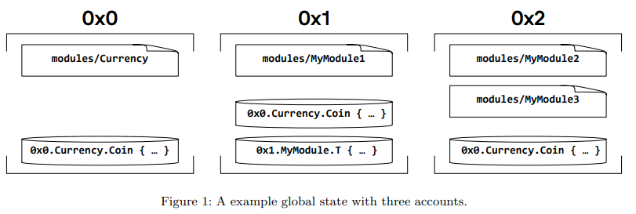
Modules and scripts
Move has 2 kinds of programs - modules and transaction scripts.
Transaction scripts are used in every user-submitted transaction and they invoke procedures of a module to change the global state.
A transaction script is one time use piece of code, whereas a module is reusable, kind of like a library, and published in the global state.

Slide 38
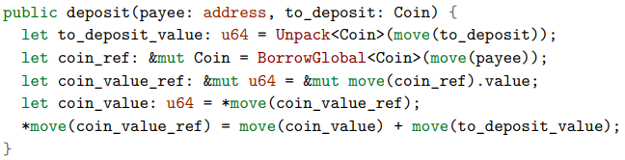
The Currency module
Now lets have a look inside the Currency module from the example and see some of the implementations of it’s methods.
At a high level, this procedure takes a Coin resource as input and combines it with the Coin resource stored in the payee’s account. It accomplishes this by:
1. Destroying the input Coin and recording its value.
2. Acquiring a reference to the unique Coin resource stored under the payee’s account.
3. Incrementing the value of payee’s Coin by the value of the Coin passed to the procedure

Slide 39
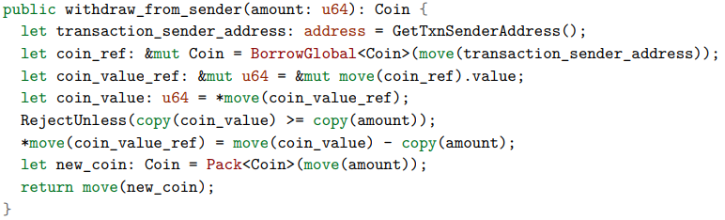
The Currency module
Now lets have a look inside the Currency module from the example and see some of the implementations of it’s methods.
This procedure is almost the inverse of deposit, but not quite. It:
1. Acquires a reference to the unique resource of type Coin published under the sender’s account.
2. Decreases the value of the referenced Coin by the input amount.
3. Creates and returns a new Coin with value amount.

Slide 40
Small Dive Into Move
  Semi-formal description of the Move language​
  Bytecode Interpreter
  Bytecode Verifier

Slide 41

Global State
  Move’s Goal:
1. Enable programmers to define global blockchain state
2. Securely implement operations for updating global state
  Global State - partial map from addresses to accounts
  Each account is a two-part container: resources(data) + modules(code)
  Different resources must have distinct identifiers
  Different modules must have distinct names
​

Slide 42
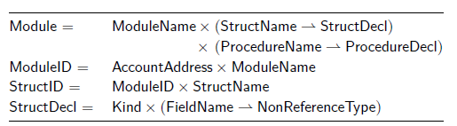
Modules
  Reminder:
  A module consists of a name, struct declarations(resources) and procedure declarations.
  Outside code can refer to a published module using a unique identifier consisting of module’s account address and the module’s name (Exp: 0x0.Currency.deposit(), 0x0.Currency.Coin)
  Move modules enable strong data abstraction
  Procedures encode rules for creating, writing and destroying the types declared by the module
*** resource Coin { value: u64 }
Kind
Notes:
- Sole authority that knows the internal layout of the types it declares
- Only functions inside Module can read or write Coin.value. External code can hold or pass Coin values but cannot peek inside or mutate them.
- Types are transperent inside and opaque outside
- Kind: explain what it is - single bit of meta-info (resource/unrestricted)

Slide 43
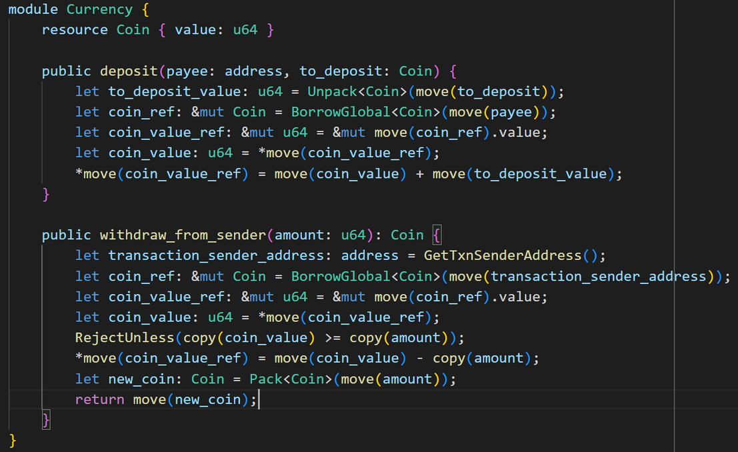
Modules
  Module example:
  One resource type: Coin
  Two procedures:
1. withdraw_from_sender
2.deposit
  Builtin bytecode instructions:
BorrowGlobal<T>
Pack<T>
Unpack<T>
  Rule:
Sum of Coin.value can never drop
below zero
Notes:
- Bytecode Instructions:
BorrowGlobal<T>
Unpack<T> - destructor
Pack<T> - constructor
- External Code must respect the invariants the module sets

Slide 44
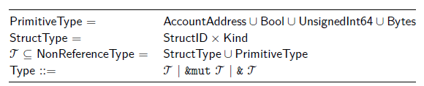
Types
  Primitive types
  Struct
  Resource: Struct type tagged with a resource kind
  Unrestricted types: All others, including non-resource struct types
  Bytecode verifier enforces restrictions on resource variables and struct fields of type resource
Notes:
- Kind: explain what it is - single bit of meta-info (resource/unrestricted)
- Resource variable, Unrestricted variable
- Small explanation about bytecode verifier

Slide 45
Types
  Restrictions:
  A resource variable cannot be copied and must always be moved
  Resource variable and struct of resource type cannot be reassigned
  A reference to a resource type cannot be dereferenced
  Unrestricted struct type may not contain a field with a resource type
  The bytecode verifier performs safety checks that enforce these restrictions
(More on that later...)
Notes:
- Talk about what reassignment may cause (value destruction)
- Talk about what derefernce may cause (resource copy)
- Talk about last restriction:
a. safe copy of unrestricted struct
b. prevents destruction of nested source

Slide 46
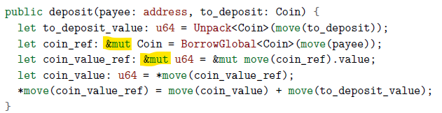
Values
  Move supports reference values (type &T or &mut T)
  Since references are momentary, the bytecode verifier enforces another restriction:
Fields of reference type are not allowed - For example: struct S { ptr : &u64 } is illegal.
Reference must be created during execution of a script and released before its end.
Notes:
- Restriction: prevents dangling or aliased pointers that an attacker may use.

Slide 47
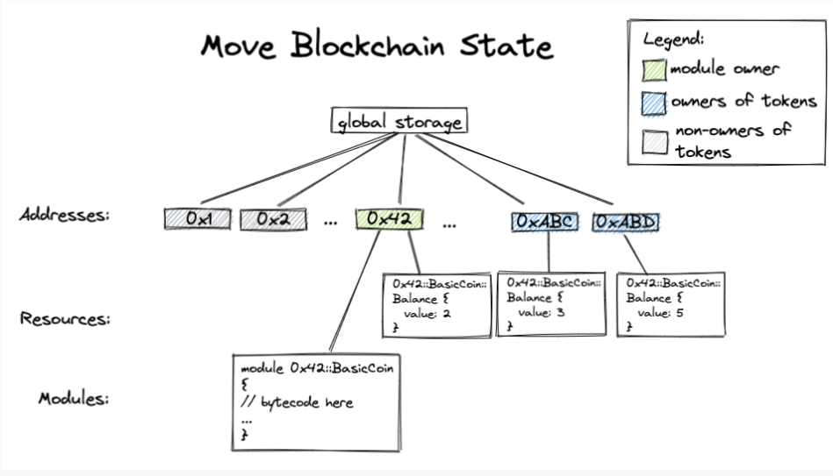
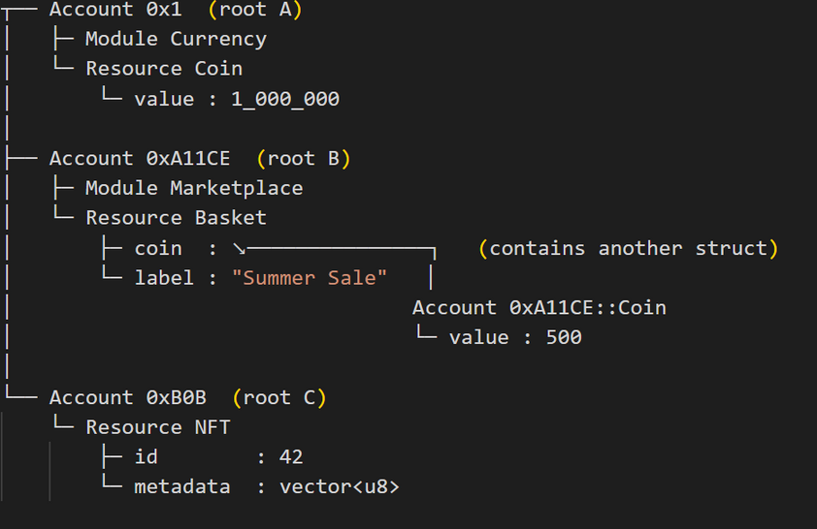
Values
  This restriction ensures that the global state is always a tree instead of arbitary graph!
  Every byte lives at one and only one position - Move names that position by an access path:
For example: root. f1 . f2 . ... . fn
  No two paths alias the same storage location - the VM can locate, read, and charge gas for any cell deterministically.
Notes:
- Restriction: prevents dangling or aliased pointers that an attacker may use.
- Containment - produces parent --> child hierarchy
- f1....fn - field identifiers
- Referenses are only way to create edges, no child can point sideways
- 0x1.Coin.value -
No other sequence of field names reaches those bytes, so the paths are canonical.

Slide 48
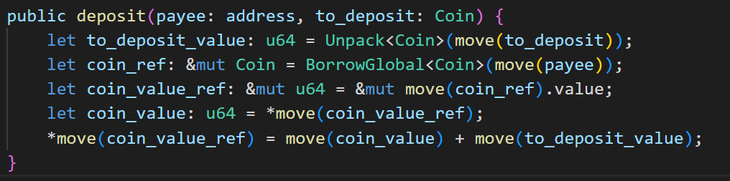
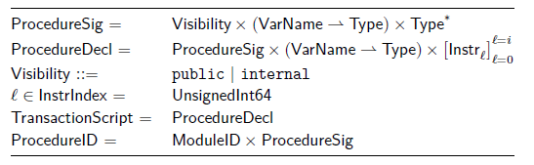
Procedures and Transaction Scripts
  Procedure signature consists of visibility, typed formal parameters, and return types.
  Procedure visibility may be either public or internal.
  Public procedures can be invoked by any module or transaction script.
  A procedure can be uniquely identified by its module identifier and its signature.
Notes:
- Explain internal/public visibility

Slide 49
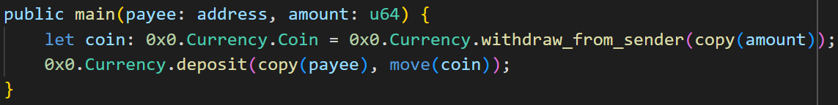
Procedures and Transaction Scripts
  The blockchain state is updated by a transaction script
  Can invoke public procedures of any module that is currently published under an account
  Simply a procedure declaration with no associated module
  Can be written off-chain (CLI,IDE) and compiled to bytecode
Notes:
- No associated module – the script is not published to global storage, does not declare structs or constants, and no other code can depend on it.

Slide 50
Procedures and Transaction Scripts
  Useful Attribute 1:
The Call bytecode instruction requires a unique procedure ID as input.
  Useful Attribute 2:
Acyclic module dependency - the dependency relationship among modules is acyclic by
construction.
  The combination of both, together with the absence of dynamic dispatch, enforces a strong execution invariant: All stack frames belonging to procedures in a module must be contiguous.
  No re-entracy issues of Etherium smart contracts in Move modules.
Notes:
- Attribute 1:
This ensures that all procedure calls in Move are statically determined — there are no function pointers or virtual calls.
- Attribute 2:
A module can only depend on modules
that were published earlier in the linear transaction history.
- Re-Entracy:
Re-entrancy is a bug pattern where external code re-invokes a vulnerable function before the first invocation finishes, exploiting half-finished state changes.

Slide 51
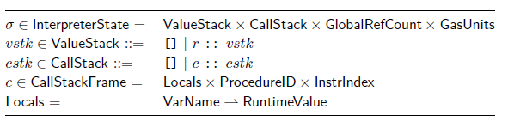
Bytecode Interpreter
  A typed, stack-based virtual machine.
  Each instruction pops its operands from the value stack, performs an operation, and pushes any results.
  Every stack slot carries an exact type (primitive, struct, reference) that the verifier has checked in advance.
Notes:
- Interpreter that evaluates instructions using a stack as its primary data structure, rather than registers. (Like JVM)
-Keeps the runtime small and deterministic; the VM never performs dynamic type checks once code is verified.

Slide 52
Bytecode Interpreter
Procedure call in the Move bytecode interpreter:
  Caller pushes arguments to a procedure onto the value stack in left-to-right order.
  Caller invokes the Call instruction, which creates a new callstack frame for the callee and loads the pushed values into the callee’s local variables.
  The interpreter begins executing the bytecode instructions of the callee procedure.
Notes:
- Interpreter that evaluates instructions using a stack as its primary data structure, rather than registers. (Like JVM)
-Keeps the runtime small and deterministic; the VM never performs dynamic type checks once code is verified.

Slide 53
Bytecode Interpreter
Execution of bytecode:
  The execution of bytecode proceeds by executing operations in sequence unless there is a branch intruction(Branch, BrTrue, BrFalse) or Return instruction.
  When the callee wishes to return, it pushes the return values onto the stack and invokes the Return instruction.
  Control is then returned to the caller, which finds the output values on the stack.
Notes:
- branch
operation that causes a jump to a statically determined offset

Slide 54
Bytecode Interpreter
Gas Metering:
  Execution of Move programs is metered (similar to the EVM)
  Each bytecode instruction has an associated gas unit cost.
  Any transaction to be executed must include a gas unit budget.
  Interpreter tracks the gas units remaining during execution and halts if the amount remaining reaches zero.
Notes:
Each opcode has a fixed gas cost looked up in an on-chain “gas schedule”. Costs are charged before execution of the instruction.
- Guarantees deterministic resource consumption; protects validators against DoS.

Slide 55
Bytecode Interpreter
Why stack-based interpreter?
  Stack machine with typed locals is a very natural fit for the resource semantics of Move.
  The low-level mechanics of moving values back and forth mirror the high-level intention of a Move program.
  A register machine would make it more complex to move resources across procedure boundaries.

Slide 56

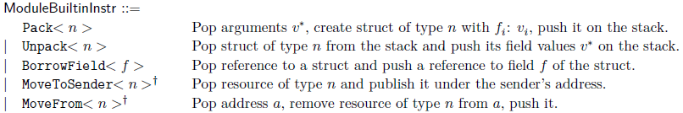
Instructions
1. Copying/Moving data:
  CopyLoc/MoveLoc - from local variables to the stack
  StoreLoc - from the stack to local variables
2. Module Builtins:
  Pack/Unpack - creating/destroying the module’s declared types
  MoveToSender/MoveFrom - publishing/unpublishing the module’s types under an account
  BorrowField - acquiring a reference to a field of one of the module’s types.
Notes:
- Move supports six broad categories of bytecode instructions

Slide 57
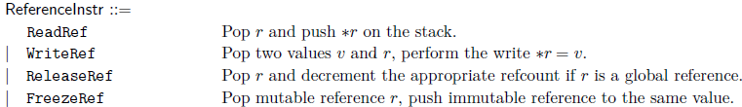
Instructions
3. Operations on typed stack values
  Pushing constants onto the stack.
  Arithmetic/Logical operations on stack operands.
4. Reference-related instructions:
  ReadRef/WriteRef - reading/writing references.
  ReleaseRef - destroying a reference.
  FreezeRef - converting a mutable reference into an immutable reference.
Notes:
- Move supports six broad categories of bytecode instructions

Slide 58


Instructions
5. Control-flow operations:
  Conditional branching.
  Calling/Returning from a procedure.
6. Blockchain-specific builtin operations:
  Getting the address of the sender of a transaction script.
  Creating a new account.
  FreezeRef - converting a mutable reference into an immutable reference.
Notes:
- Move supports six broad categories of bytecode instructions

Slide 59
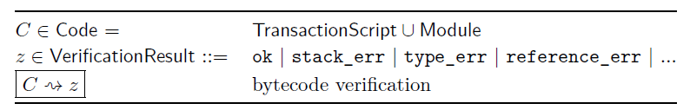
Bytecode Verifier
  Goal: statically enforce safety properties for any module and transaction script submitted.
  The verifier enforces general safety properties that must hold for any well-formed Move program.
  The binary format of a Move module or transaction script encodes a collection of tables.
Notes:
- No Move program can be published
or executed without passing through the bytecode verifier.
- tables of entities,
such as constants, type signatures, struct definitions, and procedure definitions.

Slide 60
Bytecode Verifier
The checks performed by the verifier fall into three categories:
  Structural checks to ensure that the bytecode tables are well-formed.
  Semantic checks on procedure bodies.
  Linking uses of struct types and procedure signatures against their declaring modules.
Notes:
- Possible Structure Errors:
illegal table indices, duplicate table entries, and illegal type signatures such as a
reference to a reference.
-Semantic checks on procedure bodies:
errors such as incorrect procedure
arguments, dangling references, and duplicating a resource.
- Linking errors:
illegally invoking an internal procedure and using a procedure
identifier that does not match its declaration.

Slide 61
Bytecode Verifier
Phases of semantic verification and linking:
  Control-flow graph construction:
    Code is broken into basic blocks (linear instruction sequences).
    Helps analyze how instructions flow and where they branch.
    Each block ends in a branch or return.
  Stack balance checking:
    Validates that stack height is consistent across basic blocks:
      Start with height n
      End with n (or n+m if Return returns m values)
    Ensures no access to stack frames of other procedures

Slide 62
Bytecode Verifier
Phases of semantic verification and linking:
  Type checking:
    Confirms that every instruction uses values of the correct types.
    Stack values' types are inferred, local variables are already typed.
    Operates block-by-block, using a type stack model.
  Kind checking:
    Enforces rules for resources (All the rules mentioned earlier)

Slide 63
Bytecode Verifier
Phases of semantic verification and linking:
  Reference checking:
    Uses a borrow checker for:
      Ensuring references are valid (no use-after-free or aliasing).
      Distinguishing between %T and &mut T
    Also uses dynamic reference counting to:
      Track live references to global resources
      Prevent moving or modifying a global resource while a reference exists.

Slide 64
Bytecode Verifier
Phases of semantic verification and linking:
  Linking with global state:
    Verifies that the code refers to existing and correctly-declared types and procedures:
      Structs: Check name and kind
      Procedures: Check signature, visibility, argument types, etc.
    Prevents errors like:
      Calling a deleted function
      Using undeclared types

Slide 65
Move VM:
Putting it all together

Slide 66
Move Virtual Machine
What Does the Move VM Do?
  Executes blocks of transactions.
  Applies verified updates to the global state.
Execution Flow:
  Fetch transaction Tᵢ from block
  Execute → produce effect Eᵢ
  Apply Eᵢ to state Σᵢ₋₁ → new state Σᵢ
Thanks to the seperation of the effect and the state update, we can ensure transactional semantics: if a transaction fails, no state changes are committed.

Slide 67
What is a Transaction Effect?
Transaction Effect (E):
  A map: AccountAddress → Account.
  Describes exactly what changed.
  Same structure as the global state.
Includes:
  Modified resources (e.g., coins)
  New or updated modules
Enables VM to separate execution logic from state mutation

Slide 68
Designed for Future Parallelism
As of the time of the paper: Transactions are executed sequentially.
Future goal: Speculative parallel execution. (This has been achieved on Aptos)
How?
  Move’s storage model is a tree (not a graph)
  Every read/write is tracked by access paths
  Detect conflicts easily:
    No overlapping paths → safe to run in parallel.
    Conflicts → re-execute if needed (speculative parallelism).
Enables scalability while preserving safety
Notes:
We can detect conflicts easily:
-no overlap=no conflict=safe.
-Conflict? Re execute and solve them.

Slide 69
Thank You!

