Slide 1
MOVE: A Language With Programmable Resources
Sam Blackshear, Evan Cheng, David L. Dill…

Slide 2
Overview
Background
Managing Digital Assets on a Blockchain
Move Design
Move Overview
The Move Language – Definitions

Slide 3
Background
Created by Meta
Based on Rust
Designed to be used in the Libra blockchain (Diem) but can also be used in other blockchains as well
Resource/Asset/Currency

Slide 4

Managing Digital Assets on a Blockchain

Slide 5
Encoding Digital Assets in an Open System
We want to be able to encode assets
We want to be able to transfer assets
The system is an open system. Each person can suggest any state transition, but not all state transitions should be allowed.

Slide 6
Challenges
It is challenging to choose a representation of transitions and state that encodes ownership of digital assets:
Scarcity - The supply of assets in the system should be controlled. Duplicating existing assets should be prohibited, and creating new assets should be a privileged operation
Access control - A participant in the system should be able to protect his assets with access control policies.

Slide 7
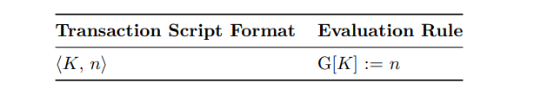
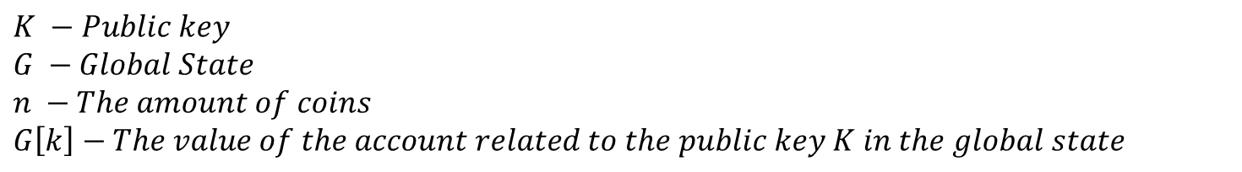
Straw Coin
$$K −Public key$$
$$G −Global State$$
$$n −The amount of coins$$
$$G\left[k\right]−The value of the account related to the public key K in the global state$$

Slide 8
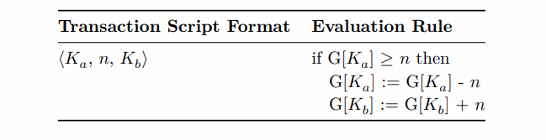
Straw Coin
$K_{a}$– $Alice^{′}s public key$
$K_{b}$–$Bob′s public key$

Slide 9
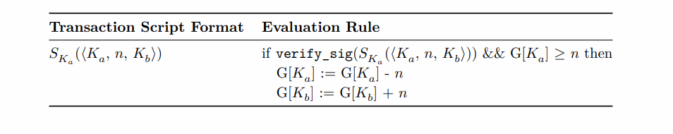
Straw Coin
${S_{K}}_{a}$– $Alice^{′}s signture using her secret key attached with her public key$

Slide 10
Problems with existing Blockchain Languages
Straw coin is an attempt to capture the essence of the bitcoin script and EVM bytecode
Unfortunately there are still some problems:
Indirect representation of assets.
Scarcity is not extensible.
Access control is not flexible.

Slide 11
Problems with existing Blockchain Languages
Indirect representation of assets.
An asset is encoded using an integer, but an integer value is not the same thing as an asset. In fact, there is no type or value that represents Bitcoin/Ether/StrawCoin

Slide 12
Problems with existing Blockchain Languages
Scarcity is not extensible.
The language only represents one scarce asset. In addition, the scarcity protections are hardcoded directly in the language semantics. A programmer that wishes to create a custom asset must carefully reimplement scarcity with no support from the language.

Slide 13
Problems with existing Blockchain Languages
Access control is not flexible
The only access control policy the model enforces is the signature scheme based on the public key. It is not obvious how to extend the language to allow programmers to define custom access control policies.

Slide 14
Partial solutions
Bitcoin scripts
Allows modification of access control, but the language isn’t turing-complete. Also, there is no option to create custom made resources.
EVM
Turing-complete, allows creating new resources, procedures, virtual calls, loops and data structures.
Problems: creating new resources can be risky, and so is dynamic dispatch (DAO attack)

Slide 15
Move Design

Slide 16
Move Design
Move was designed with 4 key goals in mind:
First-class Assets
Flexibility
Safety
Verifiability

Slide 17
First-Class Assets
A resource can never be copied or implicitly discarded
A resource can only be moved between program storage locations.
These safety guarantees are enforced statically by Move’s type system (before executing the code).
Move must allow resources to be created, modified, and destroyed.
Move programmers can protect access to these critical operations with modules

Slide 18
Flexibility
Each Libra transaction includes a transaction script that is effectively the main procedure of the transaction.
A transaction script is a single procedure that contains arbitrary Move code, which allows customizable transactions.
A script can invoke multiple procedures of modules published in the blockchain and perform local computation.
modules/resources/procedures resembles classes/objects/methods but modules can have multiple resources (or none), and procedures don’t have the notion of “this” or “self”

Slide 19
Safety
Every transaction goes through the byte-code verifier in order to check resource safety, memory safety and type safety.
The verification is done on-chain and therefor no need to add a compiler to the trusted computing base. Also we can avoid the computation required by the compiler.

Slide 20
Verifiability
Off-chain verification (for the users benefit)
Move is more amenable to static verification than most general-purpose languages:
No dynamic dispatch - easy for verification tools to reason precisely about the effects of a procedure call without performing a complex call graph construction analysis
Limited mutability - Every mutation to a Move value occurs through a reference. References are temporary values that must be created and destroyed within the confines of a single transaction script. This makes it easier for the verifier.

Slide 21
Verifiability
Modularity – one module cannot violate another module’s properties therefor the verifier can check each module by itself.

Slide 22
Move Overview

Slide 23
Modules/Resources/Procedures
Every account has an address, and every address has modules and resources.
It is impossible to create 2 modules with identical names under the same address
Similarly it is impossible to create 2 resources with identical names under the same module
A module defines what other modules can execute (like public methods). Otherwise the only action available by other modules is move
It is possible to create 2 modules with the same name under different account addresses. Same for resource, but then it is a different resource

Slide 24
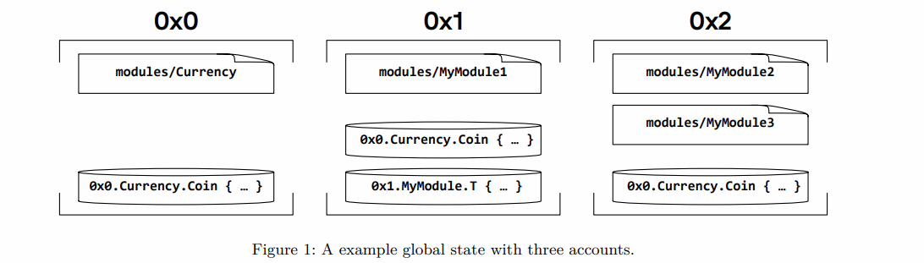
Modules/Resources/Procedures

Slide 25
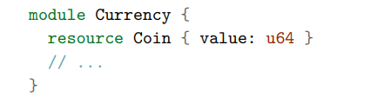
Peer-to-Peer Payment

Slide 26
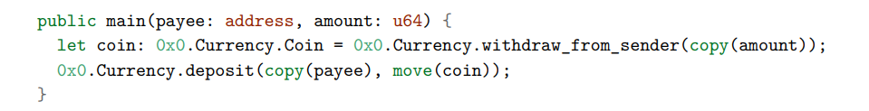
Peer-to-Peer Payment Transaction Script
Every variable must be passed via copy or move
A resource must be moved exactly once
It is forbidden to copy a resource (or there will be an error)

Slide 27
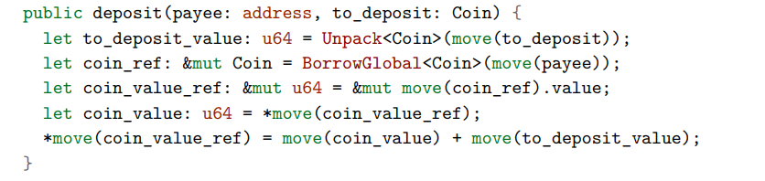
Peer-to-Peer Payment

Slide 28
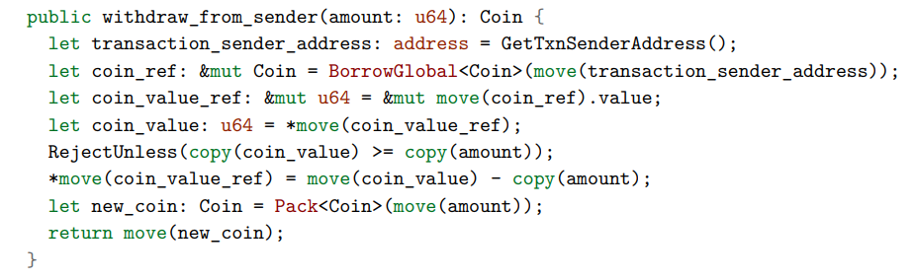
Peer-to-Peer Payment

Slide 29
The Move Language - Definitions

Slide 30

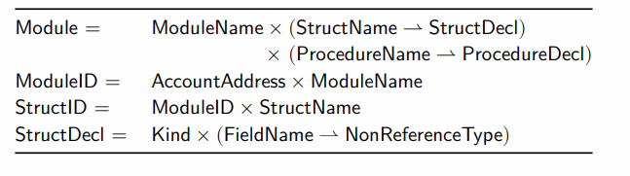
Move Semantics

Slide 31
Move Semantics
The Call bytecode instruction requires a unique procedure ID as input. This ensures that all procedure calls in Move are statically determined

Slide 32
Bytecode Interpreter
The ByteCode instructions are executed stack-based interpreter similar to JVM
The stack is used for: input, output, function calls and operands (for arithmetic calculations)
Each bytecode instruction has an associated gas unit cost, and any transaction to be executed must include a gas unit budget. Similar to EVM
Instruction types:
CopyLoc/MoveLoc – used to copy/move data of local variables to the stack. StoreLoc takes the data from the stack and stores it in a local variable.
Pack/unpack – creates/destroys the declared module’s resources
MoveToSender – publishes a new resource under a specific account (it is possible to call this instruction once per resource)

Slide 33
Bytecode Verifier
Control Flow Graph – in order to check all the possible runtime scenarios.
Stack balance checking – Verifies that a Callee function cannot access stack locations that belong to its caller.
Type checking – The verifier checks that each instruction and procedure is invoked with arguments of appropriate types
Kind checking:
Resources cannot be duplicated – restricting CopyLoc on resources and ReadRef on a reference to a resource.
Resources cannot be destroyed – restricting StoreLoc on variables that holds resource, and WriteRef on a reference to a resource.
Resources must be used - When a procedure returns, no local variables may hold a resource value.

Slide 34
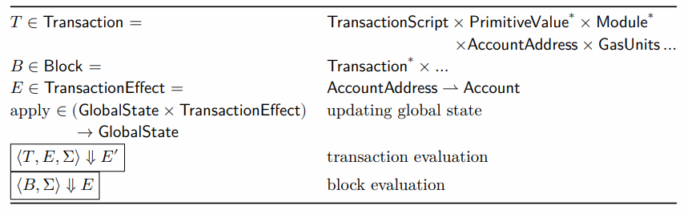
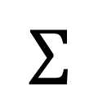
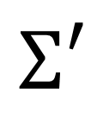
Move Virtual Machine
$$Σ′$$
$$Σ$$
E
Block 1
Block 2
Block n
Block n + 1

Slide 35

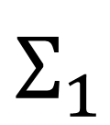
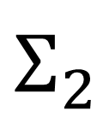




Move Virtual Machine
$$E_{1}$$
$$Σ_{1}$$
$$E_{2}$$
$$Σ_{2}$$
$${Txn}_{1}$$
$$Txn_{2}$$
$$⋮$$
$${Txn}_{n}$$
$${Txn}_{1}$$
$$Txn_{2}$$
$$⋮$$
$${Txn}_{n}$$
Bloc 1
Block n
T1
Block 1
Block 2
Block n
$$E=E_{1}∘E_{2}∘⋯∘E_{n}$$
$$Σ^{′}=E applied on Σ$$

