Slide 1


Intelligent Systems for Homeland Security
Sarit Kraus
Dept of Computer Science
Bar-Ilan University
Israel
sarit@cs.biu.ac.il
http://www.cs.biu.ac.il/~sarit/

Slide 2
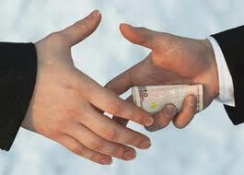
A Study of Corruption in
Different Cultures
Corruption is an important policy concern in many countries
Difficult to model and to predict in the confinements of the laboratory
Gal, Rosenfeld, Kraus, Gelfand, An and J. Lin.
New Paradigm for the Study of Corruption in Different Cultures, SBP, 2014.

Slide 3
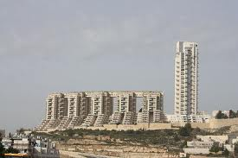
Motivation

Slide 4



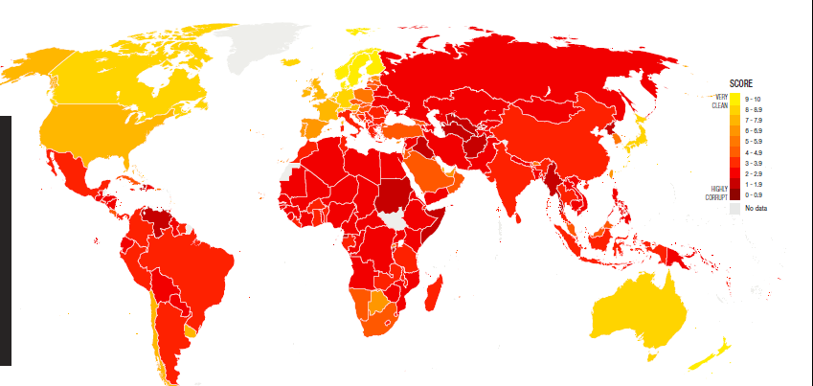
Corruption Index
Global index is a perceived measure (the lower the better):
  USA: rank 19
  Israel: rank 36
  China: rank 80

Slide 5
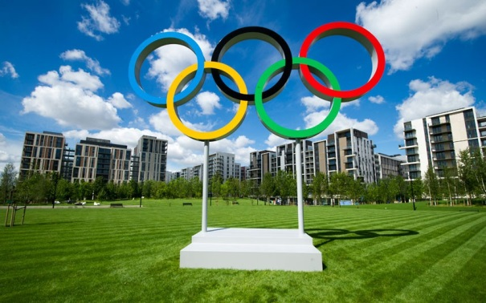
The Olympic Game
A board game providing an analogy
to group decision-making in the
real world
Three bidders compete to win contracts by submitting bids in repeated auctions
One Auctioneer determines the winner
Rules are completely open-ended. Players can exchange resources and messages privately

Slide 6





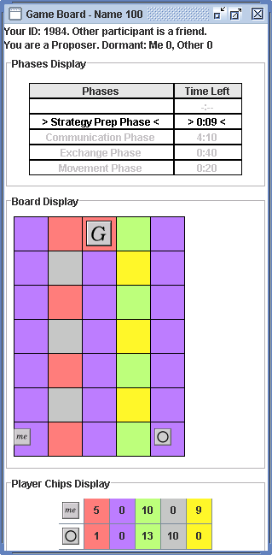
An Experimental Test-Bed
Interesting for people to play:
  analogous to task settings;
  vivid representation of strategy space (not just a list of outcomes).
Possible for computers to play.
Can vary in complexity
  repeated vs. one-shot setting;
  availability of information;
  communication protocol;
  Negotiations and teamwork
6

Slide 7
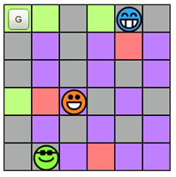
The Game Board
Reaching the goal = Earn the right to carry out projects
I’m Bidder 1
I’m Bidder 3

Slide 8
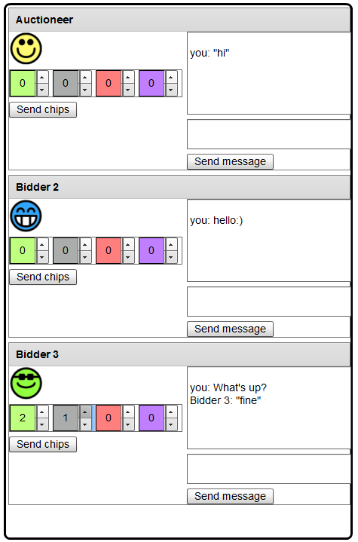
Exchanging Phase
In this phase all players can exchange messages or send chips to any other player
Messages and
chip exchange
are private
and not observed
by other players
You can send chips to a player. In this example the player is about to send 2 green chips and 1 gray to Bidder #3
You can send a private message to a player

Slide 9
Score
Players get 1 point for every chip they have left at the end of the round
If the auction winner can reach the goal, he gets
100 points bonus
The auctioneer gets 5-points bonus if the winner is able to reach the goal
The winning bid is paid to the government, not the auctioneer

Slide 10
Corruption Definition
Bidder chosen by auctioneer despite submitting a lower bid.
Defining Communication between bidder and auctioneer (may be initiated by either player).
Bidder pays auctioneer in return for getting chosen.

Slide 11
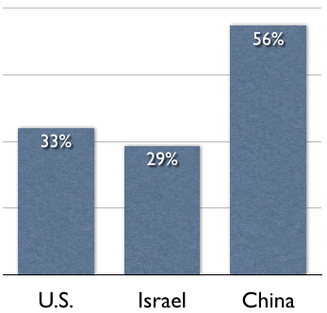
Frequency of Corruption
* Number of corruption instances increased in last rounds!
Notes:
Highest corruption level in China (not surprising), followed by US and Israel.
The difference between China and U.S. is surprising given the lower CPI level in U.S. than in Israel.
Number of corruption instances increased in last rounds of play (but there was no significant correlation between round number and corruption).

Slide 12
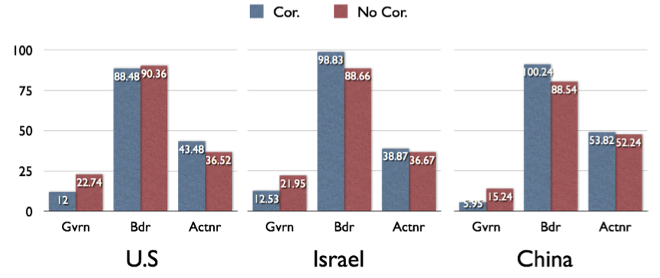
Score Comparison
Easy to predict if corruption
occurs from government profit
* More corruption in China, but winning bidders earn less!
Notes:
As expected, corruption decreases the total government score in each country.
Similar trends can be seen in China and Israel, with U.S. being surprisingly different.
The auctioneer significantly benefited from corruption in the U.S., but not in China and in Israel.
Winning bidders significantly benefited from corruption in Chin and

Slide 13
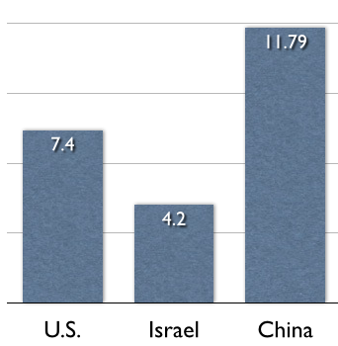
Bribery Amounts
Notes:
To explain this result we analyze the amount of chips sent by the winning bidder in each country; as can be seen the bribery in China is significantly (unnessarily) higher than in the other countries.

Slide 14
Corruption Game – Open Questions
Can we build a (culture sensitive?) agent playing the game?
Can we change the game to prevent corruption?
Should the game change be different for each country?
We can predict if corruption occurred based on the government score.

Slide 15
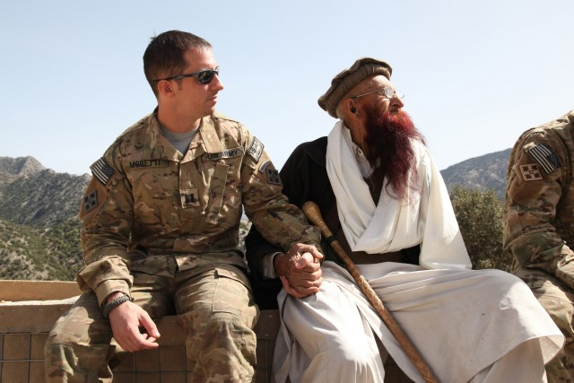
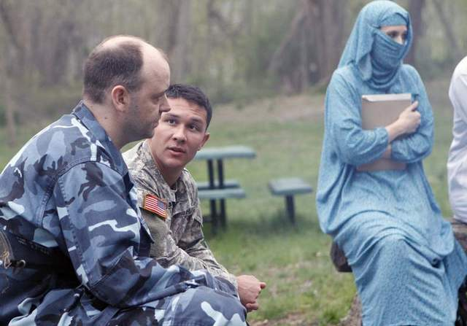
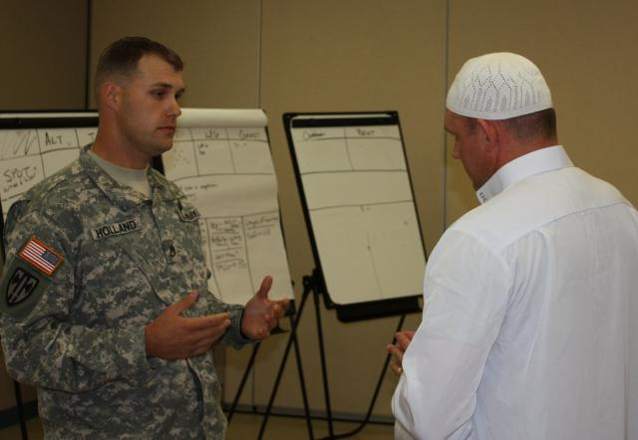
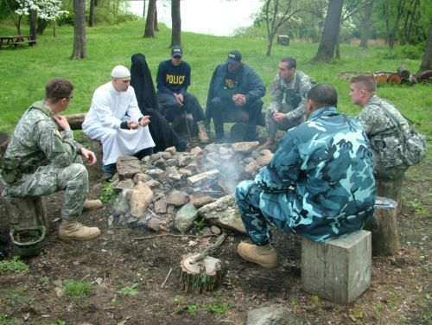
Motivation: Training People
Notes:
There are many application that make negotiation between people from different cultures. The issue here is build an agent that will know how to handle with this issue. And our hypothesis is that in order to succeed, the agent must take into account the culture issue when making negotiation.

Slide 16
CT Game
100 point bonus for
getting to goal
10 point bonus for each chip left at end of game
Agreement are not enforceable
Gal, Kraus, Gelfand, Khashan and Salmon. Negotiating with People across
Cultures using an Adaptive Agent, ACM Trans. on Intelligent Systems and Technology,
2011
16
Notes:
if I

Slide 17
The PURB-Agent
Rules!!
Agent’s
Cooperativeness
& Reliability
Estimations of others’
Cooperativeness
& Reliability
Taking into consideration
human factors
Social Utility
Expected value
of action
Expected
ramification
of action

Slide 18

Hypothesizes
People in the U.S. and Lebanon would differ significantly with respect to cooperativeness:
  helpfulness trait:
  reliability trait:
An agent that modeled and adapted to the cooperativeness measures exhibited by people will play at least as well as people

Slide 19
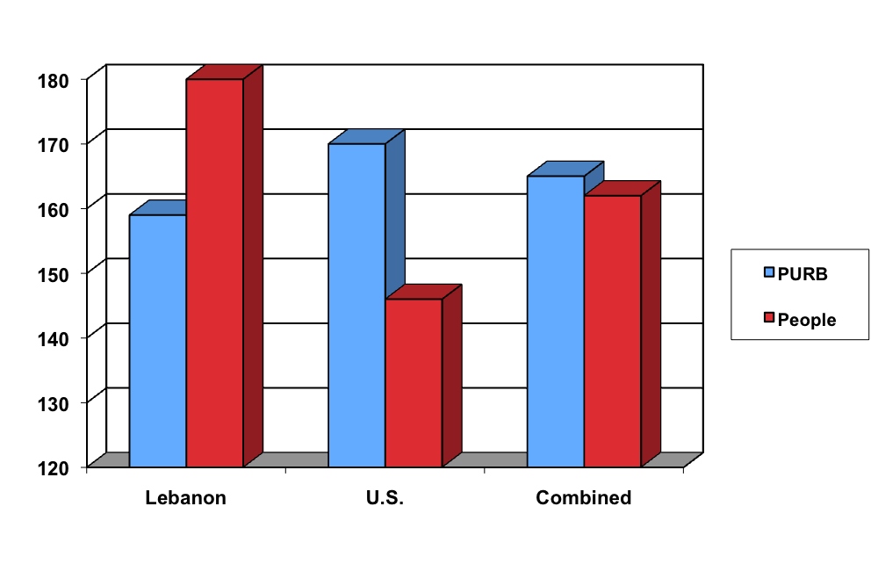
PURB vs People in Lebanon & US

Slide 20
Reliability Measures
Average | Task dep. | Task indep. | Co-dep
0.92 | 0.87 | 0.94 | 0.96 | People (Lebanon)
0.65 | 0.51 | 0.78 | 0.64 | People (US)

Slide 21
Reliability Measures
Average | Task dep. | Task indep. | Co-dep
0.98 | 0.99 | 0.99 | 0.96 | PURB (Lebanon)
0.62 | 0.72 | 0.59 | 0.59 | PURB (US)

Slide 22
Reliability Measures
Average | Task dep. | Task indep. | Co-dep
0.98 | 0.99 | 0.99 | 0.96 | PURB | Lebanon
0.92 | 0.87 | 0.94 | 0.96 | People
0.62 | 0.72 | 0.59 | 0.59 | PURB | US
0.65 | 0.51 | 0.78 | 0.64 | People

Slide 23
Reliability Measures
Average | Task dep. | Task indep. | Co-dep
0.98 | 0.99 | 0.99 | 0.96 | PURB | Lebanon
0.92 | 0.87 | 0.94 | 0.96 | People
0.62 | 0.72 | 0.59 | 0.59 | PURB | US
0.65 | 0.51 | 0.78 | 0.64 | People

Slide 24
Learning culture vs
Programming ahead of Time
Can we build an agent that will be better than the people it plays with in all countries?
Can we build proficient negotiator with no expert designed rules?
New rules?
Rules that are culture sensitive?
Learning weights of social utility from data?
Can we build prediction model?
Should we build prediction model for each culture?
Haim, Gal, Kraus, Gelfand, Cultural Sensitive Agent for Human-Computer Negotiation. AAMAS 2012.

Slide 25

Personality, Adaptive Learning
(PAL) Agent
  Data from specific culture
Machine Learning
  Human specific data
Game Theory Optimization
methods
Human Prediction Model
Take action
Collaborators: Haim, Gal, Gelfand

Slide 26
Personality, Adaptive Learning
(PAL) Agent
In this data set the Lebanon people almost always kept the agreements ➔ PAL never kept agreements
  Data from specific culture
Machine Learning
    “Nasty Agent”:
    Less reliable when fulfilling its agreement
Game Theory Optimization
methods
People adapt their behavior to their counterparts.
Human Prediction Model
Take action

Slide 27
Pal vs Humans
Notes:
Reports performance (in average score per game) for each of the countries and for each dependency condition
The best performance for PAL and the worst performance for people occurred in the U.S
PAL was able to outperform people in all dependency conditions and in all countries

Slide 28
Open Questions
Is it possible to develop new innovative learning algorithms that will allow us to learn from one culture to another when the cultures are significantly different? Can we introduce adaptation method to counterparts?
Collaborator: Kobi Gal, Avi Rosenfeld

Slide 29

Virtual Suspects for Investigation Training
Project Goal: development of a simulation system for training law enforcement personnel in investigations.
Support entities:
  Trainer
  Trainee
  Virtual Suspect
  System Manager
Notes:
Mild cerebral palsy

Slide 30
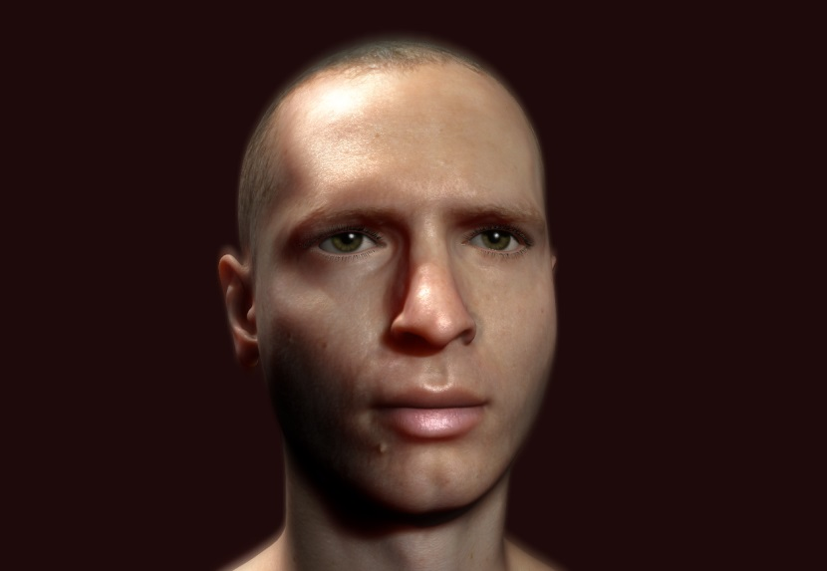
Main Goal: Virtual Suspect
  The development of a computerized system that will play the role of the suspect
    The activities of the investigator (trainee) influences the answers and behavior of the virtual suspect
Notes:
Mild cerebral palsy

Slide 31
Virtual Suspect (VS)
Database of personalized information
  Family status, employment history, friends, criminal history
Events
  Relevant event, non-relevant events [can be generate automatically]
Personality type and state

Slide 32
Psychology Based Virtual Suspect (VS) State Model
  Cognitive load
  Emotional Load
  Attitude of the VS toward the investigator
Eysenck’s personality factors
High | 0------[---X-][--] 100 | Low | Cognitive
High | 0 ---[-X-]--[---]- 100 | Low | Emotional
Dependent | 0----[-X-]-[------] 100 | Antegonizm | Attitude
Notes:
Mild cerebral palsy

Slide 33

The Process of Answering a Question
Question
VS State
Decision Making
Process
(randomization)
Possible answers
Data Base, history, Alibi,
Hot spots, Legal Access
Answer, Emotional state
Behavioral
Model

Slide 34
Conclusion: New Approach for Teams of One Operator and Multiple Robots
  Data on human behavior
  Data on robots performance
Machine Learning
  Human specific data
  Robot & environment specific data
Expected utility and Optimization
methods
Human prediction model
Robot performance model
Take action
Notes:
54

Slide 35

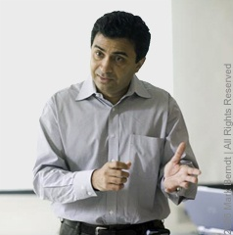
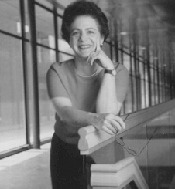
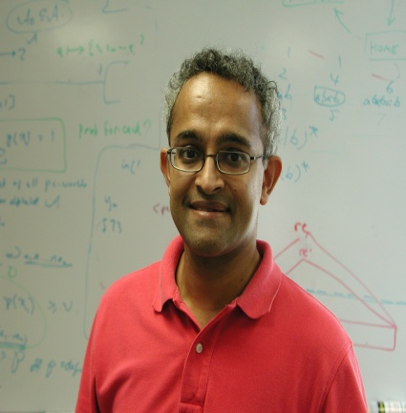
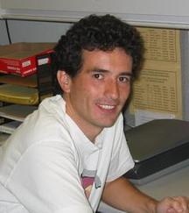
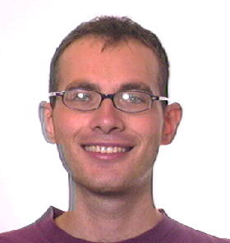


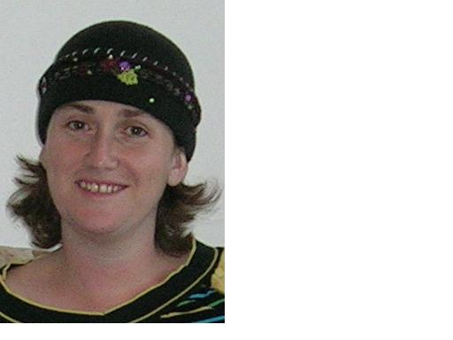
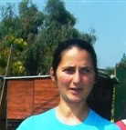
Collaborators
Gal Kaminka
Milind Tambe
Barbara Grosz
VS Subrahmanian
Fernando Ordonez
Noam Peled
Ariella
Richardson
Galit Haim
Michele Gelfand
Ya’akov Gal

Slide 36
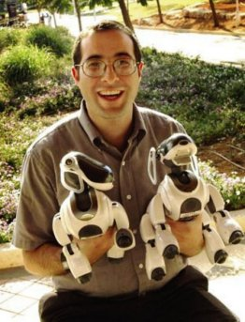
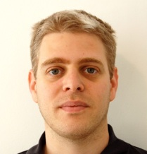
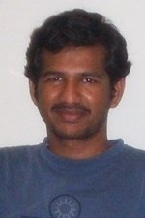
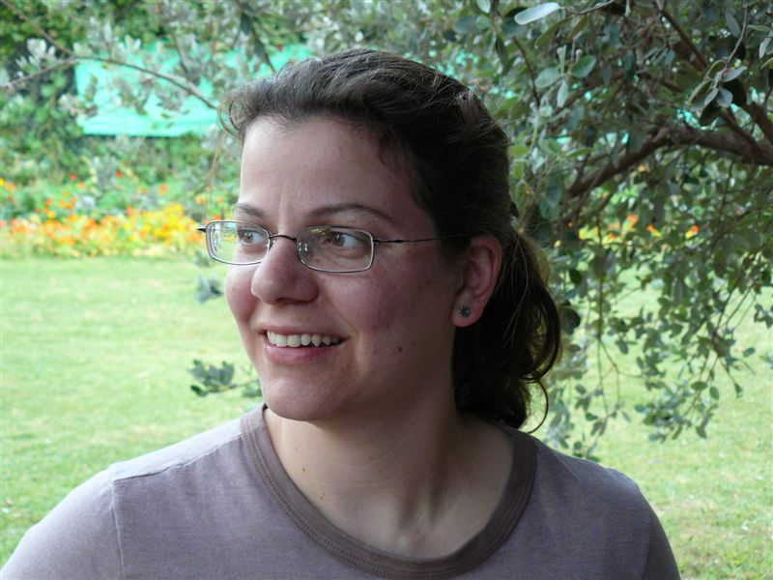
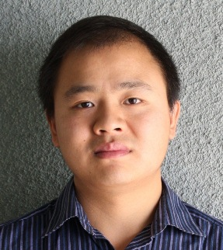

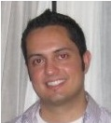


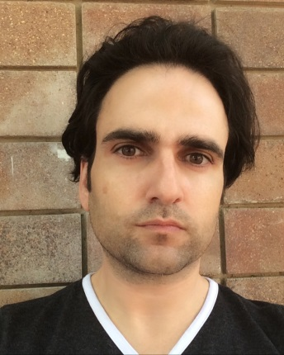
Collaborators
Ariel
Rosenfeld
Avi Rosenfeld
Yossi Keshet
Bo An
Praveen
Paruchuri
Noa Agmon
James Pita
Claudia
Goldman
Manish Jen
Amos Azaria
Moshe Bitan

Slide 37
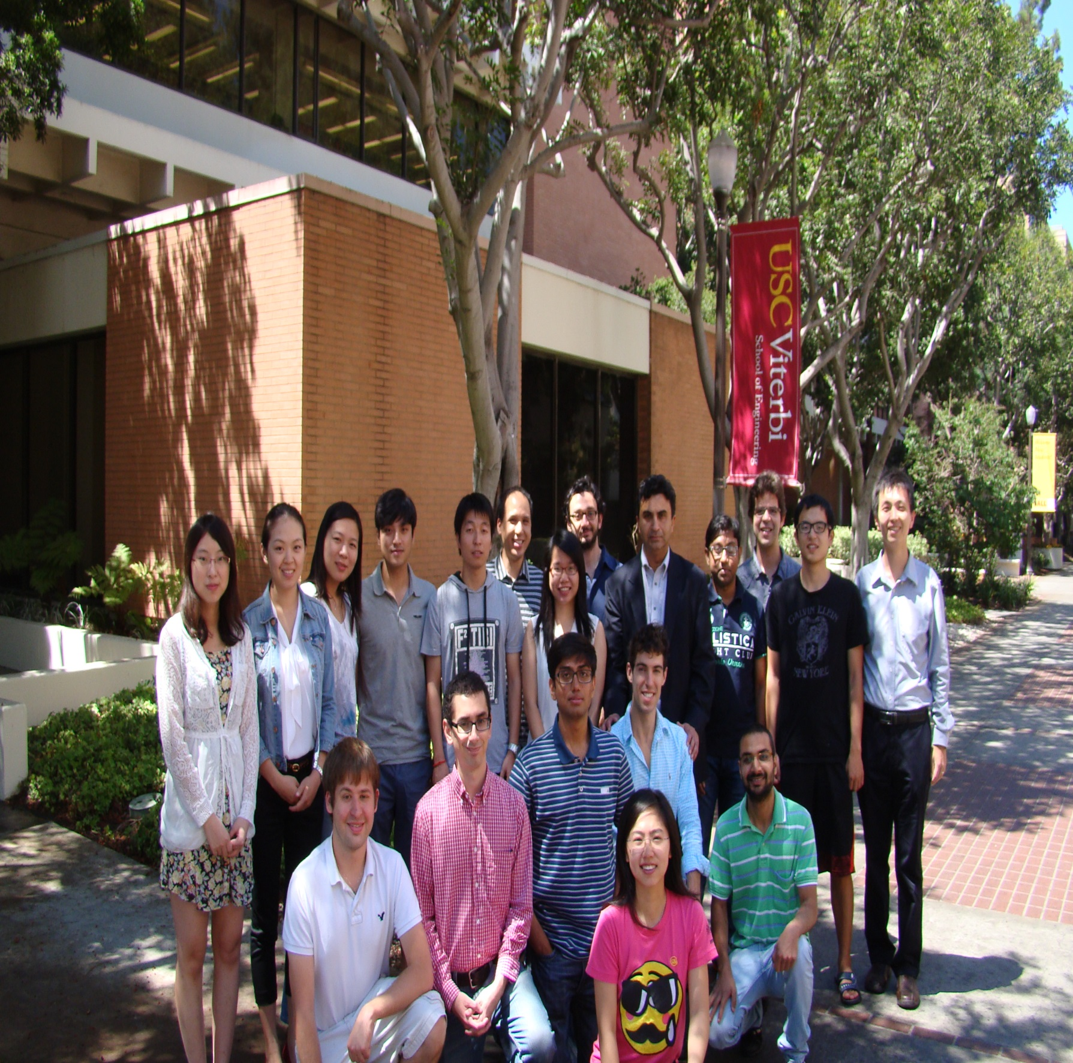
Teamcore 2013-2014

