Slide 1
Computer agents for human persuasion
Sarit Kraus Bar-Ilan University
sarit@umiacs.umd.edu
http://www.cs.biu.ac.il/~sarit/

Slide 2
Automated negotiators
Agents negotiating with people is important and useful
Developing proficient automated negotiators is challenging but possible

Slide 3
Methodology
Data
(from specific country)
Human behavior models
machine learning
Optimization
methods
Opponent* model
Take action

Slide 4
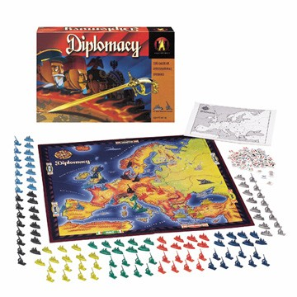
4

Slide 5
Buyer-Seller interaction
Buyers and seller across geographical and ethnic borders
Electronic commerce
Crowd-sourcing
Automated travel agents

Slide 6
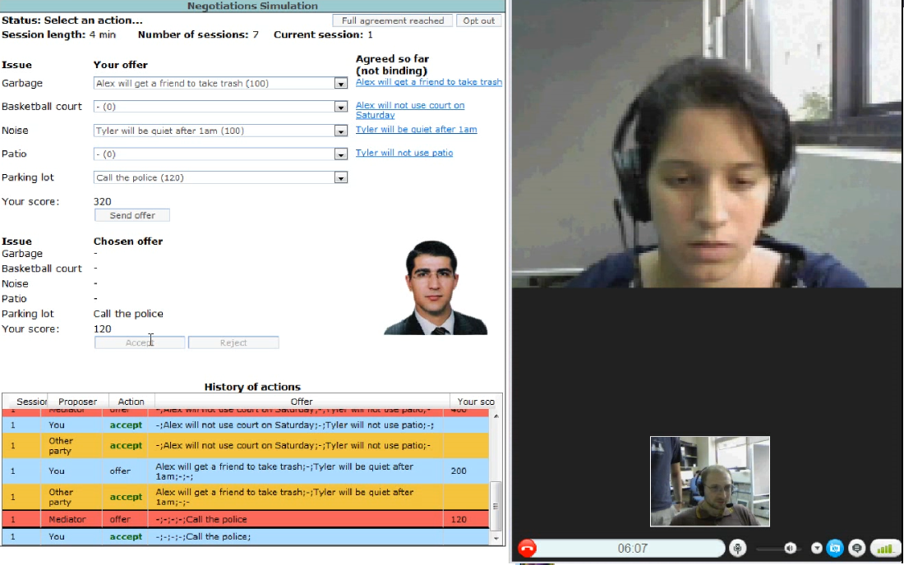
Automated mediators

Slide 7
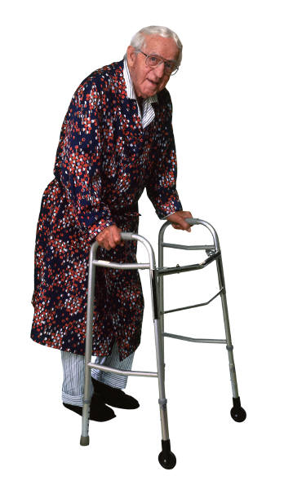
Medical applications
Gertner Institute for Epidemiology and Health Policy Research

Slide 8
Automated Coaching

Slide 9
Advice provision for decision making

Slide 10
Security applications

Slide 11
Culture sensitive agents
The development of standardized agent to be used in the collection of data for studies on culture and negotiation.

Slide 12
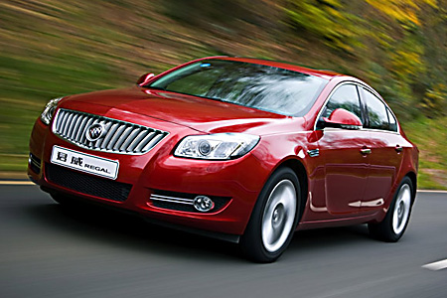
Semi-autonomous cars

Slide 13
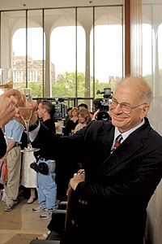
Why not equilibrium agents?
Results from the social sciences suggest people do not follow equilibrium strategies:
Equilibrium based agents played against people failed.
People rarely design agents to follow equilibrium strategies.
13

Slide 14
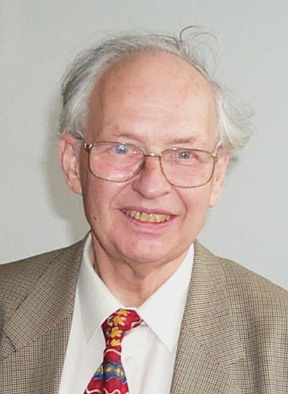
People often follow suboptimal decision strategies
Irrationalities attributed to
sensitivity to context
lack of knowledge of own preferences
the effects of complexity
the interplay between emotion and cognition
the problem of self control

Slide 15
Why not behavioral science models?
There are several models that describes people decision making:
Aspiration theory.
These models specify general criteria and correlations but usually do not provide specific parameters or mathematical definitions.

Slide 16
Methodology
Data
(from specific country)
Human behavior models
machine learning
Optimization
methods
Opponent* model
Take action

Slide 17
Automated Advice Provision in Repeated Human-Agent Interactions
Amos Azaria, Zinovi Rabinovich, Sarit Kraus, Claudia V. Goldman, Ya’akov Gal

Slide 18
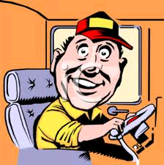
The Path Selection Problem
My goal is to minimize fuel consumption
People and computers are self-interested, but also have shared goals
I want to get to work every day and try to minimize travel time

Slide 19
Methodology
Data
(from specific country)
Human behavior models
machine learning
Optimization
methods
Opponent* model
Take action

Slide 20
Repeated Choice Selection Games
With some probability
Two players:
Sender and Receiver
A state is sampled and observed by Sender
Sender sends his advice to Receiver
Receiver receives advice and performs an action
Both players receive their
costs

Slide 21
Methodology
Data
(from specific country)
Human behavior models
machine learning
Optimization
methods
Opponent* model
Take action

Slide 22
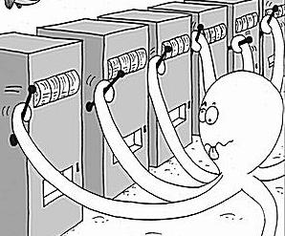
Modeling Human Actions – Multi-Armed Bandit
We assume the user faces a multi-armed bandit problem where the advice is an extra arm.
While fully rational users would use methods such as epsilon-greedy or SoftMax, humans tend to use other methods.

Slide 23
Methodology
Data
(from specific country)
Human behavior models
machine learning
Optimization
methods
Opponent* model
Take action

Slide 24
Human Behavior Models
Hyperbolic Discounting
Logit Qunatal Response: People choose actions proportionate to their expected utility.
Problem: parameters

Slide 25
Methodology
Data
(from specific country)
Human behavior models
machine learning
Optimization
methods
Opponent* model
Take action

Slide 26
Results – Human Modeling

Slide 27
Methodology
Data
(from specific country)
Human behavior models
machine learning
Optimization
methods
Markov Decision Process
Opponent* model
Take action

Slide 28
Providing Advice – Social Utility Function
C(r)= W* driving time(r) + (1-W)*fuel consumption(r)
Recommend r with the lowest cost
Determine W in simulations using the human’s model

Slide 29
Simulation Results – Advice selection methods

Slide 30
Experiments With Humans
375 subjects from Mechanical Turk.
We used 6 different settings for our experiments.
95 subjects were used for the training data-set.
In some settings the fuel consumption and the travel time were independent.
The last settings were more realistic and the travel time and fuel consumption were based on real data.

Slide 31
Amazon Mechanical Turk (AMT)
AMT has been studied for bias compared to other recruitment methods.
Our experience AMT workers are better than students
Our efforts:
Subjects were required to pass a test at start
The bonus given was relatively high and therefore significant to subjects
We have selected Turker's with high reputation
In multiple-choice questions tasks we intended to cut off all answers produced quicker than 10 seconds

Slide 32
Experiment Results

Slide 33
Conclusions
Fun
Challenging:
how to integrate machine learning and behavioral model ? How to use in agent’s strategy?
Agents negotiating with people is important
Challenging:
experimenting with people is very difficult !!!
General opponent* modeling:
Challenging:
hard to get papers to AAMAS!!!
machine learning
human behavior model

Slide 34
Acknowledgements
This research is based upon work supported in part by the ERC grant #267523 and U.S. Army Research Laboratory and the U. S. Army Research Office under grant number W911NF-08-1-0144.

