Slide 1

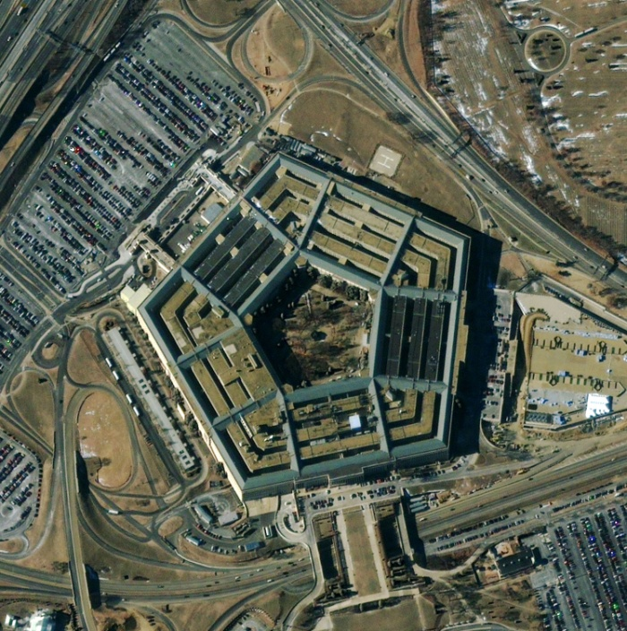
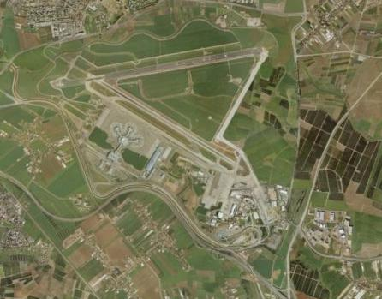
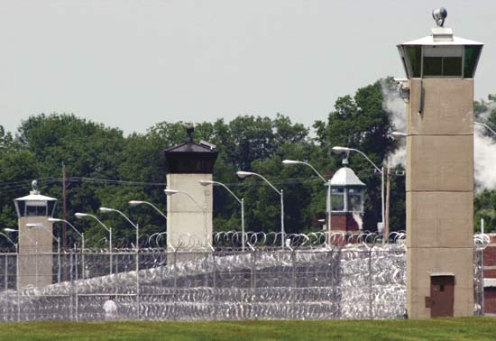
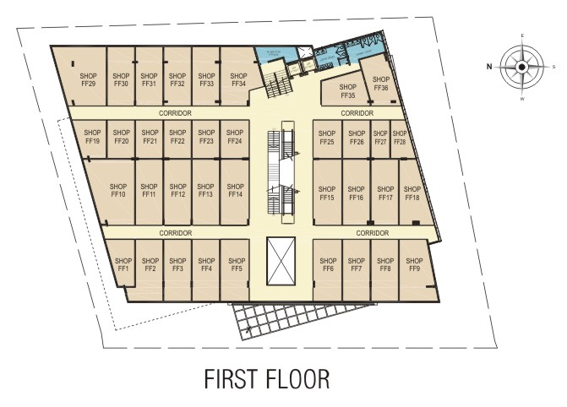
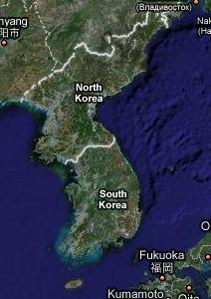
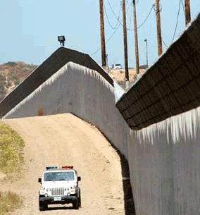
Applications: Special Case of Security Games

Slide 2
Given a team of robots, how should they plan their patrol paths along time to optimize some objective function?
How is the choice of optimal patrol influenced by
  Different robotic models
  Existence of an adversary
  Environment constraints
Multi-Robot Patrol – Main Questions

Slide 3
Repeatedly visit target area while monitoring it
  Area: linear, 2D, 3D, graph/continuous
Different objectives:
Multi-Robot Patrol – Problem Definition

Slide 4
Repeatedly visit target area while monitoring it
  Area: linear, 2D, 3D, graph/continuous
Different objectives:
Adversarial patrol: Detect penetrations
  Controlled by adversary
  [Paruchuri et al.][Amigoni et al.][Basilico et al.]…
Multi-Robot Patrol – Problem Definition

Slide 5
Repeatedly visit target area while monitoring it
  Area: linear, 2D, 3D, graph/continuous
Different objectives:
Adversarial patrol: Detect penetrations
  Controlled by adversary
  [Paruchuri et al.][Amigoni et al.][Basilico et al.]…
Frequency based patrol: Optimize frequency criteria
  [Chevalyere][Almeida et al.][Elmaliach et al.]…
Multi-Robot Patrol – Problem Definition

Slide 6
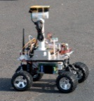
Existing frequency-based patrol algorithms are deterministic
  Therefore predictable
  Easy to manipulate by a knowledgeable adversary
Adversarial vs. Frequency-Based Patrol

Slide 7
Existing frequency-based patrol algorithms are deterministic
  Therefore predictable
  Easy to manipulate by a knowledgeable adversary
Adversarial vs. Frequency-Based Patrol
Not suitable for adversarial patrol

Slide 8
Take into account
  Robotic and environment model
  Adversarial environment
Goal
Find patrol algorithm that maximizes chances of detection
Agmon, Kaminka and Kraus. Multi-Robot Adversarial Patrolling: Facing a Full-
Knowledge Opponent, JAIR, 2011.
http://u.cs.biu.ac.il/~sarit/data/articles/agmon11a.pdf

Slide 9
Two Parties
Robots
k homogenous robots patrolling around the perimeter
Adversary
Adversary decides through which point to penetrate
  Depends on the knowledge it has on the patrol
Penetration time not instantaneous: t > 0 time units

Slide 10
Segmenting the Perimeter
Time units =
segments

Slide 11
Segmenting the perimeter
  Robot travels through one segment per time unit
Patrol Algorithm Framework

Slide 12
Segmenting the perimeter
  Robot travels through one segment per time unit
Choose at each time step the next at random
Directed movement model
  Turning around costs the system in time: τ time units
Patrol Algorithm Framework

Slide 13
Segmenting the perimeter
  Robot travels through one segment per time unit
Choose at each time step the next at random
Directed movement model
  Turning around costs the system in time: τ time units
At each time step:
  Go straight with probability p
  Turn around with probability 1-p
Characterizing the patrol: probability p of next move
Patrol Algorithm Framework

Slide 14
Segmenting the perimeter
  Robot travels through one segment per time unit
Choose at each time step the next at random
Directed movement model
  Turning around costs the system in time: τ time units
At each time step:
  Go straight with probability p
  Turn around with probability 1-p
Characterizing the patrol: probability p of next move
Patrol Algorithm Framework
Markovian modeling of the world

Slide 15
Segmenting the perimeter
  Robot travels through one segment per time unit
Choose at each time step the next at random
Directed movement model
  Turning around costs the system in time: τ time units
At each time step:
  Go straight with probability p
  Turn around with probability 1-p
Characterizing the patrol: probability p of next move
PPD : Probability of Penetration Detection
  Higher is better!
Patrol Algorithm Framework

Slide 16
Robots are placed uniformly along the perimeter
  Distance d = N/k between consecutive robots
Robots are coordinated
  If decide to turn around – do it simultaneously
Patrol Algorithm Framework – cont.

Slide 17
Robots are placed uniformly along the perimeter
  Distance d = N/k between consecutive robots
Robots are coordinated
  If decide to turn around – do it simultaneously
Robots maintain uniform distance throughout Patrol
Proven optimal in [ICRA’08,AAMAS’08]
Patrol Algorithm Framework – cont.

Slide 18
Calculate PPD for all segments
  Result: d PPD function of p
  Done in polynomial time using stochastic matrices
Find p such that target function is optimized
  Based on the PPD functions
  Target function depends on adversarial model
Two Steps Towards Optimality

Slide 19
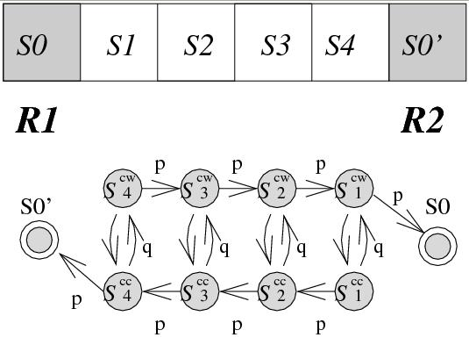
Need only to consider one sequence of d segments
  Homogenous robots, uniform distance, synchronized actions
  Everything is symmetric
PPDi = probability of arrival of some robot at segment Si
Probability of arriving at a segment – Markov chain
Calculating PPD functions

Slide 20


Slide 22
Need only to consider one sequence of d segments
  Homogenous robots, uniform distance, synchronized actions
  Everything is symmetric
PPD_{i} = probability of arrival of some robot at segment S_{i}
Probability of arriving at a segment – Markov chain
PPD_{i} is a function of p
Can be computed in polynomial time
  Using stochastic matrices
Calculating PPD functions

Slide 23
Create appropriate stochastic matrix
Compute M^{t}
Multiply by vector v_{i} = [0 0 0 0 1 0 0 0] to get PPD_{i}
The Algorithm
i^{th} location

Slide 24
Calculate PPD for all segments
  Result: d PPD function of p
  Done in polynomial time using stochastic matrices
Find p such that target function is optimized
  Based on the PPD functions
  Target function depends on adversarial model
Two Steps Towards Optimality

Slide 25
Calculate PPD for all segments
  Result: d PPD function of p
  Done in polynomial time using stochastic matrices
Find p such that target function is optimized
  Based on the PPD functions
  Target function depends on adversarial model
Two Steps Towards Optimality

Slide 26
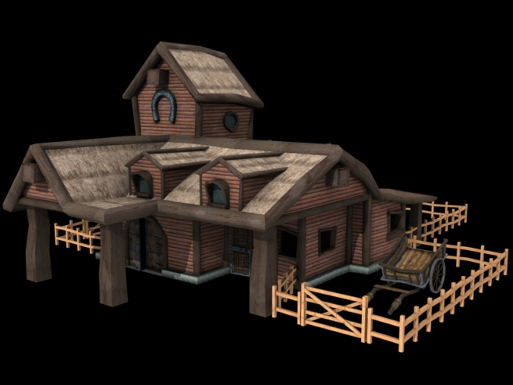
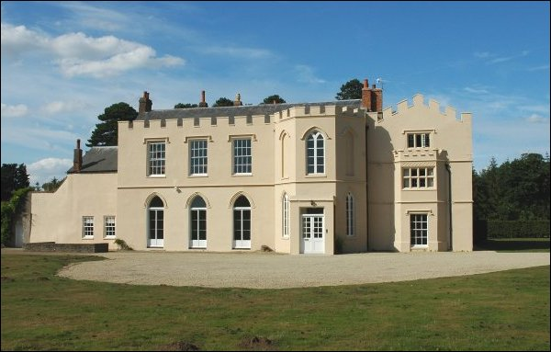
Compatibility of Algorithms to Adversarial Domain - Example
Adversary
Knowledgeable
No knowledge
Studies the system
Penetrates through weakest spot
Does not study the system
Not necessary a wise choice of
penetration spot

Slide 27
Based on adversarial knowledge:
How much does the adversary know about the patrolling robots?
Modeling Adversary Type
Full knowledge
Zero knowledge

Slide 28
Full Knowledge Adversary
Knows location of robots
Knows the patrol algorithm
Will penetrate through weakest spot
  Segment with minimal PPD
Goal: maximize minimal PPD
Optimal p calculated in polynomial time –
Maximin algorithm
Non determinism always optimal: p < 1
1-p
p

Slide 29
Find maximal point in integral intersection
Either intersection of curves, or local maxima
Maximin Algorithm
PPD_{i}(p)
PPD_{i}(p)
Time complexity: (N/k)⁴

Slide 30
Zero Knowledge (Random) Adversary
Knows only current location of robots
Choose penetration spot at random
  With uniform distribution
Goal: maximize expected PPD
Proven: optimal p = 1

Slide 31

Based on adversarial knowledge:
How much does the adversary know about the patrolling robots?
Modeling Adversary Type
Full knowledge
Zero knowledge

Slide 32

Based on adversarial knowledge:
How much does the adversary know about the patrolling robots?
Modeling Adversary Type
Full knowledge
Zero knowledge

Slide 33
Adversary might not know weakest spot
Can have some estimation:
  Choose from physical v-neighborhood of weakest spot
  Choose from several v weakest spots (v-min)
In Reality: Adversary Has Some Knowledge
PPD
PPD

Slide 34
If level of uncertainty -v- is known, can find optimal p
  In polynomial time
Other options: Heuristic algorithm
  MidAvg: Average between p values of full and zero knowledge
Calculating the Patrol Algorithm

Slide 35
In reality, when facing an adversary with some knowledge, what should we do?
Practically…
Run algorithm against full knowledge adversary
Run algorithm for uncertain adversary
Run heuristic solution

Slide 36
In reality, when facing an adversary with some knowledge, what should we do?
If theory doesn’t answer, run experiments!
Practically…
Run algorithm against full knowledge adversary
Run algorithm for uncertain adversary
Run heuristic solution

Slide 37
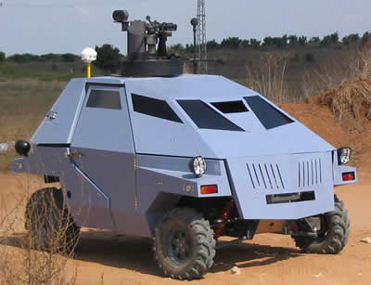

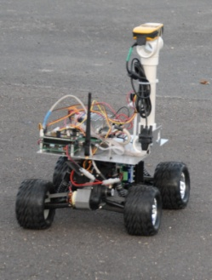
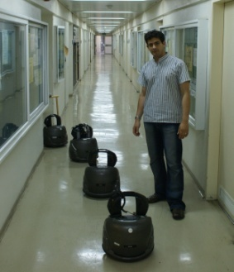
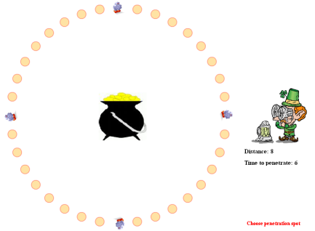
Comprehensive Evaluation

Slide 38
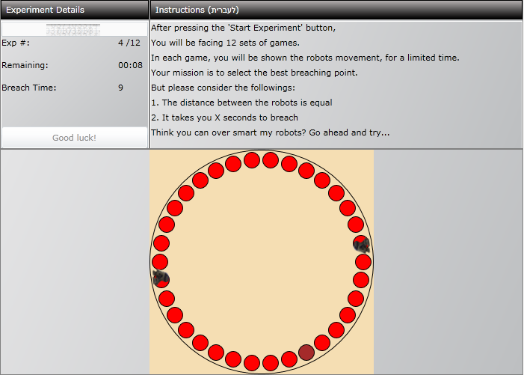
Humans play the adversary, against simulated robots
Player required to choose penetration segment
Check performance of different patrol algorithms
Three phases
The PenDet Game
Played by total of 253 people

Slide 39

Deterministic vs. Maximin in different amount of exposed information
Six sets of (d,t)
Phase 1

Slide 40
Phase 1 Results
t=penetration time
d= distance between robots

Slide 41
Phase 1 Results
t=penetration time
d= distance between robots

Slide 42
MidAvg, Maximin, v-Min, v-Neighborhood
60 seconds of observation phase
Two sets of d,t: (8,6), (16,9)
Phase 2

Slide 43
Phase 2 Results
t=penetration time
d= distance between robots

Slide 44
MidAvg, Maximin, v-Min, v-Neighborhood (same as phase 2)
Little exposed information, with multi-step training phase
Two sets of d,t: (8,6), (16,9)
Phase 3

Slide 45
Phase 3 Results
t=penetration time
d= distance between robots

Slide 46

In reality, when facing an adversary with some knowledge, what should we do?
Practically…
Run algorithm against full knowledge adversary
Run algorithm for uncertain adversary
Run heuristic solution

Slide 47
In reality, when facing an adversary with some knowledge, what should we do?
Have a good model of the adversary!!!
Practically…
Run algorithm against full knowledge adversary
Run algorithm for uncertain adversary
Run heuristic solution

Slide 48
Theory: Optimal algorithms for known adversary
  Full knowledge and zero knowledge [ICRA’08, IAS10, AAMAS’10]
  Adversary with some knowledge [AAMAS’08, IJCAI’09]
Practically: Do not assume the worst case (strongest adversary)
Future work:
  Develop additional adversarial models (some knowledge)
  Learn adversarial model and adjust to it
  Use of PDAs for evaluation [AAAI’11]
Patrol in Adversarial Environments

Slide 49
Contributions
New definition of Events
  Add utilities according to the robots actions
    Utility is time dependent
Three Event models
  Consider different time dependent utility and sensing
Compute optimal patrol strategy in polynomial time

Slide 50

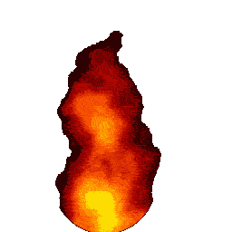
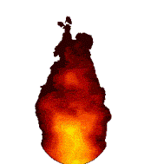


The Event
Event is local and can start at any time
  Applicable in detection of fire, gas/oil leaks, ...
Importance of detection during t time units
Event might evolve, which influences:
  Utility from detection
  Probability of detection
  (sensing)
GOAL:
Find patrol algorithm that maximizes utility

Slide 51
Optimal Patrol: Step by Step
Step 1: Determine expected utility
eud_{i} : Expected Utility from Detection
  At segment S_{i}
  A function of p
  Depends on:
    Probability of arrival at Si
    Sensing capabilities
    Relative time of detection at Si
Step 2: Determine optimal patrol
  Depends on adversarial model
Three Event models

Slide 52
Step 1: Three Models of Events
Utility is time dependent
  Earlier detection grants higher utility
Utility and local sensing is time dependent
  Earlier detection grants higher utility
  Evolved event easier to be sensed (higher probability)
Utility time dependent and can sense from distance
  Earlier detection grants higher utility
  Evolved event easier to be sensed (higher probability)
  Evolved event can be sensed from distant location
eud_{i}

Slide 53
② Time Dependent Utility/Sensing
  eud_{i} =
  Prob. of detecting the event in S_{i} X Utility from detection
  Probability of detecting the event =
  Probability of visiting and sensing
  Calculate the probability of all visits to the segment
    Visit considered with respect to the relative time of event:
      First visit in times 1,…,t
      Second visit in times 2,…,t
      ….

Slide 54
Calculating Probability of Visit
System represented as a Markov chain
Calculate all possible visits to a segment
  At all times 1…t

Slide 55
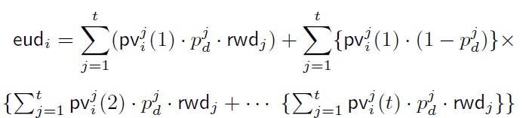
Calculating the Expected Utility
Dynamic programming inspired algorithm
Output: pv_{i} ^{j}(m): m’th visit at time j to segment S_{i}
Substitute pv_{i} ^{j}(m) in the equation of eud_{i}
Calculated in polynomial time: O(d²t³)
c
p
p
1cc
2cc
0cc
q
q
q
p
p
1cw
2cw
0cw
1cw | 1cc | 2cw | 2cc | 0cw | 0cc
 |  | 1
 |  |  | (1-p) | p
p² | p(1-p) | (1-p)² |  |  | pq
c
c
c²

Slide 56
Step 2: Determine Optimal Patrol
Worst case guarantees
  Modeled by full-knowledge adversary
  Maximize minimal eud
Average guarantees
  Modeled by zero-knowledge adversary
  Assume event can happen anywhere at random
  Maximize average eud

Slide 57
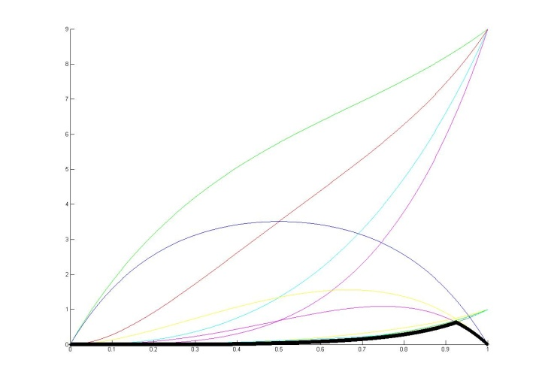
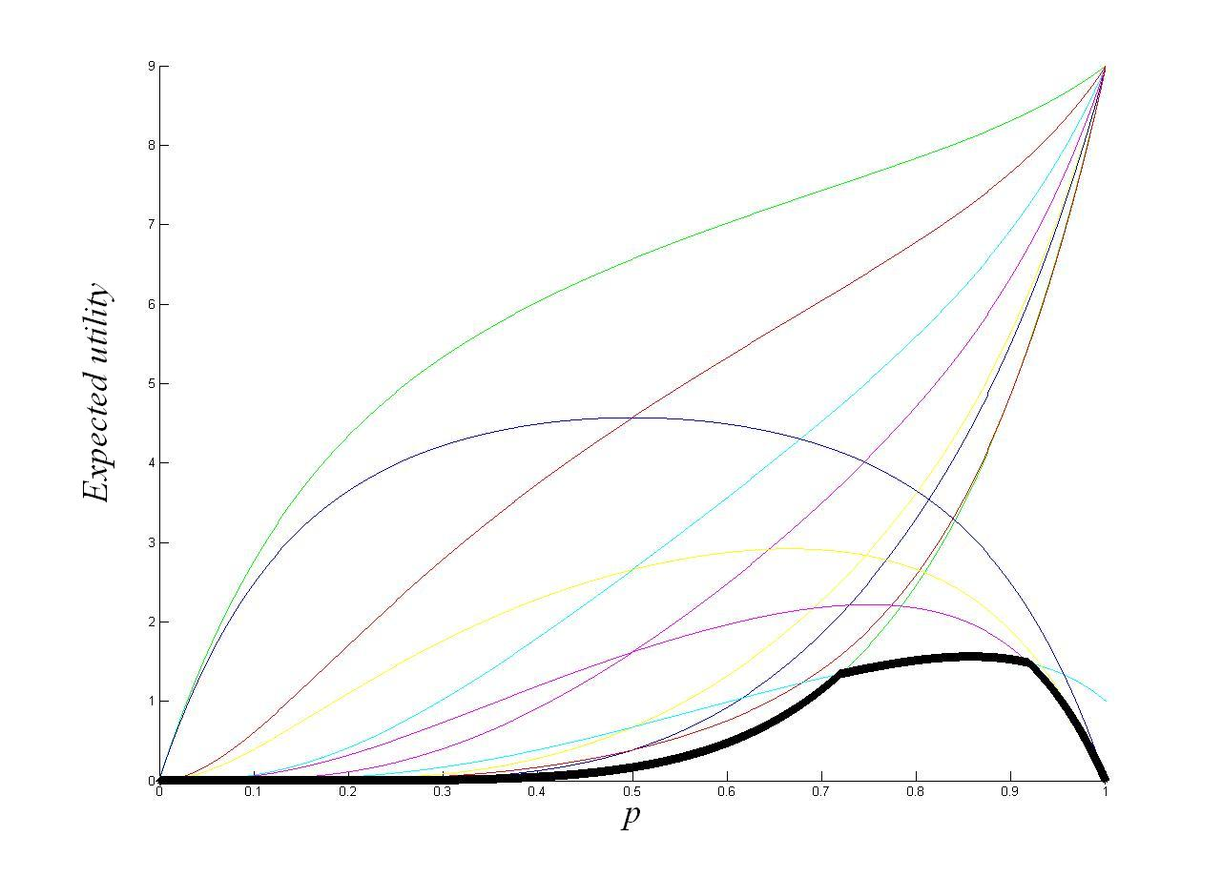
Optimality of Patrol – Worst Case Guarantees
Use variation of the Maximin algorithm [ICRA’08]
Finds maximal point in lower envelope of eud_{i} functions
Sometimes optimal patrol is indifferent to utility function
  When t is relatively small compared to d
Rwd={9,9,9,9,1,1,1,1,1}
d = 12, t = 9
Rwd={9,9,9,9,9,9,9,9,1}
Expected utility

Slide 58
Optimality of Patrol – Average Case Guarantees
Model ①
  Simple deterministic algorithm optimal
  Similar to the case where there is no utility
  Intuition: Utility does not add motivation to revisit a segment
Model ②
  Revisiting might be beneficial for detection
  However… Determinism still optimal
Model ③
  Determinism not optimal if robot can sense event from long distance

Slide 59
Summary
Introducing a new Event model
Utility and sensing is time-dependent
Polynomial-time algorithms for deciding optimal behavior
Utility does not always influence optimality
Future :
  Heterogeneous environments
  Various graph environments
  More event models

