Slide 1


Human-Agent Decision-making: Combining Theory and
Practice
Sarit Kraus
Bar-Ilan University
sarit@cs.biu.ac.il

Slide 2
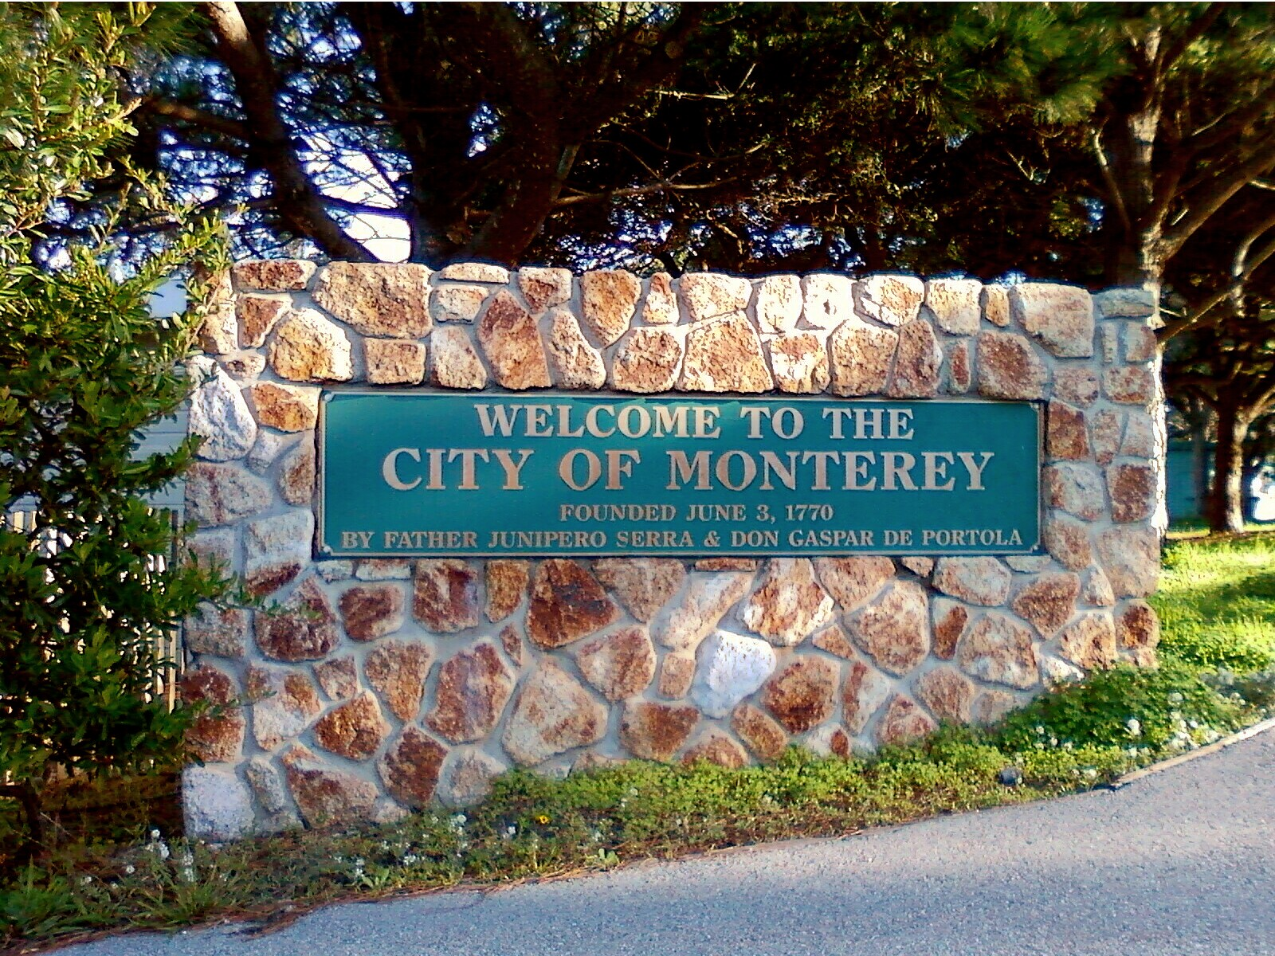

Slide 3
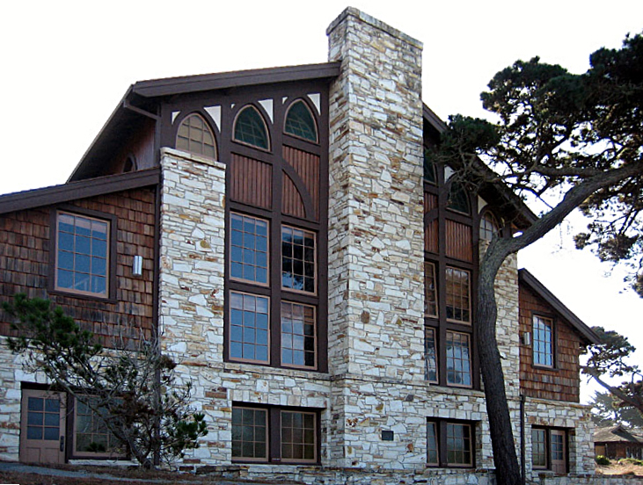

Slide 4

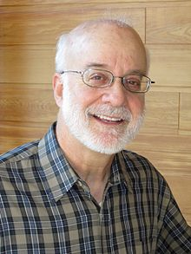

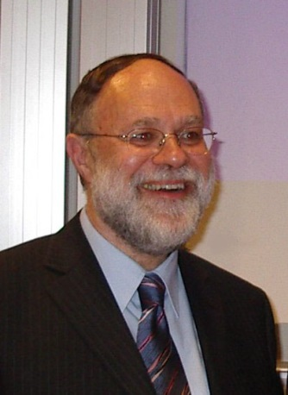

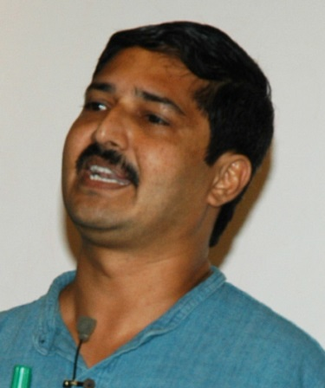
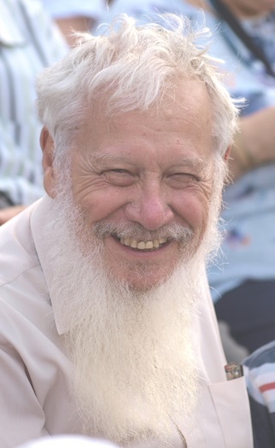
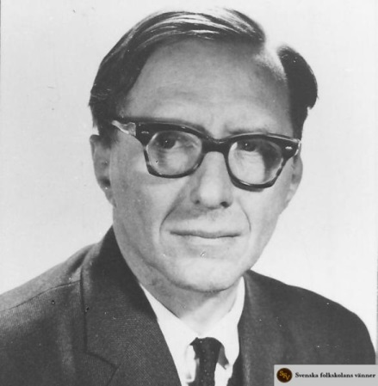
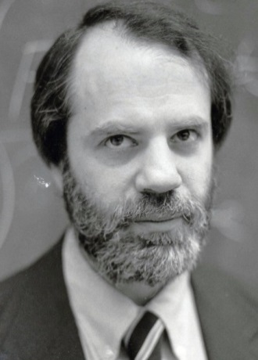
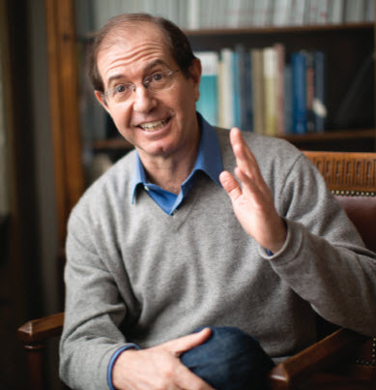
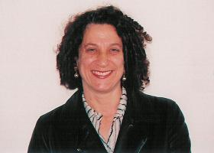
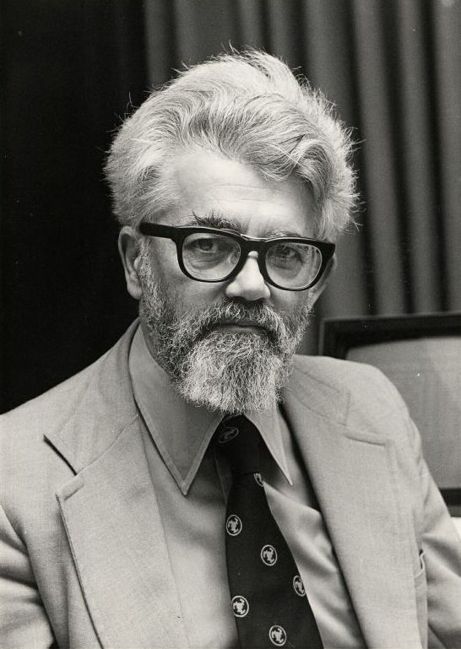
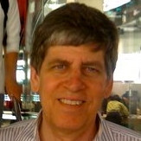

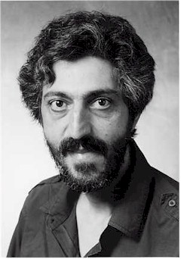
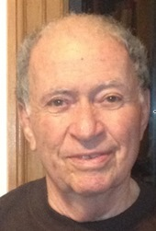

Slide 5
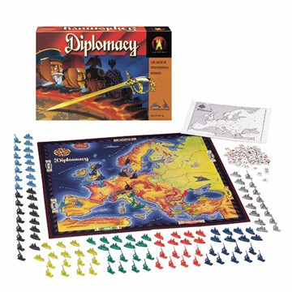

Slide 6
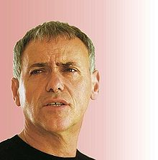
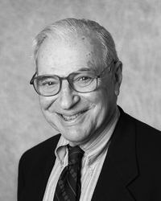

Slide 7

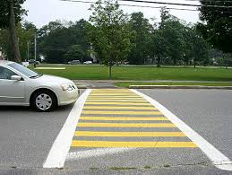
Pedestrian
Cross
 | 1,1 | 2,6
 | -1,2 | -100, -1000000
Stop
Driver
Stop
Cross

Slide 8

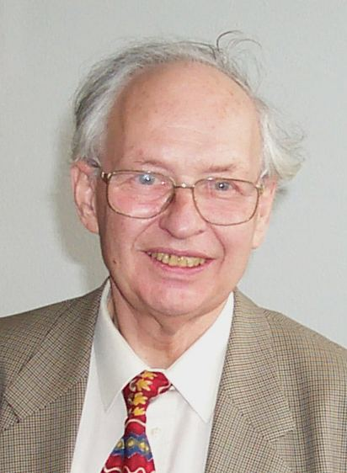
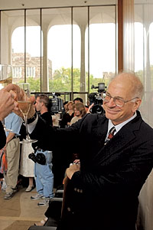
People often follow “suboptimal” decision strategies
Irrationalities attributed to
  sensitivity to context
  lack of knowledge of own preferences
  the effects of complexity
  the interplay between emotion and cognition
  the problem of self control

Slide 9



Fishing Dispute
Multi-issue Negotiation
Outcomes
TAC Limit Season Opt Out Status Quo
World State Parameters
Canada subsidizes Spain reduces Canada imposes Spain imposes ships Pollution Trade Sanctions Trade Sanctions
Hoz-Weiss, Wilkenfeld, Andersen, Pate

Slide 10
Any Player gives an offer
Alternating offers negotiation model
Other Player respond
One rejects, one opts All accept
no one opts out
Negotiation moves END END
to next time period Conflicting Offer Implemented
outcome results

Slide 11
The Automated Negotiator Agent
The agent plays the role of one of the countries.
During the negotiation the agent
  receives messages,
  analyzes them
  responds.
  It also initiates a discussion on one or more parameters of the agreement.
It takes actions when needed.

Slide 12
EQ Agent
Formal strategic negotiation theory:
The agent is based on the a bargaining model. By backward induction the agent builds the strategy to be reached at each time period according to the sequential equilibrium
The agent played very badly against humans
Heuristics

Slide 13
Heuristics
Agreements – may agree to worse agreements than in EQ.
Concession strategy.
Opting out—estimates if the opponent will opt out and may opt out.
Full offers/partial offers; First offer?

Slide 14
Experiments Results

Slide 15
Fishing Dispute: Conclusions
EQ agents does not work.
Our EQH agent played well and fair against a human player.
It raised the sum of the utilities in the simulation it was involved in.
The agent played as Spain significantly better than a human did, and just as good as a human Canada player.
Submitted to AIJ in 2002; revised and accepted 2007

Slide 16
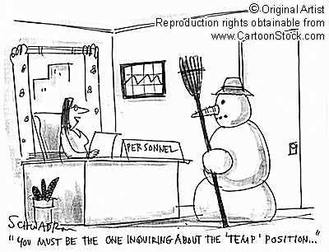
Multi-issue negotiation (cont)
Employer and job candidate
  Objective: reach an agreement over hiring terms after successful interview
  Subjects could identify with this scenario

Slide 17


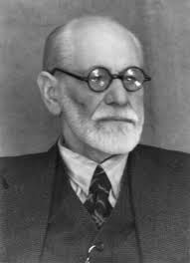
Why not Only
Behavioral Science Models?
There are several models that describe human decision making
Most models specify general criteria that are context sensitive but usually do not provide specific parameters or mathematical definitions

Slide 18
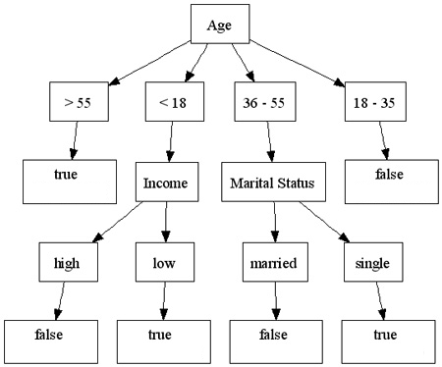
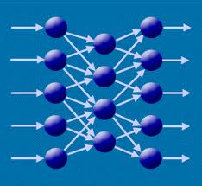
Why not Only
Machine Learning?
Machine learning builds models based on data
It is difficult to collect human data
  Collecting data on a specific user is very time consuming.
  Human data is noisy
“Curse” of dimensionality
Notes:
קללת ריבוי המימדים

Slide 19
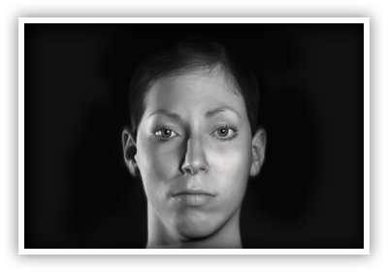
Methodology
  Human behavior models
  Data
  (from specific culture)
machine learning
  Human specific data
Optimization
methods
Human Prediction Model
Take action

Slide 20
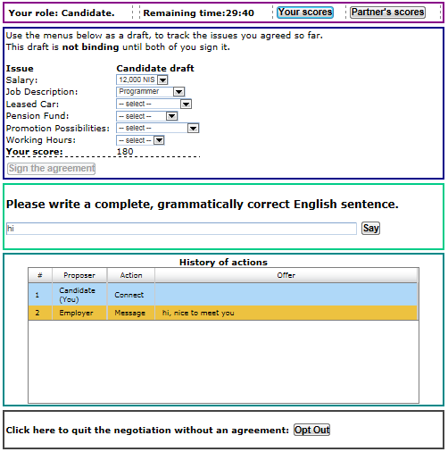
Chat-Based
Negotiation
General opponent modeling+ Optimization

Slide 21

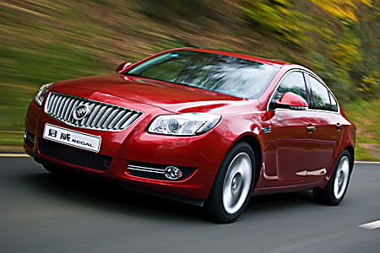
Sustainability: Reducing Fuel Consumption
Notes:
Fun; advise to be sustainability

Slide 22
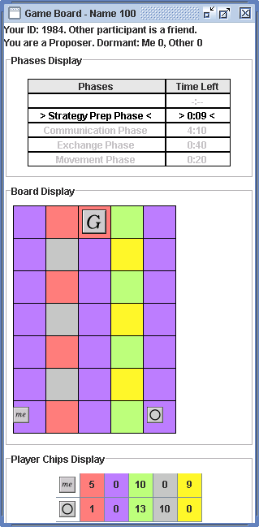
Interleaving Negotiations and actions: Color Trails (CT)
An infrastructure
for agent design,
implementation
and evaluation for open
environments
Designed with Barbara
Grosz (AAMAS 2004)

Slide 23
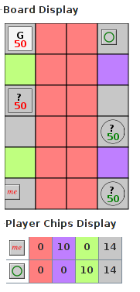
Revelation games
Combine two types of interaction
Signaling games (Spence 1974)
  Players choose whether to convey private information to each other
Bargaining games (Osborne and Rubinstein 1999)
  Players engage in finite horizon
  multiple negotiation rounds
Example: Job interview
Noam Peled; Kobi Gal

Slide 24
Perfect Equilibrium (PE) Agent
Solved using Backward induction.
No signaling.
Counter-proposal round (selfish):
  Second proposer: Find the most beneficial proposal while the responder benefit remains positive.
  Second responder: Accepts any proposal which gives it a positive benefit.

Slide 25
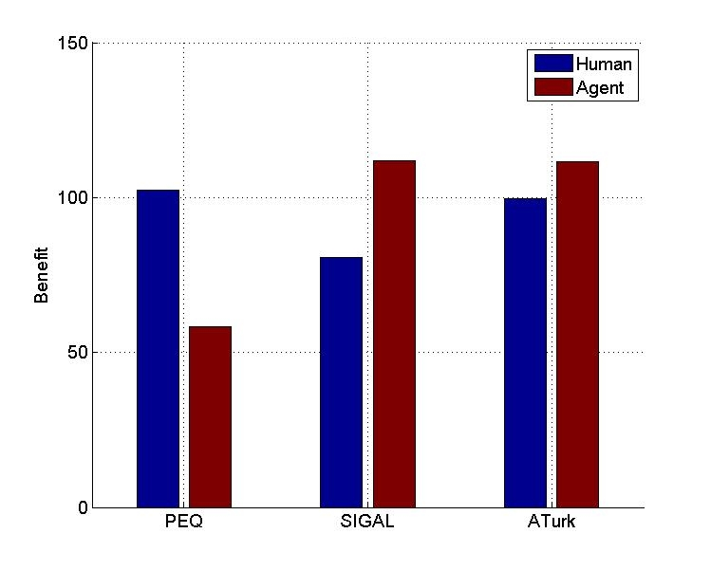
Performance of PEQ agent
130 subjects

Slide 26
Methodology
  Human behavior models
  Data
  (from specific culture)
machine learning
  Human specific data
Optimization
methods
Human Prediction Model
Take action

Slide 27
SIGAL Agent
Learns from previous games of other people.
Predict the acceptance probability for each proposal using Logistic Regression.
Models human as using a weighted utility function of:
  Humans benefit
  Benefits difference
  Revelation decision
  Benefits in previous round

Slide 28
Performance
General opponent* modeling improves agent negotiations

Slide 29



CT Game
100 point bonus for
getting to goal
10 point bonus for each chip left at end of game
Agreement are not enforceable
Collaborators: Gal, Haim, Gelfand
29
Notes:
if I

Slide 30
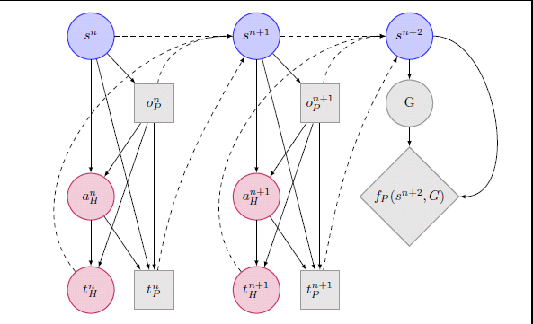
An Influence Diagram-
Two rounds interaction
Probability of acceptance
Probability of transfer
Notes:
Decisions for PAL are represented by decision nodes (gray rectangles).
Dashed edges represent information that is used to update the state at each round.

Slide 31
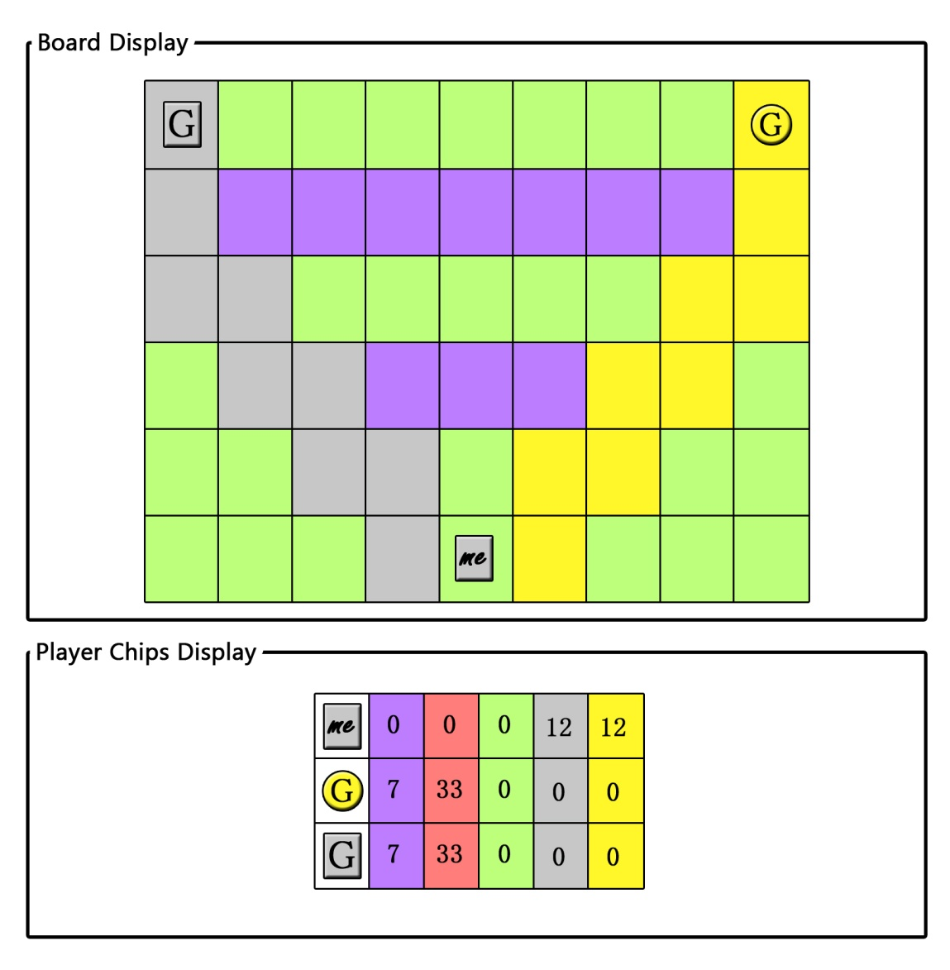
The Contract Game
Main parts:
  negotiation
  movement
Incomplete information
Automatically exchange
Game ends:
  The CS reached one of the SPs
  Did not move for two
  consecutive rounds
Collaborators: Gal, Haim, An

Slide 32



Negotiation
Odd Rounds ➔
Accept/Reject????
To which SP to propose???
Which proposal to propose???
⬅ Even Rounds

Slide 33
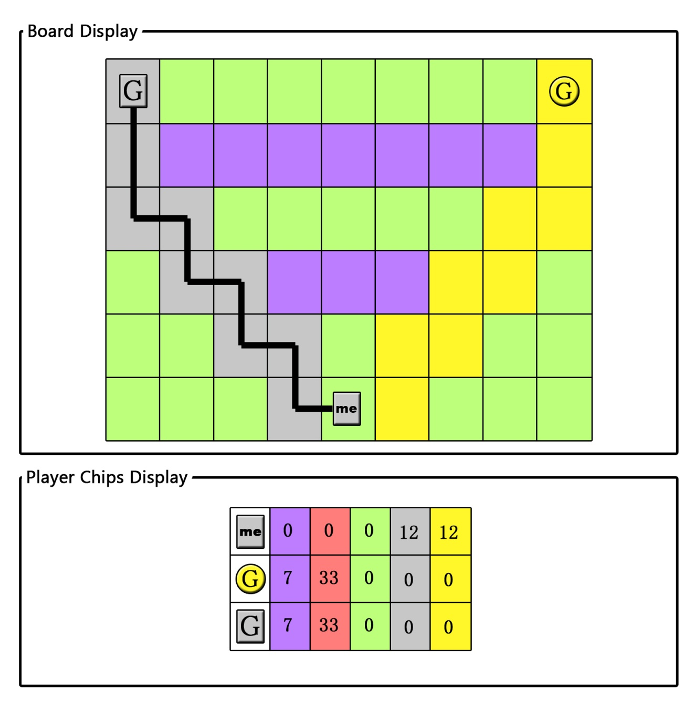
Movement
150 points bonus:
both the CS and the SPg
5 points: for each chip left
Only the CS can move
Chip with the same square-color
Visible movements
Path to goal
More than one square

Slide 34
The Challenge:
Building an Agent that Can Play One of the Roles with People
Sub-Game Perfect Equilibrium
Machine Learning + Human Behavior

Slide 35

Sub-Game-Perfect-Equilibrium Agent
Commitment offer: bind the customer to one of the SP for the duration of the game
Example:
CS proposes 11 grays for
33 red and 7 purple chips

Slide 36

Extensive Empirical Study:
Israel, U.S.A and China
530 students:
  Israel: 238 students
  U.S.A: 149 students
  China: 143 students
Baseline: 3 human players
One agent vs 2 human players
Lab conditions
Instructions in the local language:
  Hebrew, English and Chinese

Slide 37
EQ CS Player’s Performance

Slide 38
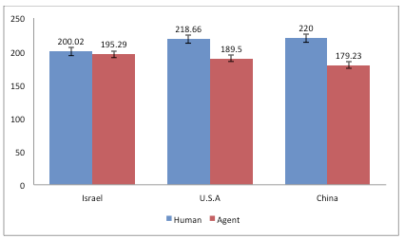
EQ SPy Player’s Performance

Slide 39
Human are Bounded Rational:
Do not Reach the Goal

Slide 40
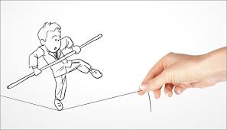
SPy EQ Agent Improvement
Assumption
– When a human player attempt to go to the goal, there is some probability p that he will fail
Risk-Averse Agent
– With respect to probability failure

Slide 41
Risk Averse Agent Results

Slide 42
Negotiation Agents Status
Multi-issue negotiation: general opponent modeling+ Optimization
Interleaving bargaining and actions in CT: sometimes EQ agents are beneficial; usually general opponent modeling+ optimization works

Slide 43

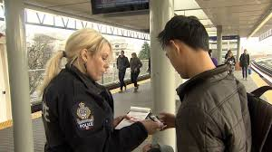
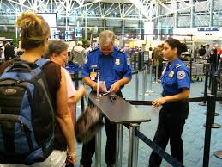
Automated Agents that Interact Proficiently with Adversaries

Slide 44
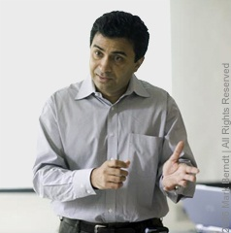
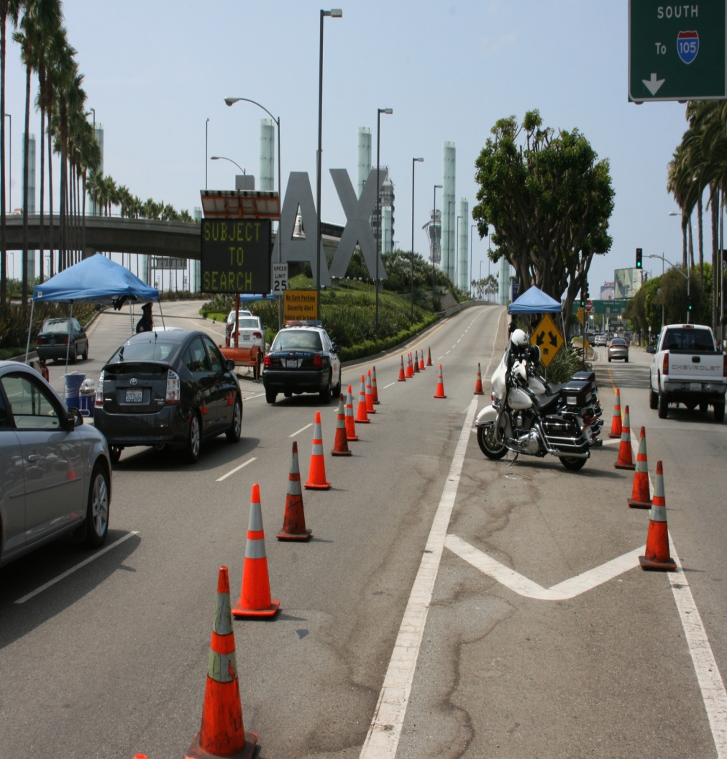
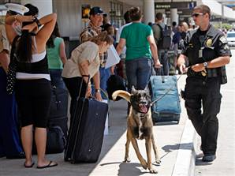
ARMOR: Deployed at LAX 2007
“Assistant for Randomized Monitoring Over Routes”
  Problem 1: Schedule vehicle checkpoints
  Problem 2: Schedule canine patrols
Randomized schedule: (i) target weights; (ii) surveillance
ARMOR-Checkpoints
ARMOR-K9

Slide 45

Stackelberg security games (SSGs): defender vs adversary
Defender’s optimal randomized strategy
Adversary
 | Terminal #1 | Terminal #2
Terminal #1 | 5, -3 | -1, 1
Terminal #2 | -5, 5 | 2, -1
Police
Notes:
P=3/13 ; q=3/5

Slide 46
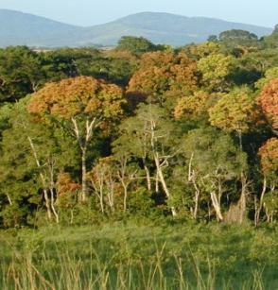
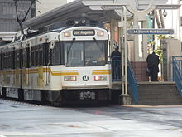
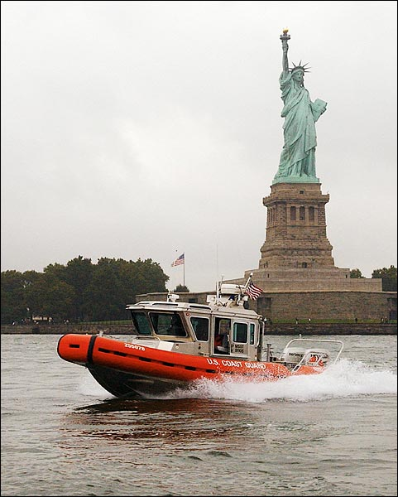
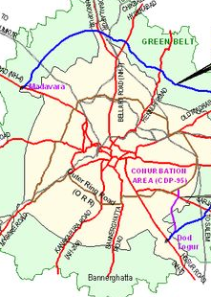


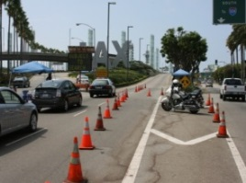
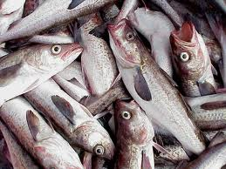
Environment
Trains
Ports
Roads
Flights
Airports
2007 2009 2011 2012 2013 2014
2007 2009
ARMOR
IRIS
PROTECT
TRUSTS
PAWS
Notes:
these applications have changed the way these agencies operate

Slide 47
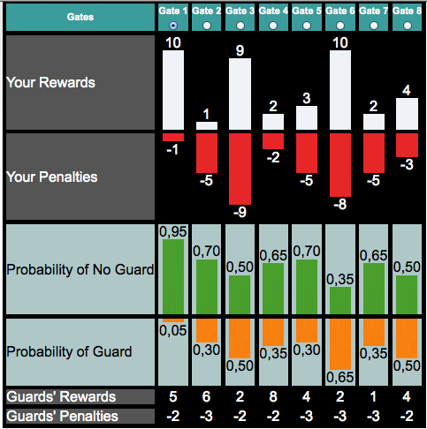
LAX Based Game
Stackelberg security games
  Defender (rational)
    Commit to a strategy first
  Adversary (bounded rational)
    Observe defender’s strategy
    Attack one of targets
Game Interface
Notes:
In SSGs, there is a rational defender attempting to optimally allocate her limited resources to protect a set of important targets and an adversary who tries to attack one of such targets. The key assumption of SSGs is that the defender has to commit to a strategy first and the adversary can observe that strategy and make his decision of attacking based on his observation. In this study, the adversary will respond non-optimally or boundedly-rational.
The SSGs can be represented as the follows: The payoffs for the defender and adversary depends on which target is attacked and whether that target is protected by the defender or not. For example, if the adversary attacks target t, he will receive a reward R_t^a if the defender is not protecting that target, otherwise, he will receive a penalty P_t^a. Conversely, the defender will receive a penalty P_t^d in the formal case and a reward R_t^d in the latter case.
In our experimental settings, we assume that the adversary has the full observation about the defender strategy. Specifically, each human subject who act as an adversary in our experiments can observe the security game as shown in the figure on the right hand side. Thus, in each game, the adversary can observe the defender’s strategy in terms of her coverage probability at each target, the reward and penalty of both the defender and the adversary. The adversary will make decision of which target to attack based on this observation. For example, as shown in the figure, the defender’s coverage probability at target 8 is 50%. If the adversary attacks this target, he will receive a reward 4 points if the defender is not protecting this target, otherwise, he will receive a penalty -3.

Slide 48
Agents-Human Interaction Status
Multi-issue negotiation: general opponent modeling+ Optimization
Interleaving bargaining and actions in CT: sometimes EQ agents are beneficial; usually general opponent modeling+ optimization works
Security games: successful deployment of Stackelberg EQ agents in the field

Slide 49
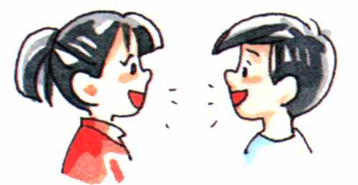


Past deliberations accumulative data
Providing Arguments in Discussions Based on the Prediction of Human Argumentative Behavior
Should performance enhancing
drugs be allowed?
Current deliberation
Update
Capital punishment?
Trial by jury?
Agent
Offer arguments
Vaccinations?
Collaborator: Ariel Rosenfeld
= Obtains information
Notes:
Semantic independent

Slide 50
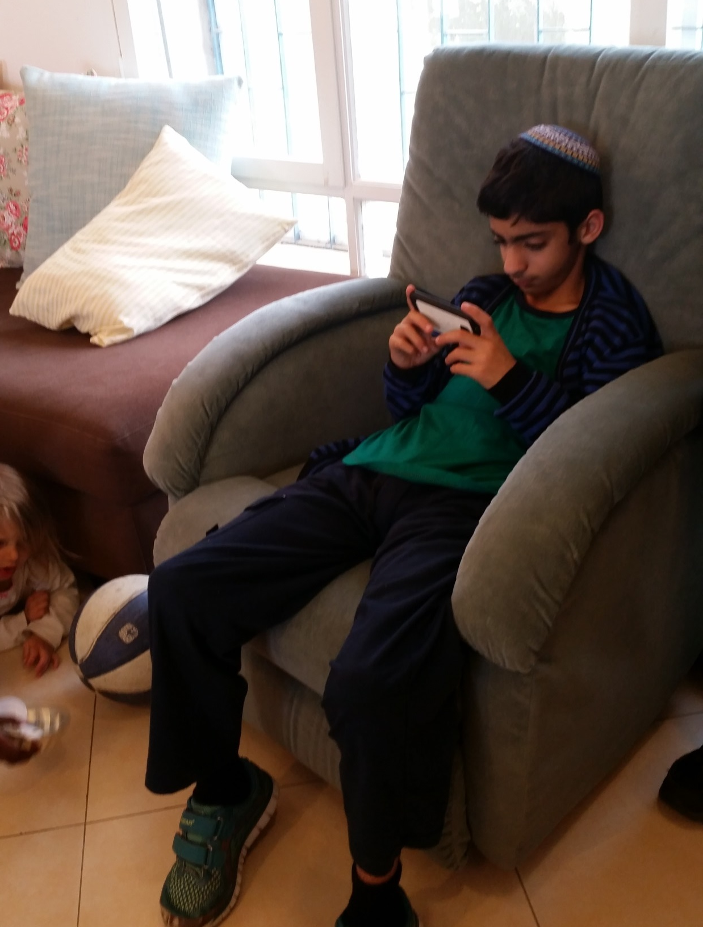

Slide 51

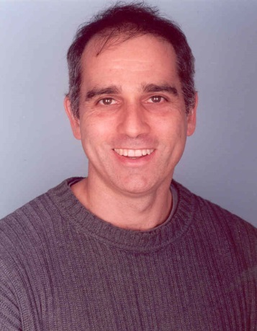




Argumentation Theory?
Extensions?
Validity values?
Justification value?
People do not reason logically.
People differ in their
argumentation choices.
There is temporal nature of
argumentation.
Dung
Wyner
Reed
Cayrol
Parsons
Giacomin
Notes:
כשהתחלתי את המחקר מאד הייתי נלהב מהתיאוריה, ורציתי לעשות עבודה פורמלית. קראתי המוני מאמרים –
אתם יודעים כמה יש שם.
האמנתי שמהתיאוריה יצאו היכולות לסוכנים, ולצערינו אנשים לא מדיינים כך.
לפני שהתחלתי לבנות את הסוכנים הייתי חכם מספיק לעשות ניסוי וגיליתי שיש בעיה.
הניסוי הראשון היה מלאכותי, ושם אנשים לא דיינו הגיוני. חשבנו שאולי זה בגלל המצבים המלאכותיים.
אז ניסינו בשיחות מתומללות – וגם בהן זה לא עבד, התיאויה הסבירה מעט מאד.
(לא להיכנס לפרטים טכנים – מה בדקנו)
רצינו להשתמש בלמידת מכונה, ורצינו לבדוק האם אפשר לשלב את ארגומנטציה בפרדיקציה
השתמשנו במבנה של המודל – המודל הפורמלי לסוכן
התיאוריה לא עזרה לי להסביר, אבל כן מהווה את הבסיס למודל של הסוכן ולפוליסי. בנוסף השתמשנו בחישובים מתירואיה בפיצרים
להראות את הדוגמא

Slide 52

Argumentation Theory?
Data Collection of 6 fictional Cases
64 participants from Amazon Turk;
  age average: 38.5
  21 females; 17 males
  3 with Phd

Slide 53

Argumentation Theory?
SUV
-0.23
Safe
8%
Too expensive
35%
High taxes
Taking a loan
Taking a loan
-0.33
33%
High interest
24%
Arvapally et al, 2012
Notes:
We can take a loan
Loans from the bank has a high interest so it is not a good idea. 0 of the leaves; Take a loan - -0.33

Slide 54



Argumentation Theory?
Transcription of Real Discussions
Penn TreeBank Project (1995) conversation database:
  CAPITAL PUNISHMENT (33)
  TRIAL BY JURY (31)
Percentage of arguments from extensions
less than 45%
Notes:
15 topics

Slide 55
Argumentation Theory is not a good predictive of human behavior
Fictional cases from the literature (142)
Transcription of real discussions (64*2 )
Students “chat” (72*2 subjects)
SUV
Safe
Too expensive
8%
High taxes
Taking a loan
33%
Taking a loan
24%
35%
High interest

Slide 56
Prediction of Argument Choice
Features:
  Justification
  Psychological features.
  Deliberation-based features (from the history of the current deliberation)
  Relevance
SUV
Safe
Too expensive
High taxes
Taking a loan
High interest

Slide 57

Predictions the Argument
Given 5 choices of a player, calculate the average of each feature, and predict the 6th one.
Notes:
72% accuracy if past decisions are available.
Random offers 25% accuracy.
Majority choice provided 42%.
The performance improves as more answers are available.

Slide 58

Capital Punishment

Slide 59

Recommendation Policies
How should the suggestions be presented?
Should we suggest the predicted arguments?
How to maintain a good hit-rate while offering novel arguments?
What will be beneficial for each user?
Notes:
האם מה שלמדנו על הפיצרים ועל הפרדקציה, האם זה יכול לעזור לנו לתת הצעות

Slide 60

Agents
Influenza Vaccinations
Prediction [17 chats]
Relevant [17 chats]
Weakly related [17 chats]
Prediction (2) + Relevant (1) [17 chats]
Argumentation Theory [17 chats]
Silent [17 chats]
Random [17 chats]
  204 participants overall.

Slide 61
Normalized Acceptance Rate
Prediction + Relevant selections distribution:
  65% prediction, 35% relevant.
Notes:
הבדל לא סגניפיקנט בין פרדיקציה+קרוב לעומת רק קרוב

Slide 62
User Satisfaction
Prediction and Relevant agents outperform Weakly related/Random agents.
Their combination seems to be even better.

Slide 63
Agents-Human Interaction Status
Multi-issue negotiation: general opponent modeling+ Optimization works
Interleaving bargaining and actions in CT: sometimes EQ agents are beneficial; usually general opponent modeling+ optimization works
Deliberations: Argumentation theory can’t predict people’s arguments; prediction+ heuristics works
Security games: successful deployment of Stackelberg EQ agents in the field

Slide 64
Challenge
The lack of good theoretical foundation for human-agent interactions yields the need to start each application from scratch
Can we do better?

