Slide 1
Agents that negotiate proficiently with people Sarit Kraus Bar-Ilan University University of Maryland
sarit@umiacs.umd.edu
http://www.cs.biu.ac.il/~sarit/

Slide 2
Main Points
Agents negotiating with people is important
General opponent* modeling:
machine learning
human behavior model

Slide 3
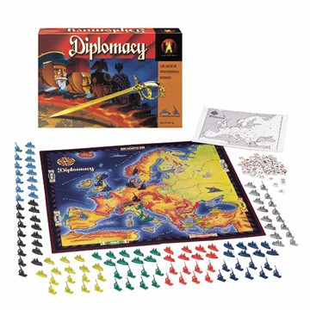
3

Slide 4

Culture sensitive agents
The development of standardized agent to be used in the collection of data for studies on culture and negotiation
Buyer/Seller agents negotiate well across cultures
Simple Computer System

Slide 5
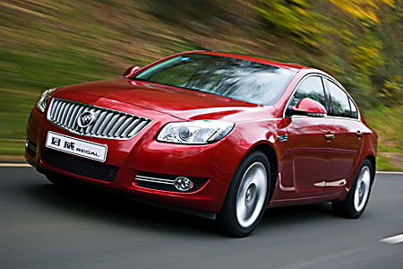
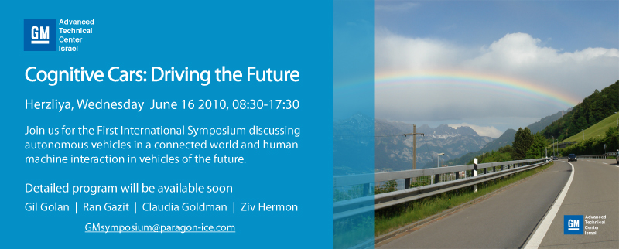

Semi-autonomous cars

Slide 6
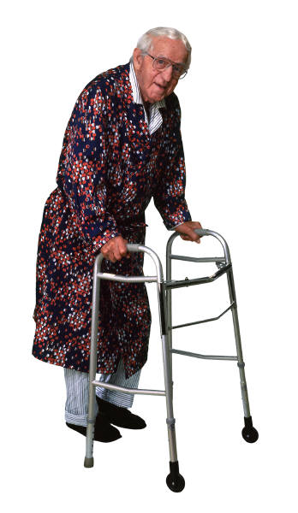

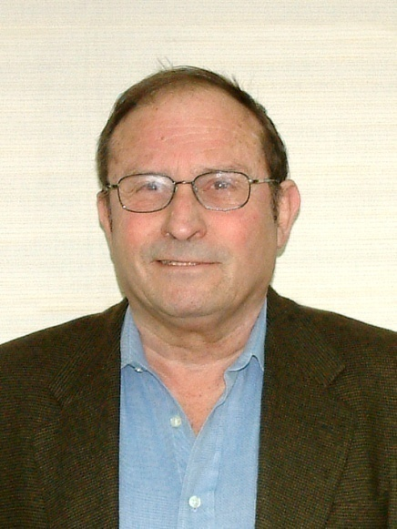
Medical applications
Gertner Institute for Epidemiology and Health Policy Research

Slide 7
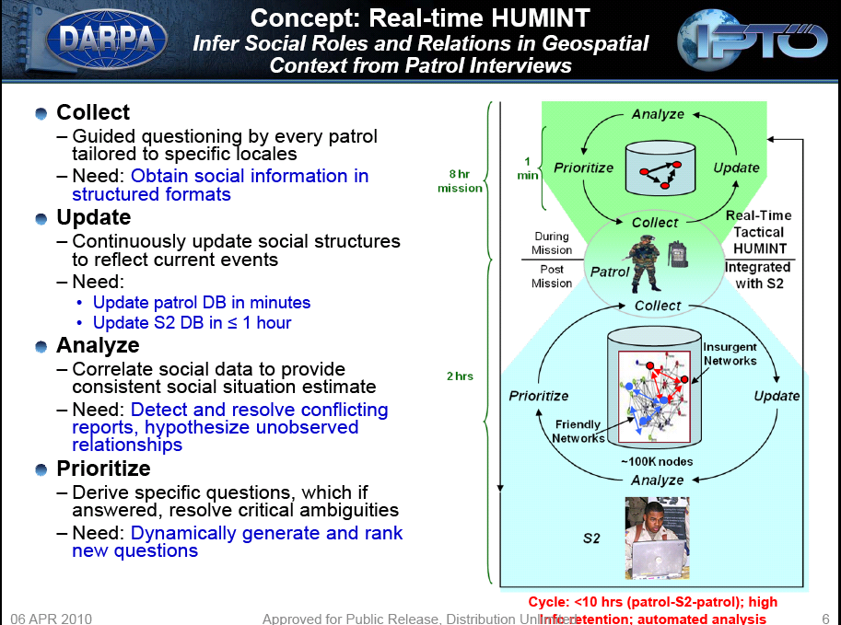
Security applications
Collect
Update
Analyze
Prioritize

Slide 8
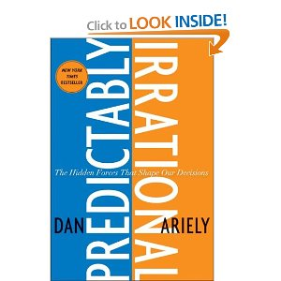
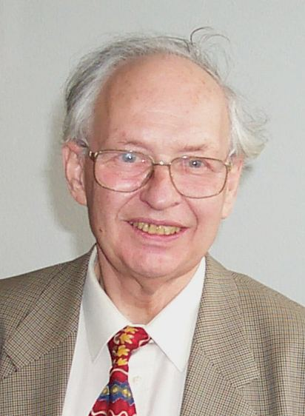
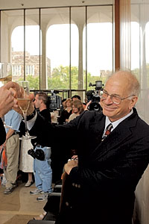
People often follow suboptimal decision strategies
Irrationalities attributed to
sensitivity to context
lack of knowledge of own preferences
the effects of complexity
the interplay between emotion and cognition
the problem of self control

Slide 9
Why not equilibrium agents?
Results from the social sciences suggest people do not follow equilibrium strategies:
Equilibrium based agents played against people failed.
People rarely design agents to follow equilibrium strategies
9

Slide 10
Why not behavioral science models?
There are several models that describes people decision making:
Aspiration theory
These models specify general criteria and correlations but usually do not provide specific parameters or mathematical definitions

Slide 11
Task
The development of standardized agent to be used in the collection of data for studies on culture and negotiation

Slide 12
KBAgent [OS09]
Multi-issue, multi-attribute, with incomplete information
Domain independent
Implemented several tactics and heuristics
qualitative in nature
Non-deterministic behavior, also via means of randomization
Using data from previous interactions
No previous data
Y. Oshrat, R. Lin, and S. Kraus. Facing the challenge of human-agent negotiations via effective general opponent modeling. In AAMAS, 2009

Slide 13
QOAgent [LIN08]
Multi-issue, multi-attribute, with incomplete information
Domain independent
Implemented several tactics and heuristics
qualitative in nature
Non-deterministic behavior, also via means of randomization
R. Lin, S. Kraus, J. Wilkenfeld, and J. Barry. Negotiating with bounded rational agents in environments with incomplete information using an automated agent. Artificial Intelligence, 172(6-7):823–851, 2008

Slide 14
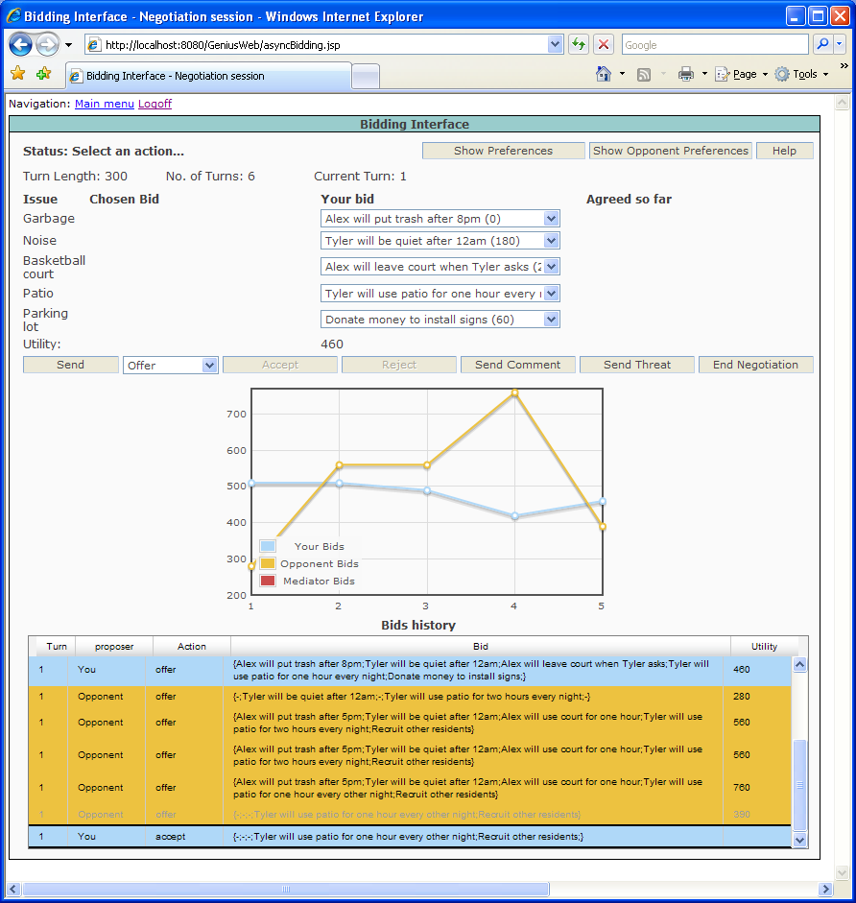
GENIUS interface
R. Lin, S. Kraus, D. Tykhonov, K. Hindriks and C. M. Jonker.
Supporting the Design of General Automated Negotiators.
In ACAN 2009.

Slide 15
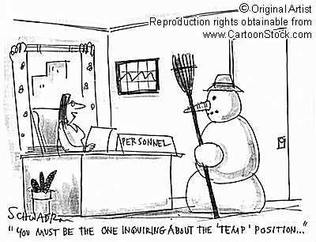
Example scenario
Employer and job candidate
Objective: reach an agreement over hiring terms after successful interview
Subjects could identify with this scenario
Culture dependent scenario

Slide 16

Cliff-Edge [KA06]
Repeated ultimatum game
Virtual learning and reinforcement learning
Gender-sensitive agent
Too simple scenario; well studied
R. Katz and S. Kraus. Efficient agents for cliff edge environments with a large set of decision options. In AAMAS, pages 697–704, 2006

Slide 17
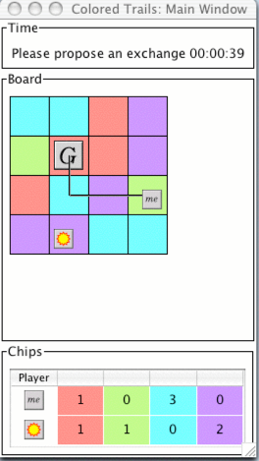
Color Trails (CT)
An infrastructure for agent design, implementation and evaluation for open environments
Designed with Barbara Grosz (AAMAS 2004)
Implemented by Harvard team and BIU team

Slide 18
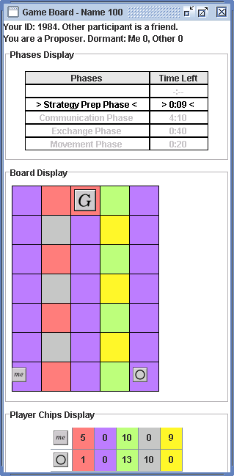
CT game
100 point bonus for getting to goal
10 point bonus for each chip left at end of game
15 point penalty for each square in the shortest path from end-position to goal
Performance does not depend on outcome for other player
18
Notes:
if I

Slide 19
Colored Trails: Motivation
Analogue for task setting in the real world
squares represent tasks; chips represent resources; getting to goal equals task completion
vivid representation of large strategy space
Flexible formalism
manipulate dependency relationships by controlling chip and board layout.
Family of games that can differ in any aspect
Perfect!!
Excellent!!
19

Slide 20
Social Preference Agent [Gal 06].
Learns the extent to which people are affected by social preferences such as social welfare and competitiveness.
Designed for one-shot take-it-or-leave-it scenarios.
Does not reason about the future ramifications of its actions.
No previous data; too simple protocol
Y. Gal and A. Pfeffer. Predicting People's Bidding
Behavior in Negotiation , AAMAS 2006.

Slide 21
Multi-Personality agent [TA05]
Estimate the helpfulness and reliability of the opponents
Adapt the personality of the agent accordingly
Maintained Multiple Personality– one for each opponent
Utility Function
S. Talman, Y. Gal, S. Kraus and M. Hadad. Adapting to Agents' Personalities in Negotiation, in AAMAS 2005.

Slide 22
CT Scenario [TA05]
Agent & human
2
4 CT players (all automated)
Multiple rounds:
negotiation (flexible protocol),
chip exchange,
movements
Incomplete information on others’ chips
Agreements are not enforceable
Complex dependencies
Game ends when one of the players:
reached goal
did not move for three movement phases.
Alternating
offers (2)
Complete
information

Slide 23
Summary of agents
QOAgent
KBAgent
Gender-sensitive agent
Social Preference Agent
Multi-Personality agent

Slide 24
Personally, Utility, Rules Based agent (PURB)
Ya’akov Gal, Sarit Kraus, Michele Gelfand, Hilal Khashan and
Elizabeth Salmon. Negotiating with People across Cultures using an Adaptive Agent, ACM Transactions on Intelligent Systems and Technology, 2010.
Show PURB game

Slide 25
The PURB-Agent
Taking into consideration
human factors
Agent’s
Cooperativeness
& Reliability
Estimations of others’
Cooperativeness
& Reliability
Social Utility
Expected value
of action
Expected
ramification
of action

Slide 26
PURB: Cooperativeness
helpfulness trait: willingness of negotiators to share resources
percentage of proposals in the game offering more chips to the other party than to the player
reliability trait: degree to which negotiators kept their commitments:
ratio between the number of chips transferred and the number of chips promised by the player.
Build cooperative agent !!!

Slide 27
PURB: social utility function
Weighted sum of PURB’s and its partner’s utility
Person assumed to be using a truncated model (to avoid an infinite recursion):
The expected future score for PURB
based on the likelihood that i can get to the goal
The expected future score for nego partner
computed in the same way as for PURB
The cooperativeness measure of nego partner
in terms of helpfulness and reliability,
The cooperativeness measure of PURB by nego partner

Slide 28
PURB: Update of cooperativeness traits
Taking into consideration
Strategic complexity
Each time an agreement was reached and transfers were made in the game, PURB updated both players’ traits
values were aggregated over time using a discounting rate
Possible agreements
Weights of utility function
Details of updates
PURB: Rules based on game status

Slide 29
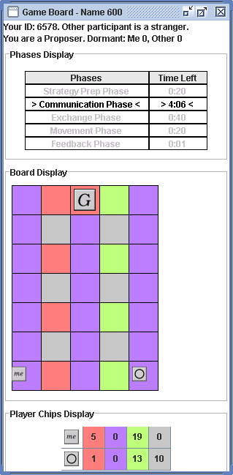
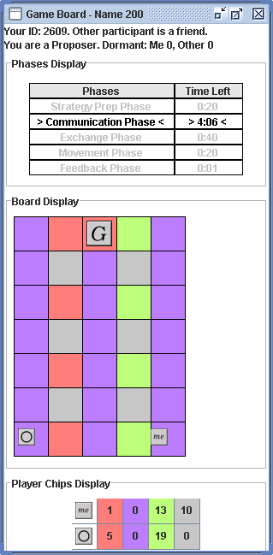

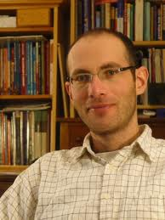
Experimental Design
Movie of instruction;
Arabic instructions;
2 countries: Lebanon (93) and U.S. (100)
3 boards
PURB is too simple; will not play well.
PURB-independent
human-independent
Co-dependent
Human makes the first offer

Slide 30
Hypothesis
People in the U.S. and Lebanon would differ significantly with respect to cooperativeness;
An agent that modeled and adapted to the cooperativeness measures exhibited by people will play at least as well as people

Slide 31
Average Performance

Slide 32
Reliability Measures
Average | Task dep. | Task indep. | Co-dep
0.92 | 0.87 | 0.94 | 0.96 | People (Lebanon)
0.65 | 0.51 | 0.78 | 0.64 | People (US)

Slide 33
Reliability Measures
Average | Task dep. | Task indep. | Co-dep
0.98 | 0.99 | 0.99 | 0.96 | PURB (Lebanon)
0.62 | 0.72 | 0.59 | 0.59 | PURB (US)

Slide 34
Reliability Measures
Average | Task dep. | Task indep. | Co-dep
0.98 | 0.99 | 0.99 | 0.96 | PURB (Lebanon)
0.92 | 0.87 | 0.94 | 0.96 | People (Lebanon)
0.62 | 0.72 | 0.59 | 0.59 | PURB (US)
0.65 | 0.51 | 0.78 | 0.64 | People (US)

Slide 35
Reliability Measures
Average | Task dep. | Task indep. | Co-dep
0.98 | 0.99 | 0.99 | 0.96 | PURB (Lebanon)
0.92 | 0.87 | 0.94 | 0.96 | People (Lebanon)
0.62 | 0.72 | 0.59 | 0.59 | PURB (US)
0.65 | 0.51 | 0.78 | 0.64 | People (US)

Slide 36
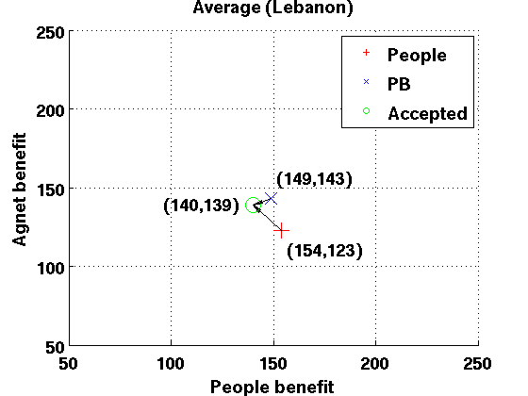
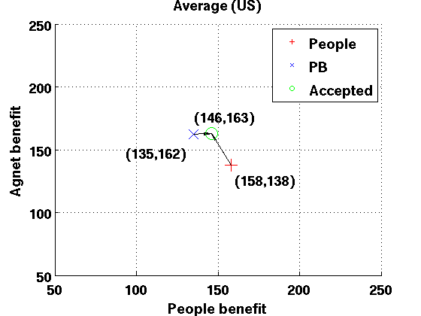
Proposed offers vs accepted offers: average
Notes:
Second, the PB agent made proposals that
were significantly more selfish in the U.S. than in Lebanon (Figure 2).h

Slide 37
Implications for agent design
Adaptation to the behavioral traits exhibited by people lead proficient negotiation across cultures.
In some cases, people may be able take advantage of adaptive agents by adopting ambiguous measures of behavior.
How can we avoid the rules?
How can improve PURB?

Slide 38
Model for each culture
General opponent* modeling:
machine learning
human behavior model

Slide 39
On going work Personality, Adaptive Learning (PAL) agent
Data collected is used to build predictive models of human negotiation behavior for each culture:
Reliability
Acceptance of offers
Reaching the goal
The utility function use the models
Reduce the number of rules
Limited search
G. Haim, Y. Gal and S. Kraus. Learning Human Negotiation Behavior Across Cultures, in HuCom2010.

Slide 40

Argumentation
Which information to reveal?
Should I tell him that I will lose a project if I don’t hire today?
Should I tell him I was fired from my last job?
Build a game that combines information revelation and bargaining
40

Slide 41
Agents for Revelation Games
Peled Noam, Gal Kobi, Kraus Sarit

Slide 42
Introduction - Revelation games
Combine two types of interaction
Signaling games (Spence 1974)
Players choose whether to convey private information to each other
Bargaining games (Osborne and Rubinstein 1999)
Players engage in multiple negotiation rounds
Example: Job interview

Slide 43
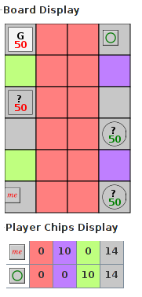
Colored Trails (CT)

Slide 44
Perfect Equilibrium (PE) Agent
Solved using Backward induction.
No signaling.
Counter-proposal round (selfish):
Second proposer: Find the most beneficial proposal while the responder benefit remains positive.
Second responder: Accepts any proposal which gives it a positive benefit.

Slide 45
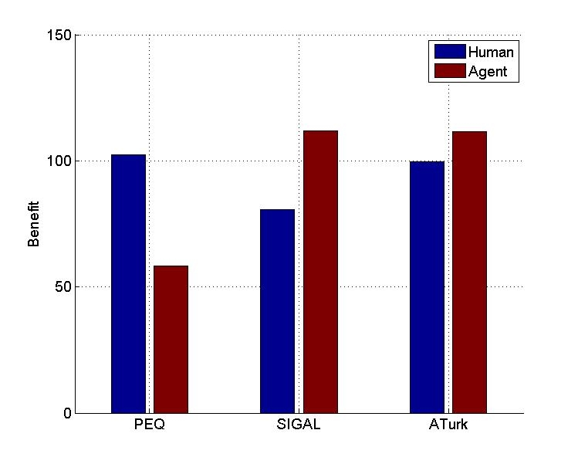
Performance of PEQ agent
130 subjects

Slide 46
SIGAL agent
Agent based on general opponent modeling:
Genetic algorithm
Human modeling
Logistic Regression

Slide 47
SIGAL Agent
Learns from previous games.
Predict the acceptance probability for each proposal using Logistic Regression.
Models human as using a weighted utility function of:
Humans benefit
Benefits difference
Revelation decision
Benefits in previous round

Slide 48
Performance
General opponent* modeling improves agent negotiations

Slide 49
Performance
General opponent* modeling improves agent negotiations

Slide 50
Learning People’s Negotiation Behavior: AAT agent
Agent based on general* opponent modeling
Decision Tree/ Naïve Byes
AAT
Avi Rosenfeld and Sarit Kraus. Modeling Agents through Bounded Rationality Theories. Proc. of IJCAI 2009., JAAMAS, 2010.
50

Slide 51
Predicting People’s Offers

Slide 52
Coordination with limited communication: FPL agent
Agent based on general opponent modeling:
raw data vector
FP vector
Decision Tree/ neural network
Zuckerman, S. Kraus and J. S. Rosenschein.
Using Focal Points Learning to Improve Human-Machine Tactic Coordination, JAAMAS, 2010.
52

Slide 53
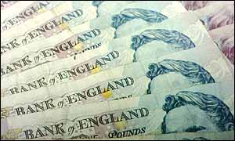
Focal Points (Examples)
Divide £100 into two piles, if your piles are identical to your coordination partner, you get the £100. Otherwise, you get nothing.
101 equilibria
53

Slide 54
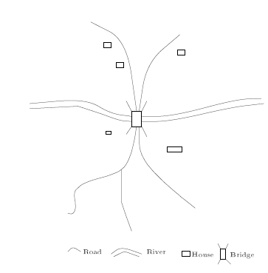
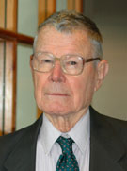
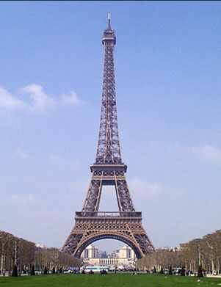
Focal Points
Thomas Schelling (63):
Focal Points = Prominent solutions to tactic coordination games.
54

Slide 55
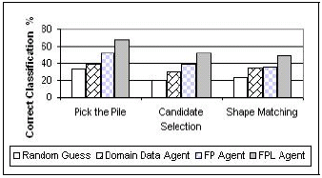
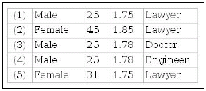
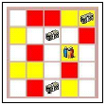

Focal Point Learning
3 experimental domains:
55

Slide 56
Main Points
Fun
Challenging:
how to integrate machine learning and behavioral model ? How to use in agent’s strategy?
Agents negotiating with people is important
Challenging:
experimenting with people is very difficult !!!
General opponent* modeling:
Challenging:
hard to get papers to AAMAS!!!
machine learning
human behavior model

Slide 57
Acknowledgements
This research is based upon work supported in part under NSF grant 0705587 and by the U.S. Army Research Laboratory and the U. S. Army
Research Office under grant number W911NF-08-1-0144.

