Slide 1
Automated Agents that Interact Proficiently with People
Sarit Kraus Bar-Ilan University
sarit@cs.biu.ac.il

Slide 2
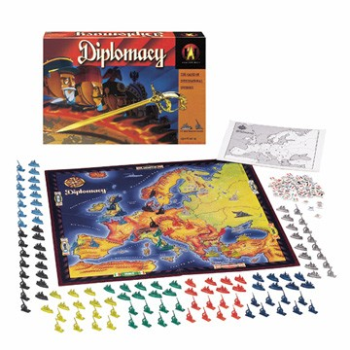

Slide 3
Buyer-Seller Interaction
Buyers and sellers across geographical and ethnic borders
Electronic commerce
Crowd-sourcing
Automated travel agents
Bargaining

Slide 4
Culture Sensitive Agents
The development of standardized agents to be used in the collection of data for studies on culture and negotiation
Bargaining

Slide 5
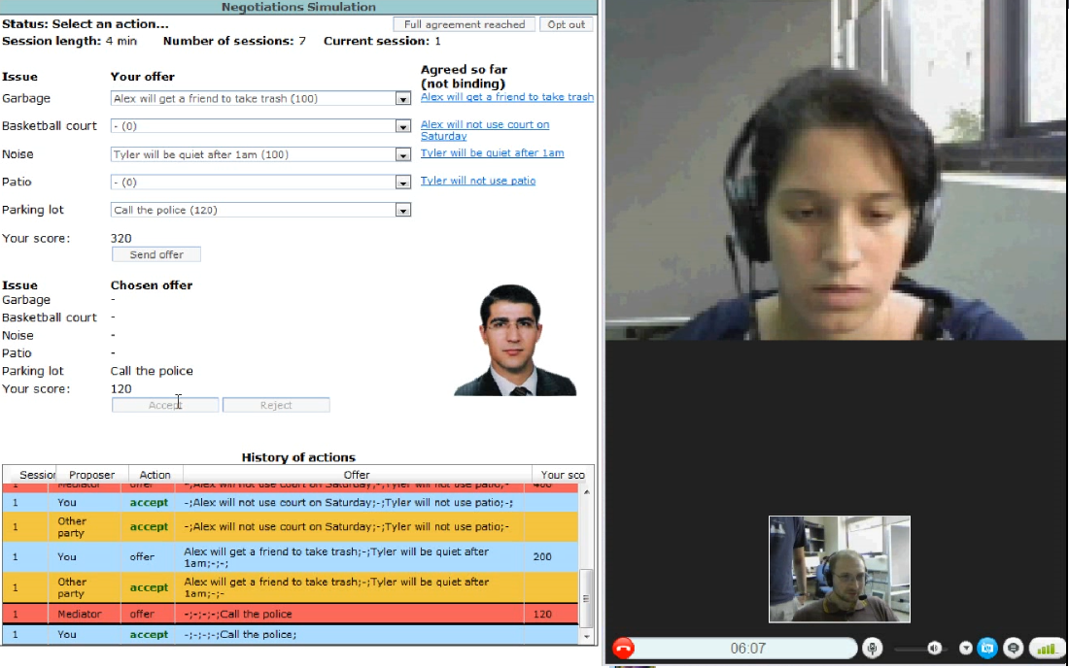
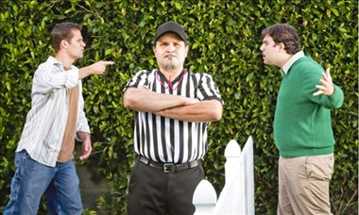
Automated Mediators for Resolving Conflicts
Bargaining

Slide 6
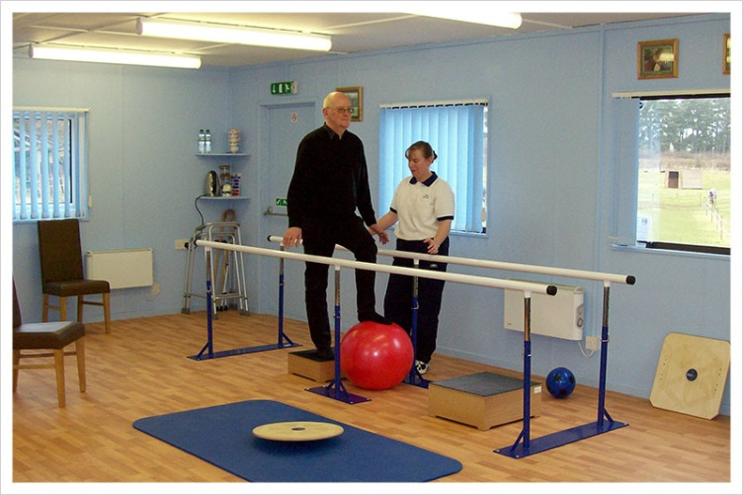
Medical Applications: Rehabilitation & Care
Reinforcement for rehabilitation in an inpatient rehabilitation unit
Personalized automated speech therapist
6
Persuasion
Sheba Hospital

Slide 7
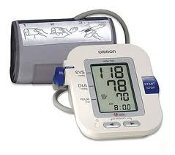
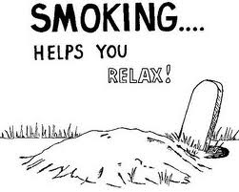
Medical Applications: Preventing Unhealthy Behaviors
Persuasion
Notes:
clients

Slide 8
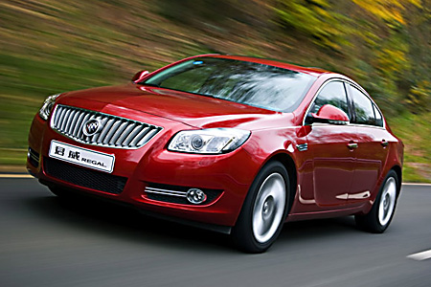
Sustainability: Reducing Fuel Consumption
Persuasion
Notes:
Fun; advise to be sustainability

Slide 9
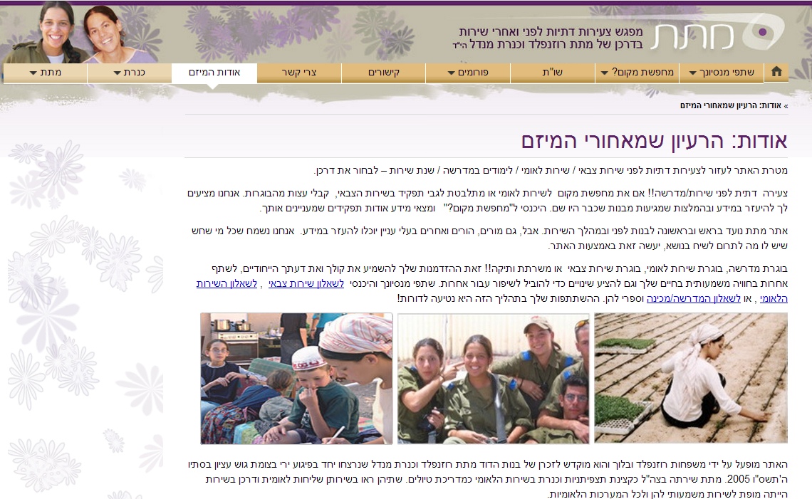
Advice Provision for Decision Making
Discussion Agent

Slide 10
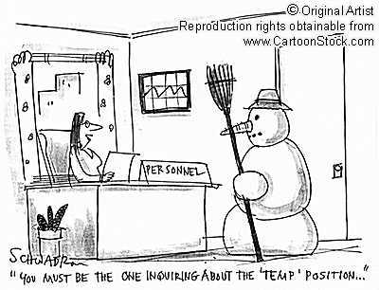
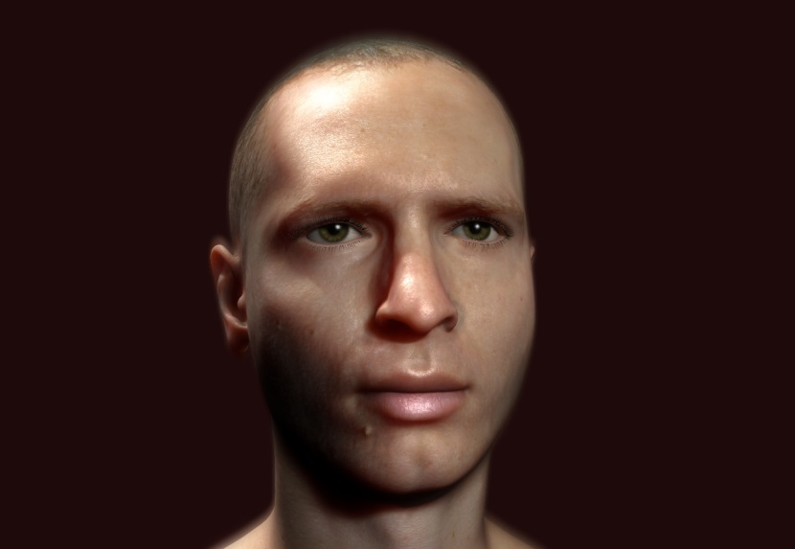
Training People
Virtual suspect to
train investigators
Training people in
negotiations
(employer-employee)

Slide 11
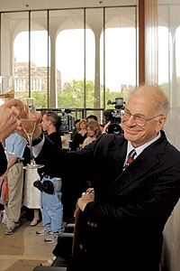
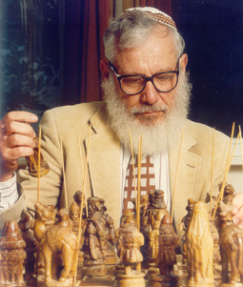
Why not Equilibrium Agents?
Nash equilibrium: stable strategies; no agent has an incentive to deviate
Results from the social sciences suggest people do not follow equilibrium strategies:
Equilibrium based agents played against people failed.
People rarely design agents to follow equilibrium strategies.

Slide 12
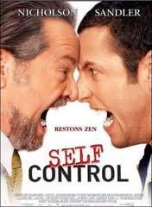
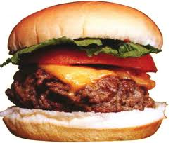
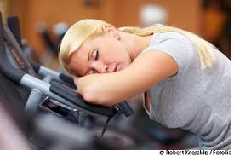
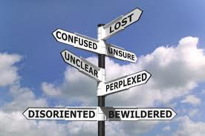
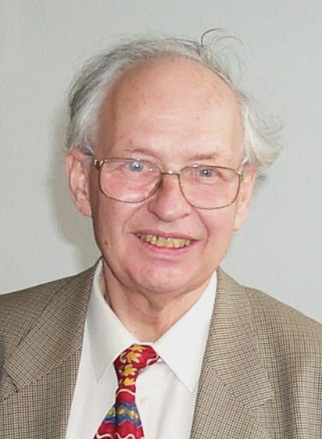
People Often Follow Suboptimal Decision Strategies
Irrationalities attributed to
sensitivity to context
lack of knowledge of own preferences
the effects of complexity
the interplay between emotion and cognition
the problem of self control

Slide 13
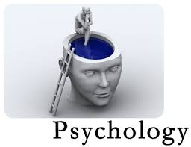
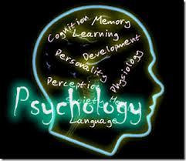
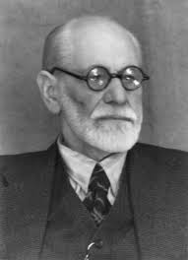
Why not Only Behavioral Science Models?
There are several models that describe human decision making
Most models specify general criteria that are context sensitive but usually do not provide specific parameters or mathematical definitions

Slide 14
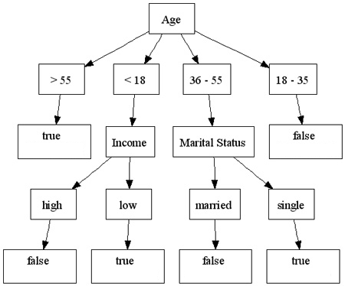
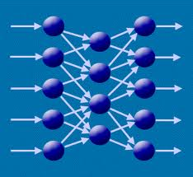
Why not Only Machine Learning?
Machine learning builds models based on data
It is difficult to collect human data
Collecting data on specific user is very time consuming.
Human data is noisy
“Curse” of dimensionality
Notes:
קללת ריבוי המימדים

Slide 15
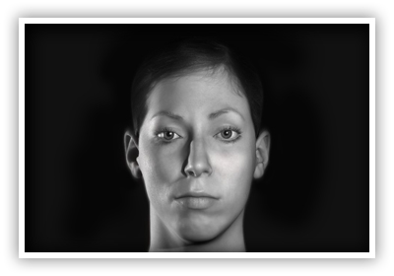
Methodology
Human behavior models
Data
(from specific culture)
machine learning
Human specific data
Game Theory Optimization
methods
Human Prediction Model
Take action

Slide 16
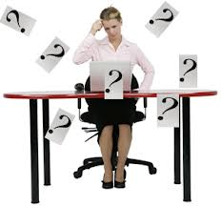
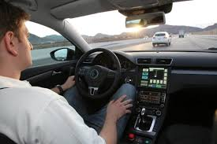
Predicting Human Decisions
Actions
Drivers choices
Negotiators’ reliability
Investors/investees
Voters
Text
Pirate game
Facial expressions

Slide 17
What is she going to do? Stay or Leave

Slide 18
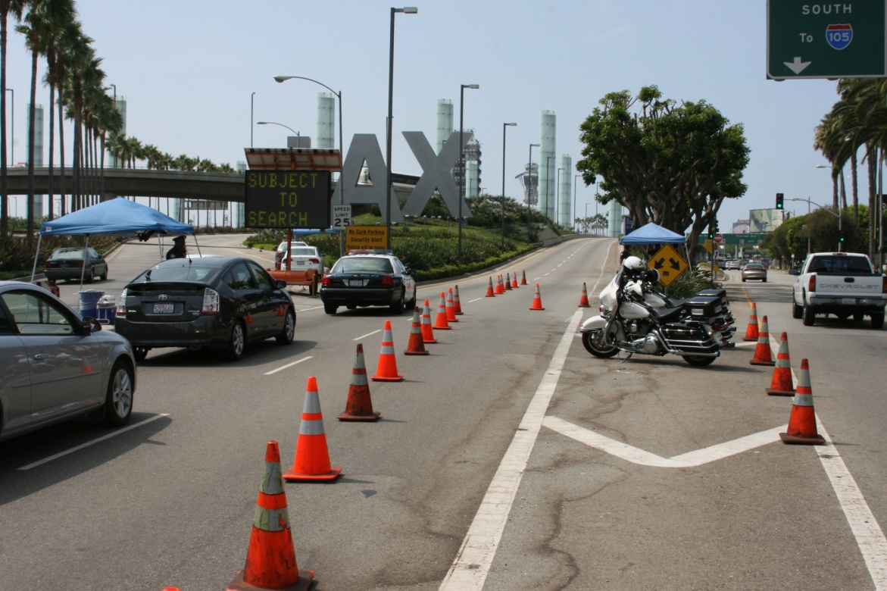
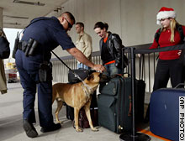
Successes?
Security in LAX

Slide 20
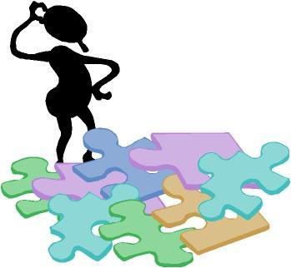
Agents interacting proficiently with people is important
Fun
Human behavior models
Data
(from specific culture)
Challenging:
How to integrate machine learning and behavioral models? How to use in agent’s strategy?
Machine learning
Human specific data
Game Theory Optimization
methods
Challenging:
Experimenting with people is very difficult !!!
Working with people from other disciplines is challenging.
Human behavior model
sarit@cs.biu.sc.il
Take action

