Slide 1
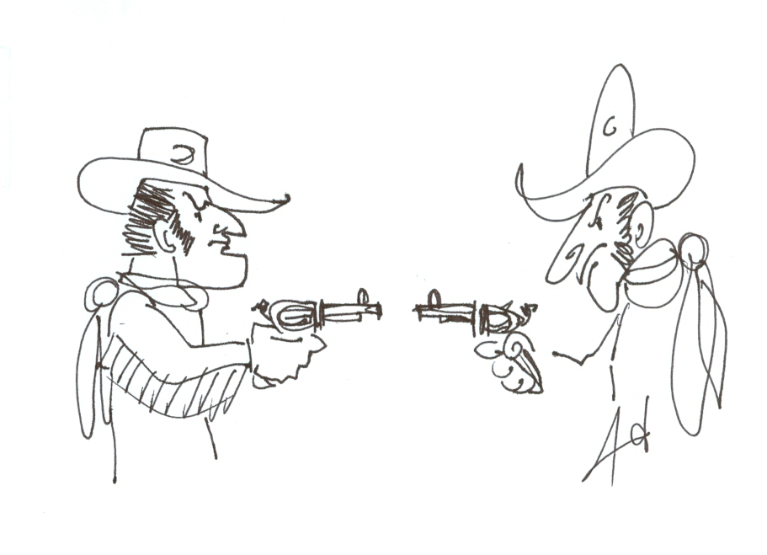
Dueling Algorithm

Slide 2
DUEL i and j
if j-i ≥ m then “no conflict”
otherwise
s $←$T[i+W[j-i+1]-1]
Cases:
if s=* then “*”
if s=P[W[j-i+1]] then kill j
else kill i

Slide 3
Data Structures
List of potential candidates
R = rightmost element of that list
N = new element
R
N

Slide 4
Initialization
Add 1 to list
R ← 1
N ← 2
R
N

Slide 5
Main Loop
While n-N ≥ m-1 (new candidate fits) do:
If N-R ≥ m (candidates are far) then:
add N to list
R ← N
N ← N+1
goto endWhile

Slide 6
Candidates are far
R
N

Slide 7
Main Loop
(Candidates are within mutual range)
Duel R and N
Cases:
N dies
R dies
* (both live)
endWhile

Slide 8
Case 1: N dies
If N dies then:
N ← N+1
goto endWhile

Slide 9
Case 1: N dies
X
R
N
N

Slide 10
Case 2: R dies
If R dies then: Remove R from list.
If list empty then:
R ← N
N ← N+1
Goto endWhile
else:
R points to previous element in list
Goto endWhile

Slide 11
Case 2: R dies
X
R
N

Slide 12
Case 3: * (no one dies)
If * then:
add N to list
R ← N
N ← N+1
Goto endWhile

Slide 13
Case 3: * (no one dies)
R
N

Slide 14
At end of Algorithm:
All elements in list are potential candidates.
All elements in list agree with each other.

