Slide 1
The Misra Gries Algorithm

Slide 2
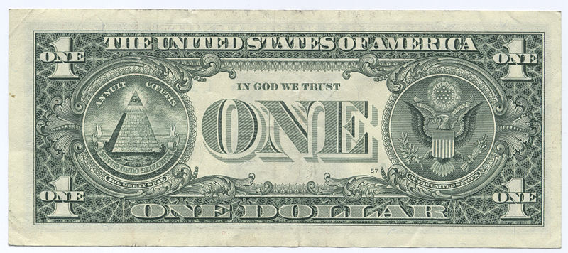
Motivation
Espionage
The rest we monitor

Slide 3
Motivation
Viruses and malware

Slide 4
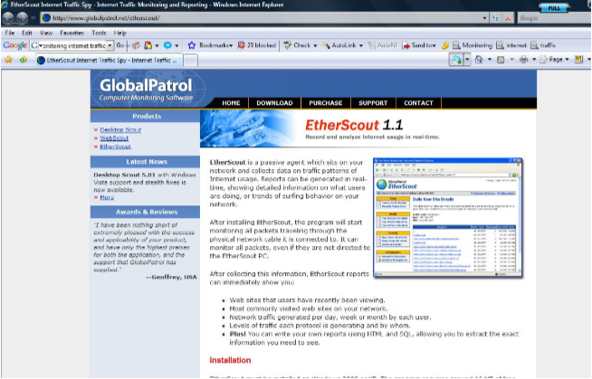
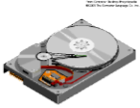
Motivation
Monitoring internet traffic

Slide 5
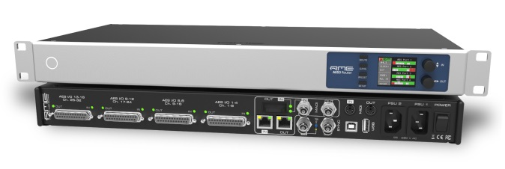
Problem
2⁵⁰ BPS
2⁵⁰ BPS
We can't store the whole input
so
We seek methods which requires small space

Slide 6
Synopsis (Summary) Structures
A small summary of a large data set that (approximately) captures some statistics/properties we are interested in.
Data Set D
Synopsis d

Slide 7
Synopsis: Desired Properties
Easy to add an element
Mergeable : can create summary of union from summaries of data sets
Easy to delete elements
Flexible: supports multiple types of queries

Slide 8
The Data Stream Model

Slide 9
What can we do easily?
32,
112,
14,
9,
37,
83,
115,
2,

Slide 10
What can we do easily?

Slide 11
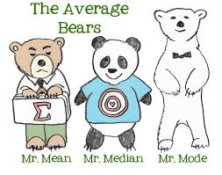
What can not be done easily?
Compute median.

Slide 12
In Pattern Matching
Pattern P is given.
Text T streams in.
Dueling algorithm, FFT - not streaming algorithms.
KMP ?
Needs O(|P|) space. (good)
May work O(|P|) time on every token. (not so good)

Slide 13
BUT…
Rabin-Karp Algorithm - streaming algorithm.
Needs O(1) space. (excellent!)
Works O(1) time on every token. (excellent!)
But result only good with high probability!

Slide 14
The Quality of an Algorithm’s Answer
Quality of approximation
Probability of result

Slide 15
The Quality of an Algorithm’s Answer
Quality of approximation
Probability of result

Slide 16
Finding Frequent Items

Slide 17
Frequent Items: Exact Solution
32,
12,
14,
32,
7,
12,
32,
7,
6,
12,
4,
Exact solution:
Create a counter for each distinct token on its first occurrence
When processing a token, increment the counter
32
12
14
7
6
4

Slide 18
Deterministic Streaming Algorithm for Finding Frequent Items
The Misra-Gries algorithm [1982] finds these frequent elements deterministically, using
O(c log m) bits, in two passes.

Slide 19
Frequent Elements: Misra Gries 1982
32,
12,
14,
32,
7,
12,
32,
7,
6,
12,
4,
32
12
14
12
7
12
4

Slide 20
Frequent Elements: Misra Gries 1982
32,
12,
14,
32,
7,
12,
32,
7,
6,
12,
4,
This is clearly an under-estimate.
What can we say precisely?

Slide 21
Algorithm Analysis
Space: c counters of log m + log n bits, i.e.
O(c(log m + log n))
Time: O(log c) per token.
Output quality?

Slide 22
Algorithm Analysis
Let $f_{j}$ be the frequency of key j.
$\hat{f_{j}}$ be the value of the counter for j at the
end of the algorithm.
Claim: $f_{j}−\frac{m}{c}≤\hat{f_{j}}≤f_{j}$.

Slide 23
Proof
Clearly $\hat{f_{j}}≤f_{j}$.
For the other side:
Consider every time that counter j is decremented. c other counters are also decremented at that point. It means that there were c times that other keys than j were encountered, for each such decrement.

Slide 24
Proof
Consequently: There are no more than $\frac{m}{c}$ such decrements, or $f_{j}−\frac{m}{c}≤\hat{f_{j}}$.
Conclude:
The counter of any key whose frequency is more than $\frac{m}{c}$ times is non zero at the time of the query.

Slide 25
Finding Frequent Elements
How do we verify that all elements in the counters are frequent?
-- Another pass.

