Slide 1
Parallel and Distributed Algorithms
Amihood Amir

Slide 2
The PRAM Model
Parallel Random Access Machine
Processor
Processor
Processor
Processor
Memory
Processor
Processor
Processor
Processor
Processor
Processor

Slide 3
The PRAM Model
Shared-memory multiprocessor
unlimited number of processors, each:
has unlimited local memory
knows its ID
able to access the
shared memory in
constant time
unlimited shared
memory
1
P₁
2
3
P₂
.
.
.
P_{i}
.
.
P_{n}
m

Slide 4
The PRAM Model
Why do we need it?
General theoretical framework of parallel
algorithms.
Model for proving complexity results.
Analyse maximum parallelism.

Slide 5
The PRAM Model Complexity
Complexity Measures
For Processors:
Time: number of instructions executed.
Space: number of memory cells used.
For the PRAM machine:
Time: from start to end of operation.
Number of Processors.

Slide 6
The PRAM Model Complexity
Work:
PRAM time x Number of Processors
Optimal Speedup:
When the work equals the optimum time complexity of a serial algorithm.

Slide 7
The PRAM Model Complexity
Example:
1. Sorting n numbers in time O(1) using n²
Processors.
Work: O(n²). Not optimal speedup.
2. Sorting n numbers in time O(log n)
using n Processors.
Work: O(n log n). Optimal speedup.

Slide 8
Processor Activation
Assume a central processor activates necessary processors in constant time.
May be implemented by the same program in all processors. Common central clock.

Slide 9
Shared Memory Access
Concurrent (C) means, many processors can do the operation simultaneously in the same memory
Exclusive (E) not concurent
EREW (Exclusive Read Exclusive Write)
CREW (Concurrent Read Exclusive Write)
Many processors can read simultaneously the same location, but only one can attempt to write to a given location
ERCW (Exclusive Read Concurrent Write)
CRCW (Concurrent Read Concurrent Write)
Many processors can write/read at/from the same memory location

Slide 10
Concurrent Write
What value gets written?
Priority CW – Based either on processor priority (e.g. higher number) or value priority (e.g. larger value)
Common CW – multiple processors can simultaneously write only if values are the same
Arbitrary/Random CW – any one of the values are randomly chosen

Slide 11
Concurrent Write - Comparison
Priority ≥ Arbitrary ≥ Common ≥ CREW ≥ EREW
Most Least
Powerful Poweful
Least Most
Realistic Realistic

Slide 12
Example
Problem: “OR”
Input: n bits.
Output: The inclusive or of all bits.
Serial Algorithm: If any of the bits is “1”, output “1”, otherwise output “0”.
Time: O(n).

Slide 13
Example
CRCW priority Algorithm:
When many processors write simultaneously, the maximum number is written.
Algorithm:
Write your number in location “output”
Correctness: If any of the bits is “1” it is the maximum. Thus it gets written and is the output.
Time: O(1).
Work: O(n).
OPTIMAL SPEEDUP

Slide 14
Example
EREW Algorithm:
Idea:
Compare all pairs and write down maximum.
Now half the input size.
Keep going until only one value left.

Slide 15
Example
0 0 0 1 1 1 0 1 0 0 0 0 1 1 0 1

Slide 16
Example
0 0 0 1 1 1 0 1 0 0 0 0 1 1 0 1
0 1 1 0 0 0 1 1

Slide 17
Example
0 0 0 1 1 1 0 1 0 0 0 0 1 1 0 1
0 1 1 0 0 0 1 1
1 1 0 1

Slide 18
Example
0 0 0 1 1 1 0 1 0 0 0 0 1 1 0 1
0 1 1 0 0 0 1 0
1 1 0 1
1 1

Slide 19
Example
0 0 0 1 1 1 0 1 0 0 0 0 1 1 0 1
0 1 1 0 0 0 1 0
1 1 0 0
1 1
1

Slide 20
Example
EREW Algorithm for processor Pj
In time i (i goes from 1 to log n):
If there is a non negative k such that
j=k2^{i}+1
then write in memory location M[j] the
result of M[j] inclusive or M[j+2^{i-1}]
Time: O(log n).
Work: O(n log n).
NOT OPTIMAL SPEEDUP

Slide 21
The Distributed Model
Local Memory – processors have local connections
Processor
Processor
Processor
Processor
Processor
Processor
Processor
Processor
Processor
Processor

Slide 22
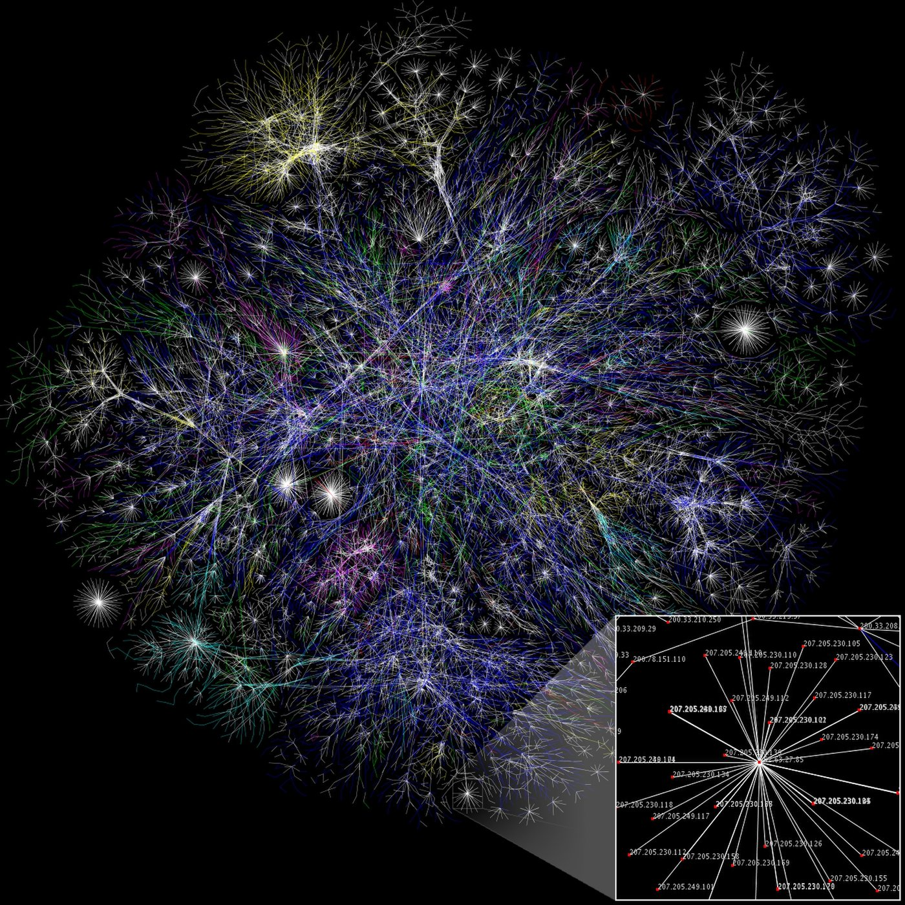
The Internet

Slide 23
Safety and Liveness
Safety property : “nothing bad happens”
holds in every finite execution prefix
if one general attacks, both do
a program never terminates with a wrong answer
Liveness property: “something good eventually happens”
no partial execution is irremediable
both generals eventually attack
a program eventually terminates
Admissible executions satisfy safety and liveness properties for a particular system type.

Slide 24
Communication: Asynchronous vs. Synchronous
Asynchronous:
no upper bound on message delivery time
no centralized clock
no bound on relative speed of processes
Synchronous:
communication in rounds
In a round a process:
delivers all pending messages
takes an execution step (which may involve sending one or more messages)
if no failures, every message sent is eventually delivered

Slide 25
Uniform Algorithms
Number of processors not known.
Algorithm can not use information about
the number of processors.

Slide 26
Anonymous Algorithms
Processors have no I.D.
Formally, they are identical automata.
A processor can distinguish between its different ports.

Slide 27
Complexity
TIME
each processor’s state set includes terminated states
termination:
all processors in terminated states
no messages in transit
Message Complexity
Count maximum total number of messages
Synchronous: number of rounds till termination.
Asynchronous: Set some unit of time as maximum
message delay.

Slide 28
Leader Election
Example 1: A Bank maintains multiple servers in
their cloud, but for each customer, one of the
servers is responsible, i.e., is the leader
What if there are two leaders per customer?
Inconsistency
What if servers disagree about who the leader is?
Inconsistency
What if the leader crashes?
Unavailability

Slide 29
Leader Election
Example 2: A group of cloud servers
replicating a file need to elect
one among them as the primary
replica that will communicate
with the client machines
Example 3: Group of NTP servers: who is
the root server?

Slide 30
Leader Election
We consider leader election on a bidirectional ring.

Slide 31
Leader Election
Two types of termination state:
In every admissible execution exactly one process enters an elected state – the leader. All others are in a non-elected state.
elected
non-elected

Slide 32
Impossibility Result
Theorem: There is no deterministic leader election algorithm for an anonymous bidirectional ring, even in a synchronous and non-uniform system.
Proof:
Let S be a system of n>1 processors on a ring.

Slide 33
Theorem Proof
Lemma: At the end of each round of execution of S, every processor in S is at the same state.
Proof: By induction on the number of rounds k.
Base Case: k=0. Clear. They all start at the same state.
Inductive hypothesis: At the end of round k, all processors are in the same state.
Need to prove that they are at the same state at the end of round k+1.

Slide 34
Theorem Proof (cont.)
Because of inductive hypothesis processors sent the same messages the end of round k.
Thus, they all receive the same message from left and right.
They apply the same transition functions (since they are identical). Thus they are at the same state at the end of round k+1.
Conclude: If one processor enters a “leader state” they all do.

Slide 35
LCR Algorithm LeLann (1977) Chang-Roberts(1979)
Not anonymous: every process has a unique ID.
Asynchronous
Unidirectional
Uniform

Slide 36
LCR Algorithm (cont.)
3: upon receiving m from right
4: case
5: m.uid > uid_{i} :
6: send m to left
7: m.uid < uid_{i} :
8: discard m
9: m.uid = uid_{i} :
10: leader := i
11: send <terminate, i> to left
12: terminate
endcase
13: upon receiving <terminate, i> from right neighbor
14: leader := i
15: send <terminate, i> to left
16: terminate
1: upon receiving no message
2: send uid_{i} to left (clockwise)

Slide 37
613
17
365
26
18
248

Slide 38
613
613
17
365
17
365
26
18
26
18
248
248

Slide 39
613
17
613
365
26
248
18
248

Slide 40
613
17
613
17
365
26
18
613
18
248
248

Slide 41
613
17
613
613
365
26
248
18
613
248

Slide 42
613
17
613
613
365
26
613
613
18
248
248

Slide 43
613
613
17
613
613
365
26
248
613
18
613
248

Slide 44
613
613
17
<terminate,613>
613
365
26
613
613
18
613
248

Slide 45
613
613
613
17
613
<terminate,613>
365
26
613
613
18
613
248

Slide 46
613
613
613
17
613
613
365
26
613
<terminate,613>
18
613
248

Slide 47
613
613
613
17
613
613
365
26
613
613
<terminate,613>
18
248

Slide 48
613
613
613
17
613
613
365
26
<terminate,613>
613
613
18
248

Slide 49
613
613
613
17
<terminate,613>
613
613
365
26
613
613
18
248

Slide 50
613
613
613
17
613
613
365
26
613
613
18
248

Slide 51
LCR Algorithm Correctness
Highest processor ID always moves on
Therefore it completes cycle and highest ID gets chosen leader (liveness)
No other ID can complete cycle – so no incorrect leader is chosen (safety)

Slide 52
Complexity
Message complexity:
O(n²)
Time complexity:
O(n)
This bound is tight…
n-1
n-2
0
1
Can we do better?
2

Slide 53
HS Algorithm Hirschenberg and Sinclair (1980)
Ring is bidirectional
Each process p_{i} operates in phases
In each phase l, p_{i} sends out “tokens” containing uid_{i} in both directions
Tokens are intended to travel distance 2^{l} and return to p_{i}
Token continues outbound only if greater than tokens on path
Otherwise discarded
All processes always forward tokens moving inbound
However, tokens may not make it back
If p_{i} receives its own token while it is going outbound, p_{i} is the leader
Phase 1
Phase 1
Phase 2
Phase 2
Phase 2
Phase 0
Phase 0
Phase 0
Phase 1

Slide 54
HS algorithm (cont.)
Correctness: As in LCR algorithm.
Time: O(n)
Message complexity: O(n log n)

